Slide 1
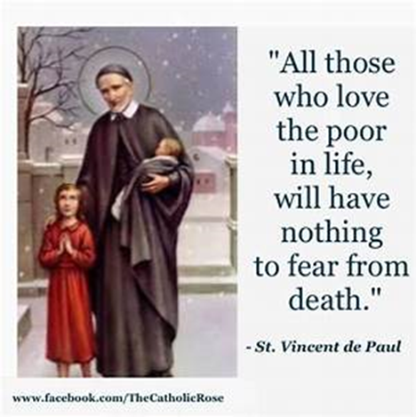
St Faustina Conference Saint Vincent de Paul Society
Spiritual Meeting
10 July 2021

Slide 2
Agenda
TIME | EVENT | SPEAKER
9:30 AM | Meeting called to order by President | Dave Scharett
9:31 AM | Roll call by Secretary | Amy Whittaker
9:32 AM | Opening Prayer & The Lord’s Prayer | Dave
9:36 AM | Spiritual Advisor’s Presentation | Father Eversole
9:46 AM | Treasurer’s Report | Don Carlson
9:50 AM | Home Visitation Report | Dave
9:52 AM | President’s Report | Dave
10:05 AM | Public Affairs Report | Annie Mason & Cathy Lee
10:10 AM | Friendly Visitations Report | Amy Whittaker
10:15 AM | Secretary’s Report | Amy
10:20 AM | New Business | All Vincentians
10:25 AM | Closing Prayer | Father Eversole

Slide 3
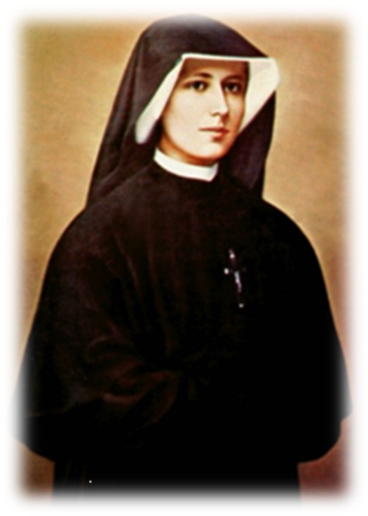
Pray to God for healing
& Have FAITH
In the Gospels Jesus is constantly healing the sick in every town he visits.
Those who are ill flock to his presence and often beg for his healing touch.
Jesus responded generously to their requests, lifting them up, especially when they showed the authenticity of their faith.
They truly believed that God could heal them, and it was their faith that saved them.

Slide 5
Spiritual Advisor’s Presentation
Father Eversole

Slide 6
Treasurer’s Report: Don Carlson
Current Balance
Bills Paid
Donations
Online donations
Other donations
Other financial issues as appropriate

Slide 7
Saint Faustina Conference Emergency Assistance
Total Cases Worked | 35 |  | CC RENT | $6,974.47
Total Cases Helped | 7 |  | CONF RENT | $1,257.00
Utilities Paid | 1 |  | CONF UTILITIES | $67.96
Rent Paid | 5 |  | GAS | $27.20
Other Payments | 1
Cases still OPEN | 11 |  | Grand Total | $8,326.63
Cases Closed | 24
GOOD NEWS….. Arlington Catholic Charities Emergency Assistance WILL REMAIN AT $2000 maximum per case.
TOTAL ASSISTANCE FOR JUNE $8,326.63
Two Assistance Line Monitors and Two Case Workers made all this happen in June
We continue to need volunteers to support the Emergency Assistance Ministry

Slide 8
SVdP Youth Conference
Recruitment may start this month
Stephen Bolas wants his sons to join: Shawn 16 and Daniel 14

Slide 10
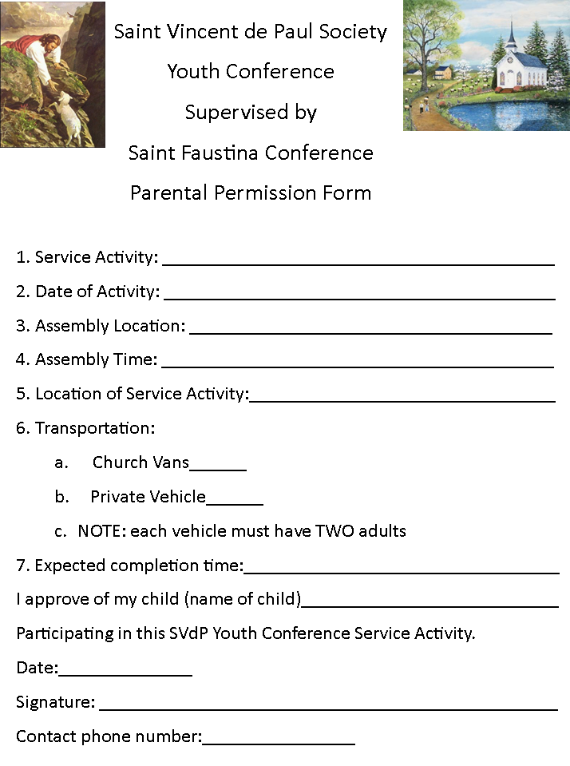

Slide 11
President’s Report
Members of the Saint Matthew Women’s Guild and Parishioners are making quilts and pillows for our Santa’s Sack Ministry. The vast donation of material (cloth) donated to us is now being used to provide for needy children.
Two of our members will become NEW Case Workers for our Conference Emergency Assistance Ministry.
BB&T Bank and Sun Trust Bank are merging. The BB&T Branch that we used is now closed. The Sun Trust Bank across the street from Bob Evans in South Point is now our bank.
Nomination of Alice Foley to join Saint Faustina Conference

Slide 14
Public Affairs Report: Annie Mason
Public Affairs activities/issues to report
Friends of the Poor ® Walk

Slide 15
Friendly Visitations
Updates on the Friendly Visitations Ministry: Amy Whittaker and Ann Ellis
Training

Slide 16
Secretary’s Report: Amy Whittaker (Laura)
Open Old Business from prior meeting
Student scholarships: when and where will they be awarded update?
Approval of Prior Meeting Minutes
The next Conference Spiritual Meeting will be Saturday, July 24th at 9:30 am In Person and via ZOOM

Slide 17
New Business: open to all members

Slide 18
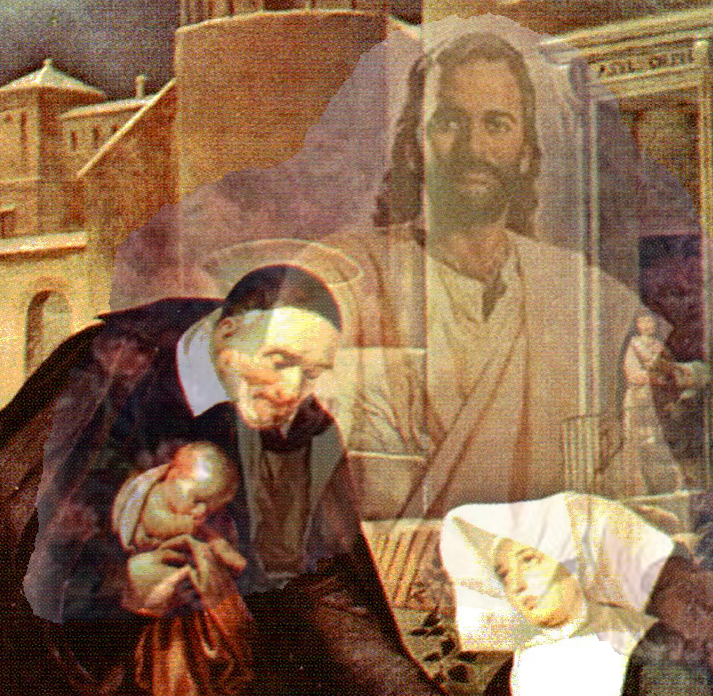
Closing Prayer & Spiritual Advice: Father Eversole

