Slide 1
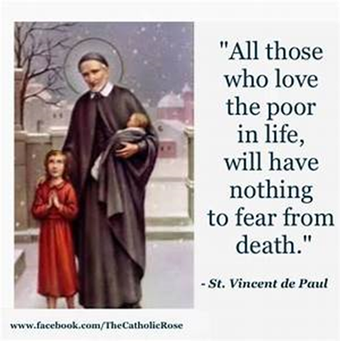
St Faustina Conference Saint Vincent de Paul Society
Conference Spiritual Meeting
9 January 2021

Slide 2
Agenda
Time | Event | Speaker
9:00 AM | Meeting call to order by the President | Dave Scharett
9:01 AM | Roll call by Secretary | Amy Whittaker
9:05 AM | The Lord’s Prayer | John Tighe
9:10 AM | Spiritual Advisor’s Presentation | Father Eversole
9:20 AM | Reflections of The Rule, PART II: Vincentian Spirituality and Vocation; Rule 2.1: Love in Union with Christ | Laura Morris
9:35 AM | Home Visitations Results | Dave Scharett
9:40 AM | President’s Report | Dave Scharett
9:45 AM | Public Affairs Report | Annie Mason
9:50 AM | Treasurer’s Report | Don Carlson
9:52 AM | Secretary’s Report | Amy Whittaker
9:54 AM | New Business | Dave Scharett
9:59 AM | Closing Prayer | Father Eversole

Slide 3
The Rule, Part II
Rule 2.1: Love in Union with Christ
Convinced of the truth of the Apostle St. Paul’s words, Vincentians seek to draw closer to Christ. They hope that someday it will be no longer they who love, but Christ who loves through them.
(Galatians 2, 20 “… I have been crucified with Christ; it is no longer I who live, but Christ who lives in me; and the life I now live in the flesh I live by faith in the Son of God”), and that even now, in their caring, the poor may catch a glimpse of God’s great love for them.
Your reflections ……….

Slide 4
Home Visitation Results
Recent Cases or Cases that emphasize the impact of Home Visits on families:
Our 58-year-old dialysis homeless man has found an affordable home!!
Rent includes all utilities
Systemic change for those we help is our goal.

Slide 5
President’s Report
Status of 2 new Conference Ministries
SVdP Youth Conference update: Cathey Lee and Dave
Friendly Visitations Ministry Update: Amy Whittaker
Hispanic/Latino Grant: Application submitted and $500 received
Continuing to explore Society and CARES Grants
5. Thanksgiving Dinners: The Conference provided 35 Thanksgiving Dinners to our Neighbors-In-Need.
6. Coats-To-Go: SFC with the support of 3 KoC Councils (Bishop Keating, Battlefield, & Holy Trinity) distributed 193 winter coats, numerous winter scarfs, hats, socks, mittens, and 54 BAGS of personal hygiene products (donated by Holy Trinity Council)
7. Santa’s Sack Ministry: Goal of Christmas gifts for 150 children. Our Conference partner MANARC is providing substantial support this year by “adopting” our 30 neediest families for Christmas. Multiple significant donors throughout the year have provided a wide array of toys, dolls, teddy bears, and games.

Slide 6
Public Affairs Officer’s Report: Annie Mason
Updates

Slide 7
Treasurer’s Report: Don Carlson
Bank Account status:
Balance
Month’s Expenditures to Date
Receipts, Receipts, Receipts: The key to tracking expenditures!!!
Donations, Donations, Donations: Of all kinds must be reported to the Treasurer

Slide 8
Secretary’s Report: Amy Whittaker
Prior meeting minutes approved
Old Business from last meeting

Slide 9
New Business
Does any member have a new business to present?
Santa’s Sacks are being assembled in the next room for those that would like to stay and assist that Ministry.
The Next Spiritual Meeting will be on 19 December at 9:00 AM In-Person AND via ZOOM

Slide 10
Society’s Closing Prayer
Father Eversole’s Closing Prayer
Please pray for our
Neighbors-In-Need

