Slide 1
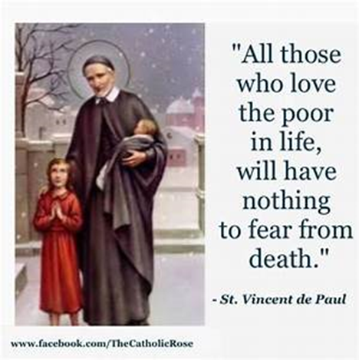
St Faustina Conference Saint Vincent de Paul Society
Spiritual Meeting
15 May 2021

Slide 2
Agenda
TIME | EVENT | SPEAKER
10:0 AM | Meeting called to order by President | Dave Scharett
10:01 AM | Roll call by Secretary | Amy Whittaker
10:02 AM | Opening Prayer & The Lord’s Prayer | Dave
10:06 AM | Spiritual Advisor’s Presentation | Father Eversole
10:16 AM | Treasurer’s Report | Don Carlson
10:20 AM | Home Visitation Report | Dave
10:30 AM | Education Ministry Report | Laura Morris
10:35 AM | Public Affairs Report | Annie Mason
10:40 AM | Friendly Visitations Report | Amy
10:45 AM | Secretary’s Report | Amy
10:50 AM | New Business | All Vincentians
10:55 AM | Closing Prayer | Father Eversole

Slide 3
At Day’s End
Is anybody happier because you passed his way?
Does anyone remember that you spoke to him today?
The day is almost over, and its toiling time is through;
Is there anyone to utter now a kindly word of you?
Can you say tonight, in parting with the day that’s slipping fast,
That you helped a single brother of the many that you passed?
Is a single heart rejoicing over what you did or said;
Does the man whose hopes were fading, now with courage look ahead?
Did you waste the day, or lose it? Was it well or sorely spent?
Did you leave a trail of kindness, or a scar of discontent?
As you close your eyes in slumber, do you think that God will say,
“You have earned one more tomorrow by the work you did today?”
At Day’s End
The SFC Prayer
Followed by
The Our Father
(next slide)

Slide 5
Spiritual Advisor’s Presentation
Father Eversole

Slide 6
Treasurer’s Report: Don Carlson
Current Balance
Balance minus $2000 for Scholarships and $700 obligated by Grants
Bills Paid
Donations
Online donations
Other donations
Other financial issues as appropriate

Slide 7
Home Visitations
Last Month we provided @ $9000 in financial assistance thanks to the Catholic Charities Emergency Assistance (CC EA) $2000/month per caller
Joe Darr has joined the Home Visitation Ministry
E-signature capability now exists
Food delivery capability established for special needs
Catholic Charities Emergency Assistance $2000 per caller ends at the end of this fiscal year (June 30th for CC). Assistance will revert to prior levels.
Saint Patrick Parish notified
Saint Matthew Parish notified

Slide 8
Education Ministry Report
Update on Education Ministry: Laura Morris

Slide 9
Public Affairs Report: Annie Mason
Public Affairs activities/issues to report
Any further update on Friends-Of-The-Poor/Run-Walk

Slide 10
Friendly Visitations
Updates on the Friendly Visitations Ministry: Amy Whittaker and Ann Ellis

Slide 11
Secretary’s Report: Amy Whittaker
Open Old Business from prior meeting
GRANT WRITING!!!
Student scholarships status if not already discussed
VIRTUS Training (includes background check) completions???
Approval of Prior Meeting Minutes
The next Conference Spiritual Meeting will be Saturday, June 5th at 9:30 am via ZOOM

Slide 12
New Business: open to all members

Slide 13
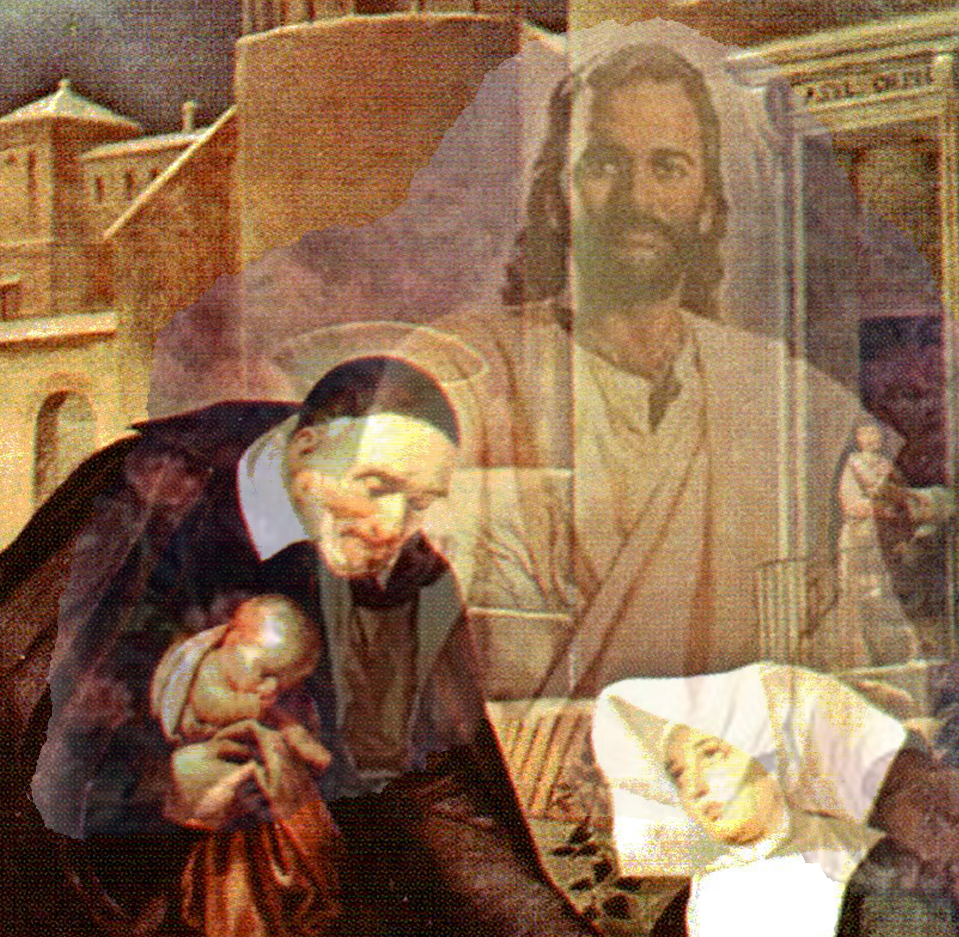
Closing Prayer & Spiritual Advice: Father Eversole

