Slide 1
The Society of St. Vincent de Paul
An Introduction for New Members
Notes:
Welcome participants and include any “housekeeping” notes.
Remind all that once we are gathering in person again, they should attend Ozanam Orientation, which will give them a more detailed understanding of each topic introduced today!

Slide 2

Opening Prayer
Open my eyes that I may see the deepest needs of men, women and children; Move my hands that they may feed the hungry;
Touch my heart that it may bring warmth to the despairing; Teach me the generosity that welcomes strangers;
Let me share my possessions with people in need; Give me the care that strengthens the sick;
Help me share in the quest to set prisoners free.
In sharing our anxieties and our love, our poverty and our prosperity; We partake of your divine presence. Amen.
Notes:
Feel free to substitute a different prayer. On webinars, it is best to ask all participants to mute, although they should pray along.
Introduce the tradition of offering the Sign of the Cross only at the beginning of the opening prayer, and the end of the closing prayer, so that the entire meeting is offered as a single prayer!

Slide 3
Who We Are
A Worldwide Network of Charity

Slide 4
Our Mission Statement
A network of friends, inspired by gospel values, growing in holiness and building a more just world through personal relationships with and service to people in need.
Notes:
(Read statement aloud)
The Society is not an “agency” it is a ministry, a vocation for lay people. Our members are all volunteers, with just a handful of paid staff members to support them in their work.
Our Mission Statement explains in precise and concise language who we are and what we do:
We are friends, we are Christians, we are inspired, growing, building, and serving.
Everything else we talk about today is just expanding from this simple mission statement.

Slide 5
Our Purpose and Scope
The Society’s primary purpose is the spiritual growth of its members.
“No Work of Charity is Foreign to the Society”
Notes:
Purpose of the Society
The society’s primary purpose is the spiritual growth of its members.
Our secondary purpose is to serve those in need and bring them closer to God.
Scope of the Society’s Works
Society engages in a number of works covering all the needs, trials and tribulations of human life, both corporal and spiritual
(Consider sharing an example of how you have helped a neighbor in an unusual way)
These two things make the Society unique and special! We serve God first, and seek always to help “in the best way possible,” with no strings attached.

Slide 6
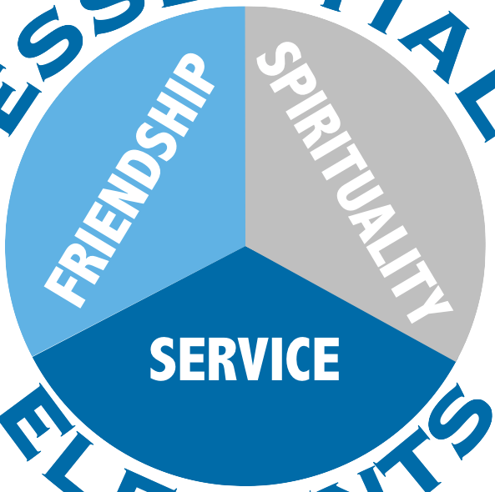
Our Essential Elements
Notes:
We will talk about each of these in more depth later. These Essential Elements are deeply integrated into all that we do.
Spirituality:
We bear witness to Christ, serving His poor as a visible sign of His church on earth.
We show Christ’s face to the needy, and see Christ’s face in them.
We evangelize by example, not proselytizing.
We pray with and for those in need
Friendship:
We join in true friendship, drawing nearer to the divine model by fulfilling the Greatest Commandment: to love our neighbor as ourselves, for the love of God.
Person to person relationships with those in need
Collaboration with other conferences
Praying and reflecting with our fellow Vincentians at meetings and retreats.
Service:
To establish a personal contact between its members and those who suffer, to help in the best way possible, and to promote self sufficiency, and most importantly to grow closer to God by serving “the least of these.”
The Rule, Part III, Statute 1: The Essential Elements
The Essential Elements of the Society of St. Vincent de Paul are Spirituality, Friendship, and Service.

Slide 7

Our Organization
You are here!
Council General
National Council
(Arch)Diocesan Councils
District Councils
Conferences
Worldwide Organization
Based in Paris, France
850,000 members in 155 countries
Regional Council
Notes:
Our “org chart” is very simple! At the top is Christ in the person of the poor.
Members, as part of parish-based Conferences, serve them, and Conferences support and serve the Members (you!)
District Councils are formed to support 3 to 12 Conferences; Diocesan Councils, in turn, are formed to support Districts and Conferences.
The National Council of the United States, through its Regional Councils, supports all of the above; and together with other National Councils, we form the International Council General, which is based in Paris, France.
Did you know the Society’s official language is French?

Slide 8
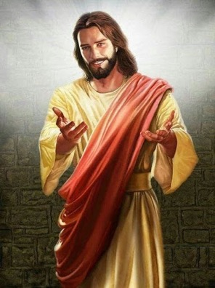


A Network of Charity Encircling the Earth
You are here!
The Society of St. Vincent de Paul
Notes:
Our founder, Frederic Ozanam, envisioned a network of charity encircling the earth, and it has come to pass!
<click to advance>
You are part of something big!

Slide 9
Our Vincentian Heritage
Saints, Blesseds, and the Vincentian Family
Notes:
Let’s talk a little bit about the history of the Vincentian Family, which includes more than the Society of St Vincent de Paul.

Slide 10
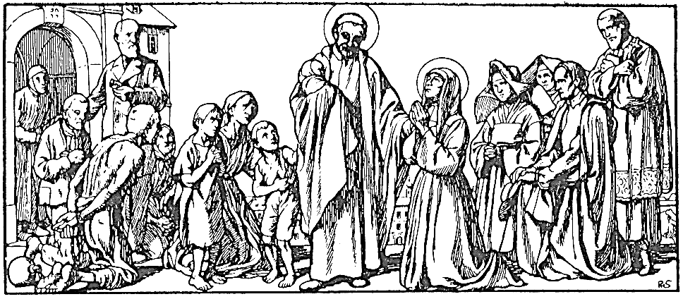
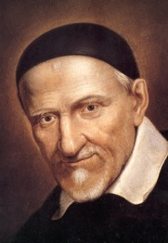
St. Vincent, Apostle of Charity
Notes:
The story begins with our Patron and namesake, St. Vincent de Paul.
Known today as the “Apostle of Charity,” and by many outside of the church as the founder of modern, organized charity, Vincent started his life on a very different path.
Vincent spent almost half of his life seeking his vocation, and the rest of his life sharing this charism, this grace from God, with others.

Slide 11
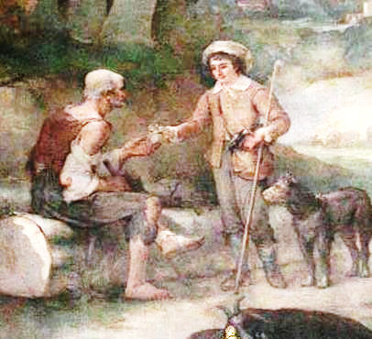
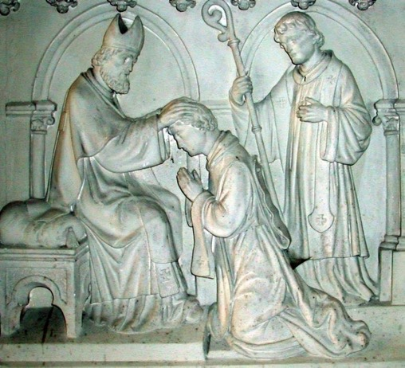
Early Life & Education
Born in 1581
Ordained at 19
Notes:
(Presenters: the most important thing to know is that Vincent originally studied for the priesthood to gain income and social status)
Born April 24, 1581 as one of six kids in a poor farming family in rural France. When he was 13, he was sent off to boarding school to study for the priesthood, which he pursued not as a vocation, but for the income and social status it would provide.
He was ordained at 19 (well below the required minimum age of 25) and continued his studies, earning a doctorate in theology in 1604.
He spent a number of years after that as personal tutor and spiritual director for a wealthy family in Paris.

Slide 12
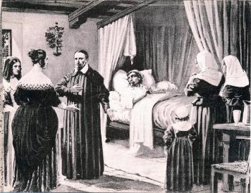
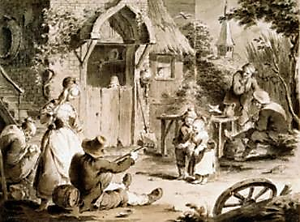
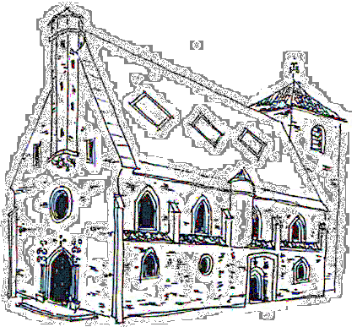
1617: Conversion and Vocation
Bringing God’s love to the forgotten.
“The poor suffer less from lack of generosity than from lack of organization.”
Parish in Chatillon
Notes:
(Presenters: Tell the stories in your own words – this slide may take two minutes, but it is the origin story of the Vincentian Family)
In 1617, two events happened which were moments of personal conversion for Vincent, who by then had finally been assigned as a parish priest.
Vincent went to take the confession of a man who was near death, unable to come to church, but needing to reconcile with God.
Vincent’s heart was touched, and he realized the church needs to go to the people, not wait for the people to come. He desired to go to the farthest places and tell all those who find themselves lost that God exists; that He is a God of gentleness who has not forgotten them.
Later that year, Vincent was told of a poor farm family whose members were so ill they could not even care for each other. In his homily, he urged the congregation to go to this family and help. That afternoon, he encountered crowds going to and from the stricken family’s home. He realized that much of the food that had been delivered would spoil before it was ever eaten. He famously concluded that “the poor suffer less from a lack of generosity than from a lack of organization.”

Slide 13


The Vincentian Family
Confraternities of Charity (1617)
Congregation of the Mission (1625)
Notes:
Just days later, Vincent gathered a group of ladies from the Parish to form the first of the Confraternities of Charity, which still exist today (under a different name.)
A few years later, seeing the need for a permanent company of priests to continue the missions to rural areas, Vincent founded a new priestly order, the Congregation of the Mission.

Slide 14
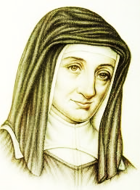
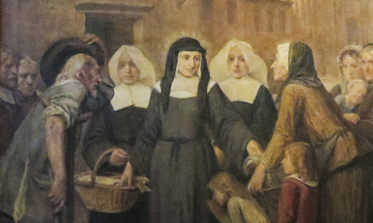
St. Louise de Marillac
Notes:
The same year he founded the Congregation of the Mission, Vincent would meet a 34-year-old widow with a teenaged son who was seeking her religious vocation.

Slide 15
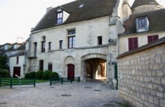
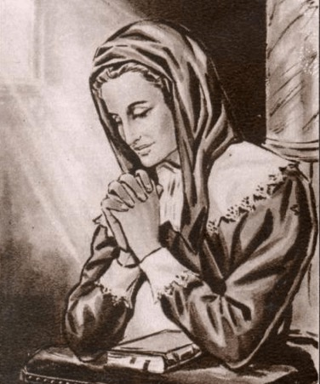
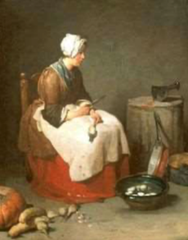
A Life of Wealth and of Poverty
Notes:
(Presenters: the most important points are that 1. Louise went back and forth between comfort and deprivation – material and emotional – many times. 2. Her vision from God foretold meeting Vincent)
Born out of wedlock on August 12, 1591 Louise never knew her mother, who died when Louise was an infant. Her father, a wealthy widower, claimed her as his natural daughter and provided for her.
She spent her early childhood in a boarding school – it was a school for the wealthy, and she was very comfortable and happy, learning about the fine arts, and her faith.
Her father died when she was 12, and she was forced to leave this place, moving to a poor boardinghouse. There, Louise suddenly lived a very different life, spending all of her time learning and performing domestic chores. She maintained her strong faith, and at 15 sought to become a nun.
She was not admitted.
Without many other options, she married at age 22. Her husband was secretary to the queen, and once again, Louise lived a life of comfort and wealth with her husband and their son.
But as so often seemed to happen in her life, she again was to suffer misfortune. The queen was exiled, her husband was out of work, and soon he fell very ill – an illness that would prove fatal.
In a time of deep doubts, Louise prayed and received a vision from God, assuring her that one day she would live a religious life, serving the poor, and that she would have a new Spiritual Director who would show her the way.

Slide 16
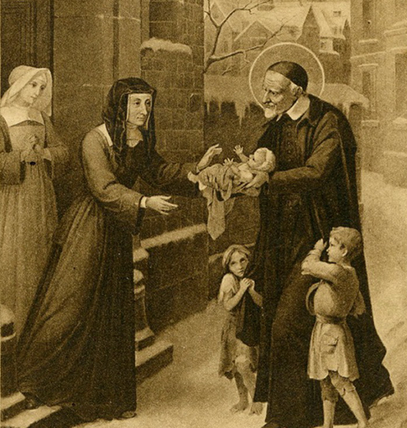
Vincent: Mentor & Spiritual Director
Notes:
When she met her new Spiritual Director soon after her husband’s death, Louise recognized his face from her vision: it was Vincent.
As her mentor, he helped her learn to trust in Divine Providence, and to let go of her anxieties.
He very soon entrusted Louise not only to assist the Confraternities of Charity, but to supervise them.

Slide 17

Daughters of Charity
“They will have as a monastery the houses of the sick and they will also be the Superior’s residence: for their cell, a rented room; for the chapel, the Parish Church; for their cloister, the streets of the city; in continuous obedience to Providence and offering all that they are.”
Notes:
In working with the Confraternities of Charity, Louise relied on young, mostly rural and uneducated girls to help.
In these young women, Louise could see the fulfillment of her vision of a religious order that would care for the poor. At that time, nuns lived in cloisters; they did not go out in public or serve the poor.
Louise brought her idea to Vincent, and together they founded the Daughters of Charity in 1633.
This was, for its time, a radical new idea for women in religious life. At the age of 42, Louise had finally taken the vow she had sought as a girl.

Slide 18
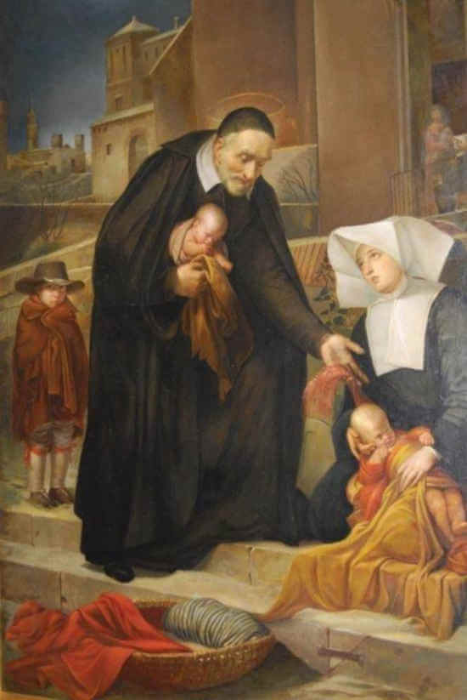
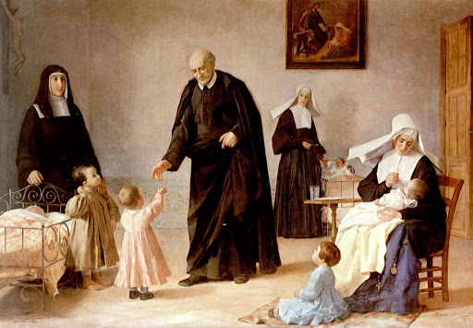
Friendship and Complementarity
Notes:
Vincent and Louise, during 35 years together, founded hundreds of charities; Vincent, the visionary and teacher; Louise, the great organizer. United in purpose and holiness, they gave us such a beautiful model of friendship, complementarity, and true charity.

Slide 19
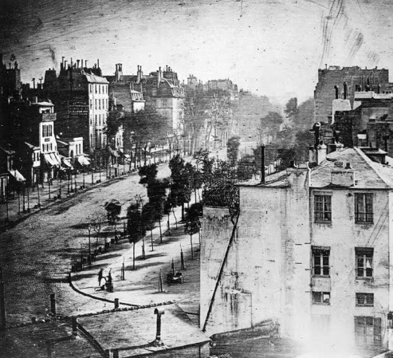
Paris in the1830s
A time of revolution
A weakened church
New forms of poverty
Notes:
200 years later, Paris was in turmoil. Multiple revolutions had already occurred, and more were to come.
The church had fallen out of favor with many, and was even blamed for many social troubles.
The industrial revolution had brought many people from the countryside to the city, where new forms of poverty appeared in the city’s slums.
Photo: First known photo of a human, taken in 1838 in Paris– the Paris of Frederic and Rosalie

Slide 20
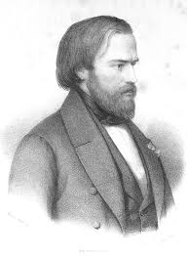
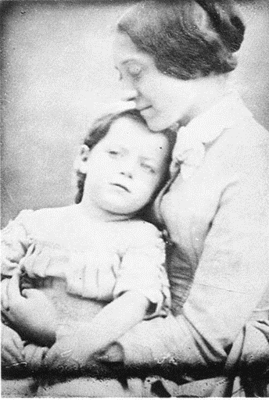
Frédéric Ozanam
Fifth of 14 children, son of a doctor
Brilliant intellect and widely known voice
1813-1853
Deeply devout and extraordinarily humble
Devoted husband and father
Notes:
(Key point to express here: As a layman, Frederic is perhaps our best role model as Vincentians.)
Frederic was one of three siblings to survive into adulthood. His great intellect was recognized even when he was a boy. He lived only 40 years, and remained deeply devoted to the Catholic Church, seeing it as central to the solution of social ills.
Although he considered the priesthood, Frederic, like us, remained a layman. He loved his wife Amelie, and absolutely doted on his little girl, Marie.

Slide 21

The Founding of the Society
Catholicism challenged by professors & students
The Conference of History
A challenge from critics of the Church
Notes:
When he arrived at the Sorbonne in 1831, Frederic often found himself defending the faith against the criticisms of both his professors and fellow students. He soon gained the respect of all with his polite, but forceful argument.
He joined a group called the Conference of History that met at the newspaper office of a man named Emmanuel Bailly. They met on Saturdays to discuss a wide range of subjects, and the conference attracted a variety of people with differing opinions and beliefs.
One Saturday, during a heated debate between Frederic and his Catholic friends, and a group of anti-Catholic students, Ozanam and his friends were challenged:
“We agree that at one time your Church was a great Church and was a great source of good. But what is your Church doing now? What is she doing for the poor? Show us your works and we will believe you.”
With his broad knowledge, formidable intellect, and debating skills, Frederic certainly could have ably defended the church. Instead, he accepted the challenge, and took it to heart. He and several of his friends agreed to meet and discuss what they might do.

Slide 22
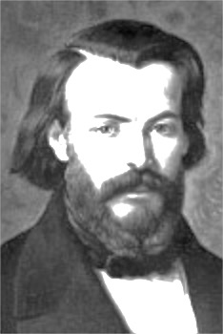





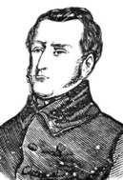
Founders of the Society
Frederic Ozanam
Emmanuel Bailly
François Lallier
Paul Lamache
Auguste Le Taillander
Jules Devaux
Félix Clavé
Notes:
On April 23, 1833, Frederic Ozanam’s twentieth birthday, the six students gathered in Bailly’s newspaper office.
Ozanam’s words moved all present: “We must do what is agreeable to God. Therefore, we must do what our Lord Jesus Christ did when preaching the gospel. Let us go to the poor!” And so, in the Providence of God, the Society of St. Vincent de Paul was born.
The six students elected Bailly, then a middle-aged man, to be the president of this Conference of Charity. After a year, they had renamed the group the Society of St. Vincent de Paul.

Slide 23
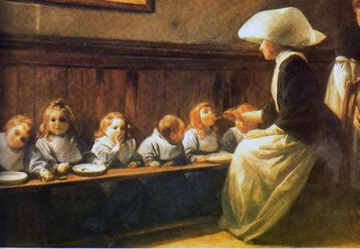
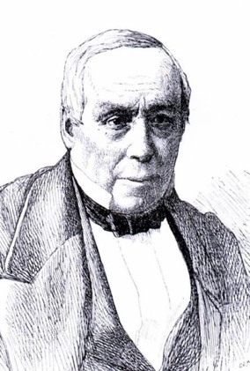
Bl. Rosalie Rendu: Mentor
Notes:
One of Bailly’s first acts was to introduce the young men to Sister Rosalie, a Daughter of Charity, who could be described as the “Mother Teresa of 19th Century Paris.”
She was widely known and loved throughout Paris for her many good works.

Slide 24
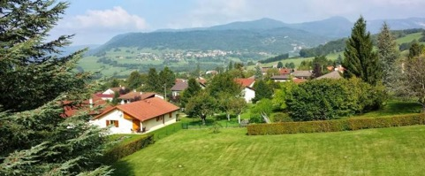
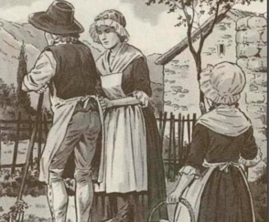
Courage and Faith
Born in 1786
Notes:
Born September 9, 1786, Rosalie grew up in the mountains near the Swiss border. She was the eldest of four girls; impulsive, impetuous, mischievous…and had a great sense of humor
When she was young, the Church was outlawed in France, and her family sheltered fugitive priests and bishops.
She received her First Communion in the basement from a priest who later would be martyred.
Soon after the church was restored to public practice of the faith, Rosalie went away to school, but soon felt the call to religious life when she read St. Vincent’s words about the Daughters of Charity. At 15, she left for Paris.

Slide 25
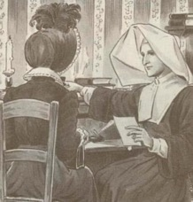
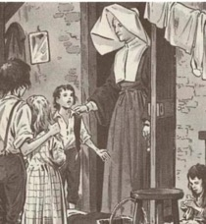
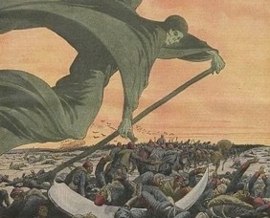
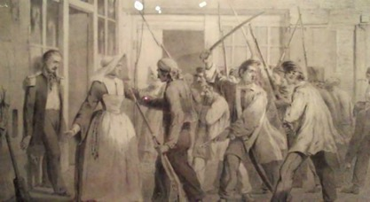
“Mother Teresa” of the Mouffetard
Serving Rich and Poor…
…in Times of Plague and War
Notes:
She became a Daughter of Charity, and was assigned to the Mouffetard, one of the poorest slums in Paris at 17. She would spend the next 54 years in that district, serving all who were in need.
Both rich and poor sought her advice and help, and she helped them all happily. She and the other Daughters risked their lives fearlessly during cholera epidemics, caring for the infected and the dying.
In times of revolution, she tended to the wounded from both sides.
"I am a Daughter of Charity,” she said. ” I come to the assistance of those in distress wherever I meet them."

Slide 26
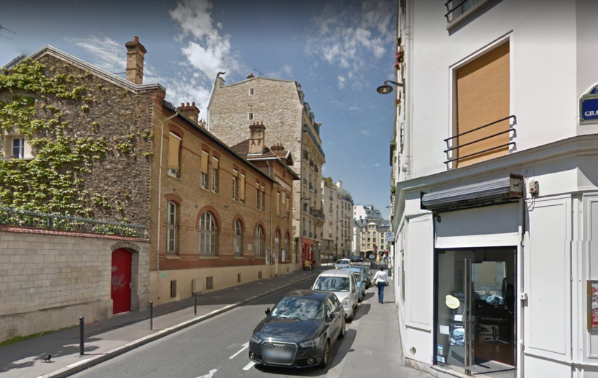
Rosalie and the Society
Patience
Understanding
Politeness
Notes:
Photo of Rosalie’s house of charity on rue de l'Epee-de-Bois
The first Conference had no “hotline.” It was Rosalie who assigned the young men families to visit, and taught them how to serve the poor. Her biographer and collaborator described her advice (click for animation before reading):
She...recommended to them patience, which never considers the time spent listening to a poor person as wasted, since this person already takes comfort in the good will that we demonstrate by {listening]; understanding, more inclined to pity than to condemn faults that a good upbringing did not ward off; and finally, politeness, so sweet to a person who has never experienced anything but disdain and contempt.
Because the poor trusted Rosalie, they trusted these young men in their top hats.

Slide 27

The Rule
Originally written in 1835
A spiritual document
Only revised a few times
Last revised 2018
Notes:
(Presenters: the most important point to convey is that the Rule is not some simple “book of instructions.” It helps ground us in our spirituality first; it is intertwined in all that we do.)
In 1835, when the first Conference was not quite two years old, Frederic observed that the meetings were “nearly always concerned with business” and that members lacked the enthusiasm and “rays of charity” with which the Society had begun. They performed their duties “out of habit.”
With Frederic’s input, François Lallier and Emmanuel Bailly wrote the first edition of the Rule of the Society of St Vincent de Paul. It has only been revised a handful of times since then.
The Rule serves to remind us of our primary purpose (growth in holiness) and to describe our spirituality and our heritage. Additionally, the Rule gives us our basic framework of governance.
There are many publications available to help us in our work. With very few exceptions, they are all “guidelines.”
The Rule is not a guideline – it is nearly always the first reference when we have questions!

Slide 28
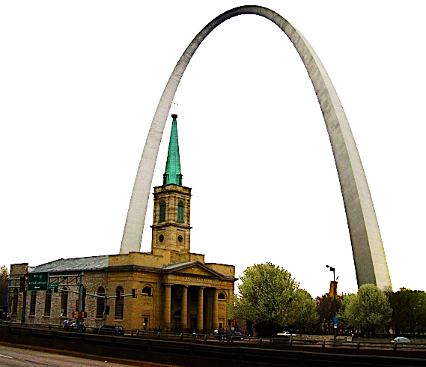
The Society in the United States
Founded
20 November 1845
First President
Dr. Moses Linton
Aggregated
2 February 1846
St. Louis, Missouri
Notes:
It took only 12 years for the Society to expand as far as the United States. This year, we celebrate the 175th Anniversary of that first Conference at the Old Cathedral in St. Louis. Our National Council is still headquartered in that city.

Slide 29
Spirituality
Come, Holy Spirit, Live Within Our Lives

Slide 30
Apostolate of the Laity
Spiritual Life
The Whole of Life
Secular Life
“Spirituality is life in Christ and in the Spirit, which is accepted in faith, expressed in love, and inspired by hope…not a part of life, but the whole of life guided by the Holy Spirit.”
Pope Saint John Paul II
Notes:
We are a lay organization, answering the Universal Call to Holiness. To do this, Pope Saint John Paul II explained:
“There cannot be two parallel lives in your existence as lay men and women: on the one hand, the so-called ‘spiritual’ life, with its values and demands; and on the other, the so-called ‘secular’ life, that is, life in a family, at work, social relationships, in the responsibilities of public life and in culture.” (Christifidelis Laici)
(Click, then read quote on screen)

Slide 31
The Five Vincentian Virtues
Simplicity
Gentleness
Humility
Selflessness
Zeal
Notes:
Summarize in your words, using the excerpt from the Rule below as reference. (Click to make each virtue appear on the slide.)
THE RULE, PART I
2.5.1 Essential virtues
Vincentians seek to emulate St. Vincent in the five virtues essential for promoting love and respect for the poor:
Simplicity – frankness, integrity, genuineness.
Humility – accepting the truth about our frailties, gifts, talents, and charism, yet knowing that all that God gives us is for others and that we can achieve nothing of eternal value without His grace.
Gentleness – friendly assurance and invincible goodwill, which mean kindness, sweetness and patience in our relationship with others.
Selflessness – dying to our ego with a life of self-sacrifice; members share their time, their possessions, their talents and themselves in a spirit of generosity.
Zeal – a passion for the full flourishing and eternal happiness of every person.

Slide 32
To See the Face of Christ
“We do what we do for the person of Jesus, who is, in truth, the flesh-and-blood poor person before us.”
The Manual
Notes:
(Consider sharing a story of a personal encounter with Christ that you experienced)
One of the most important precepts in our Vincentian Spirituality is to see and to serve Christ in the person of the poor.
St. Vincent saw the historical Jesus in the poor. Christ could have come to us as a king, a warrior, a man of power and wealth, but instead chose to be among us as a poor man.
Bl. Frederic saw the risen, scarred Jesus in the poor; wounded, suffering as we ourselves do not suffer.
Both men saw the same Christ, and the transformative grace of serving Him exactly as he asked us to serve (“whatever you do for the least of these…”).
As Vincentians, we see the face of Christ in those we serve!

Slide 33
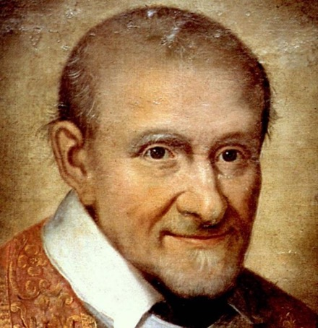
Trust in Providence
“Behold, now, how little is needed to become a Saint? Nothing more than to acquire the habit of willing, on every occasion, what God wills.”
St Vincent de Paul
Notes:
Trust in Providence is abandonment to God’s Will.
As Christ put it: “Let the day’s own troubles be enough for the day.”
Vincent taught that our works would be judged not by their outcome, but by the charity which accompanied them.
Our plans may not always work out as we intend, but they will always turn out in accordance with God’s Will.
We are not in control, He is. And that should be cause for comfort, not anxiety!

Slide 34
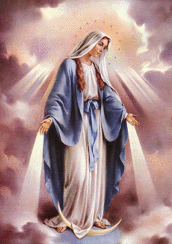
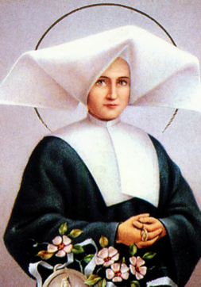
Devotion to Mary
“O Mary, conceived without sin,
pray for us who have recourse to you.”
Our Lady of the
Immaculate Conception
St. Catherine Labouré
Notes:
At Frederic’s urging, the Society adopted Our Lady of the Immaculate Conception as our patroness. He was certainly inspired by St. Catherine Laboure’s vision of the miraculous medal, a vision she had in Paris in the same year that he arrived to attend school.
What an example of God’s Providence that these three holy people, Frederic, Rosalie, and Catherine, would be within a few blocks of each other in 1830s Paris!
“The Society,” Frederic once observed, “is a providential fact.”

Slide 35

The Central Role of Prayer
We pray…
…to open and close every meeting
…before and after every home visit
…with those we serve
We partake in the Eucharist frequently to sustain us in our Vincentian activities
Notes:
(Presenters: important point to convey is that our prayer is tied to our works. They can’t be separated. Reference from the Manual below.)
St. Vincent said: “Give me a man of prayer, and he will be able to do all things; he can say with the Apostle, ‘I can do all things in him who strengthens me.’” For Vincent, prayer flows from and leads to action. Separated from ministry, prayer can turn escapist and create illusions of holiness. Separated from prayer, ministry can become superficial and compulsive.
Excerpted from: Manual: Section 3.3

Slide 36
Friendship
We Serve the Poor and Each Other
Notes:
Our mission statement says that we are a “network of friends.” In few places is our friendship more clearly expressed than in our Conference Meetings, but it extends far beyond that.

Slide 37

A Community of Faith
“The members meet as brothers and sisters with Christ in the midst of them, in Conferences that are genuine communities of faith and love, of prayer and action.”
Notes:
“The entire Society is a true and unique worldwide Community of Vincentian friends.”
“Meetings are held in a spirit of fraternity, simplicity and Christian joy.”
“Unlike other organizations within and outside the Church, the Conference meets less to conduct business than to celebrate and deepen its unity for essentially spiritual reasons. Opening and closing prayers, together with spiritual reflections, heighten our awareness of the Holy Spirit’s presence.” (Manual)
Our primary purpose is to grow in holiness together.
Our Conference is not just a club – it is a community of faith, and the meetings are a time to grow together in spirit!

Slide 38
We meet regularly
Conferences meet frequently, but at least twice a month
The meeting agenda includes:
    Opening Prayer
    Spiritual Reflection
    Secret Collection
    Home Visit Reports
    Other Conference Business
    Closing Prayer
Notes:
(The agenda items on the slide are an abbreviated version of the agenda in the Rule)
Frequent meetings allow us to renew our friendships. Most Conferences meet weekly, but our Rule requires us to meet at least twice a month.
The normal agenda is laid out in the rule, but you can see here a few of the most important items, and we will talk about a few of them in more detail shortly.

Slide 39

Spiritual Reflection
“…members are always invited to comment as a means of sharing their faith…”
Notes:
(Presenters: important point to convey is that this reflecting together is the most important part of the Conference meeting!)
At every Conference Meeting, we set aside time for prayer and reflection, which normally is led by the Conference Spiritual Advisor. The Rule does not give us much specific guidance about the Spiritual Reflection, but it does say that “…members are always invited to comment as a means of sharing their faith…”
It is so very important to always share our reflection, especially reflection on our home visits, together in our community of faith so that each of us may benefit from the others’ insights.
These reflections are the most important item on the agenda every week!
We share honestly, we listen openly, we grow together.

Slide 40
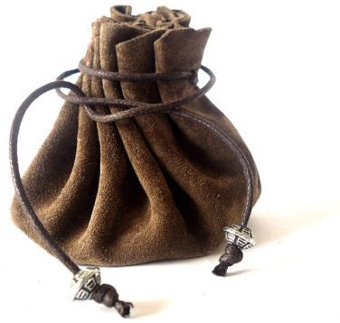
Secret Collection
Begun at very first meeting!
“Help us to be generous with our time, our possessions, and ourselves in this mission of charity.”
our
our
our
Notes:
Since the very first meeting, Conferences have followed the tradition of the Secret Collection. In the early days, this was the only source of funds. In order to spare members from any judgment based on what they were able to contribute, and also to ensure that the Conference offered assistance based on need, not based on the amount each family’s advocate donated, the bag was passed, and each member put his hand into it. Only the members themselves knew what they had given.
Although Conferences today have other sources of funds, the tradition has become a true sacrificial offering, honoring our Rule, which states that we give of “our time, our talents, our possessions, and ourselves…” We pray for the generosity to give these things in our opening prayer at each meeting.

Slide 41
Decision-making
All decisions are made by consensus after the necessary prayer, reflection and consultation. The democratic spirit is fundamental at all levels of the Society and, when appropriate, matters are put to a vote.
Rule, Part I, 3.10 Democracy
Notes:
As long they do not contradict the Rule or the Scriptures, the Conference makes its own decisions; they are not commanded by Councils, nor by their officers. Decisions are made by consensus, rather than votes.
Consensus reduces the need for formal voting and builds the concept of teamwork. It also emphasizes the importance of group decision-making over the dominance of one or more individuals.

Slide 42

Consensus is Unity, not Unanimity
Notes:
Unity, not unanimity! Something which we can all support, even if it is not every individual’s first choice.
(A simple way to think of consensus: Voting is like two wolves and sheep deciding what’s for dinner. Consensus is like a group of friends deciding where to go for lunch.)

Slide 43
A Community of Friendship
The friendship that unites us with each other unites us also with our neighbors in need.
Notes:
Our friendship also extends beyond our fellow Vincentians. We serve those in need as friends.
As our Rule puts it:
“Vincentians endeavor to establish relationships based on trust and friendship. Conscious of their own frailty and weakness, their hearts beat with the heartbeat of the poor. They do not judge those they serve. Rather, they seek to understand them as they would a brother or sister.”
The Rule, Part I, 1.9

Slide 44
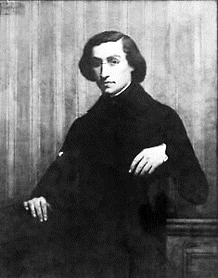
The Strongest Tie
But the strongest tie, the principle of a true friendship, is charity, and charity could not exist in the hearts
of many without sweetening itself from outside.
It is a fire that dies without being fed, and
good works are the food of charity. So it is in
our own interest first of all that our association
has been established, and if we assemble
under the roof of the poor, it is at least equally
for them as for ourselves, so as to become progressively better friends.
Frederic Ozanam, 1834
Notes:
Ask participants to read silently these words of Blessed Frederic.
Then, in breakout groups, discuss this new understanding of Friendship.

Slide 45
Service
Person-to-person. A Means, Not an End.
Notes:
Presenters: please emphasize that home visit training takes place primarily within each Conference.

Slide 46
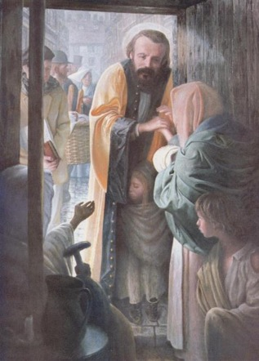

Home Visits: the Heart of the Society
Notes:
Our Society was founded with the declaration (the promise!) that we would go to the poor. We go as servants, to see and to serve Christ himself.
Although the Society performs many Special Works, the home visit remains our primary form of service.

Slide 47
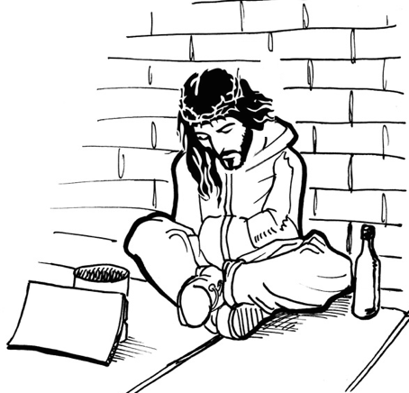
Why do we go to those in need?
To see the Face of Christ
To be the Face of Christ
To be friends
To maintain dignity
To expedite assistance
To see the whole picture
To better protect confidentiality
Please Help
Notes:
This is easier when we see an actual face!
We show His face the same way that Christ himself did: by being present.
If an old friend calls us for help, we don’t send them to the office! We treat the poor as friends.
The poor spend a lot of time in offices, taking a number, standing in line, filling out forms. Not with us.
“I can’t afford bus fare or time off of work!” You don’t have to – I will come to you!
Two-thirds of human communication is non-verbal. On the phone you can’t see the threadbare carpet, the sparse furniture… as Frederic said:
“The knowledge of social wellbeing and reform is to be learned not only from books nor from the public platform, but by climbing the stairs to the poor man’s garret, sitting by his bedside, feeling the same cold that pierces him, hearing the secret of his lonely and troubled mind.”
CONFIDENTIALITY! In the comfort of home, our neighbors will more easily confide in us. Always be clear that what they share, we hold in the strictest confidence, and never share with anybody without their permission

Slide 48

How do we go to those in need?
In pairs
With eyes, ears, and hearts open
Without judgment
As servants
With prayer
Notes:
Our Rule calls us to make our home visits “in the Vincentian spirit.” The Vincentian spirit is less a set of rules than an attitude!
In pairs: The Apostolic Tradition, observing from two perspectives adds depth, complementarity
Eyes & Ears: Our friends should do most of the talking. We are there to listen and observe.
Judgment: We are there to judge the need, not the person!
Servants: We are not social workers, or advisors – we are servants
Prayer: We pray on our home visits (with permission) – “where two or three are gathered…”

Slide 49
Other Works of the Society
Twinning
Disaster Relief
Food Pantries
Thrift Stores
Collaboration
Immediate Needs
Home Visit
Prison Ministry
Evangelization
Housing
Advocacy
Eldercare
Immigration
Services
Notes:
All other works have sprung from the home visit and must be supportive of them.
(Presenters may wish to mention one or two specific local works.)

Slide 50
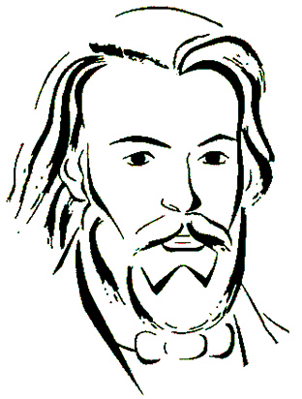
We Grow in Holiness Together
“[The] end of the Society is especially to rekindle and refresh … the spirit of Catholicism, that fidelity to meetings, and union of intention and prayer are indispensable to this end, and that visiting the poor should be the means and not the end of our association.”
Frederic Ozanam, 1838
Notes:
Ask participants to read silently.
Either:
Discuss in groups how this understanding of our primary purpose might impact how you approach home visits.
Or:
Ask for thoughts from the whole group after a few moments of silent reflection.

Slide 51
The Vincentian Pathway
Our Continuing Formation

Slide 52
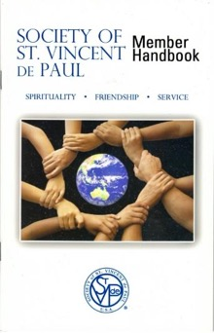
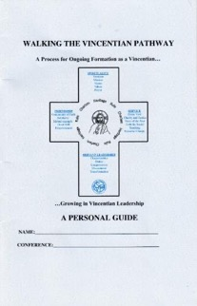
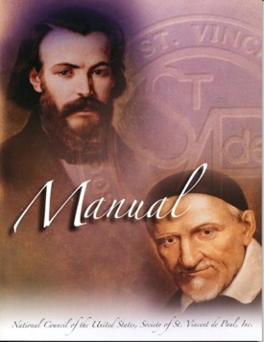
Personal Formation
Attend Ozanam Orientation!
Weekly E-Gazette
SVdPUSA.org
FamVin.org
Notes:
Encourage attendees to continue their personal formation, especially now, as we spend more time at home!
If you do not have them, get a copy of the Rule and Manual! The Rule is not a list of instructions, it is a spiritual document describing our vocation.
The Member Handbook is a great overview that will lead you to further study, and encourage you to reach out to more experienced Members of your Conference to talk!
The Vincentian Pathway booklet will direct your studies on a path organized around our Essential Elements, and the call to Servant Leadership.
There are many online resources, too!

Slide 53

Closing Prayer
Heavenly Father,
Inspired by Your servants St. Vincent and St. Louise, Bl. Frederic and Bl. Rosalie,
May we bear witness to Your compassionate and liberating love
By serving Your poor cheerfully,
And each other humbly,
On our path towards Holiness in union with you, Lord Jesus.
Notes:
Remind attendees we close our prayer (our meeting) with the sign of the cross

