Slide 1
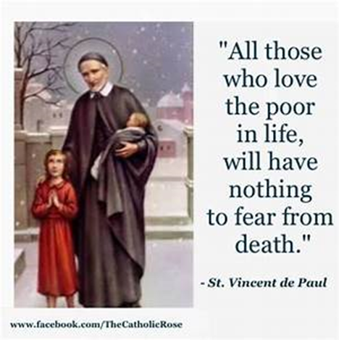
St Faustina Conference
Saint Vincent de Paul Society
Spiritual Meeting
20 February 2021

Slide 2
Agenda
TIME | EVENT | SPEAKER
9:00 AM | Meeting called to order by President | Dave Scharett
9:01 AM | Roll call by Secretary | Amy Whittaker
9:05 AM | Opening Prayer & The Lord’s Prayer | Dave Scharett
9:10 AM | Spiritual Advisor’s Presentation | Father Eversole
9:15 AM | Treasurer’s Report | Don Carlson
9:20 AM | In Keeping With Our Opening Prayer | Dave
9:30 AM | President’s Report | Dave
9:35 AM | Public Affairs Report | Annie Mason
9:40 AM | Secretary’s Report | Amy
9:45 AM | New Business | All Vincentians
9:57 AM | Closing Prayers | Laura Morris & Father Eversole

Slide 3

O Mighty God, I thank You for Your Word that says that You do not see people in the same way that other people do. You see that we have been created in Your image and likeness. You see that there are no racial differences, because with You, Lord, what is beneath the surface is who we are. What is on the outside is our temporary earthly body. It is our shell. So, I thank You, that I no longer need to be concerned about external judgment, because You, Father, look inside me and know who I am. You know my heart, my God. I am Yours and in You I find my strength! I declare healing in Jesus’ name. Amen.
1 Samuel 16:7
“But the Lord said to him, “Pay no attention to how tall and handsome he is, I have rejected him, because I do not judge as man judges. Man looks at the outward appearance, but I look at the heart.”
My Prayer for Strength and Healing
Followed by
The Our Father
(next slide)

Slide 4
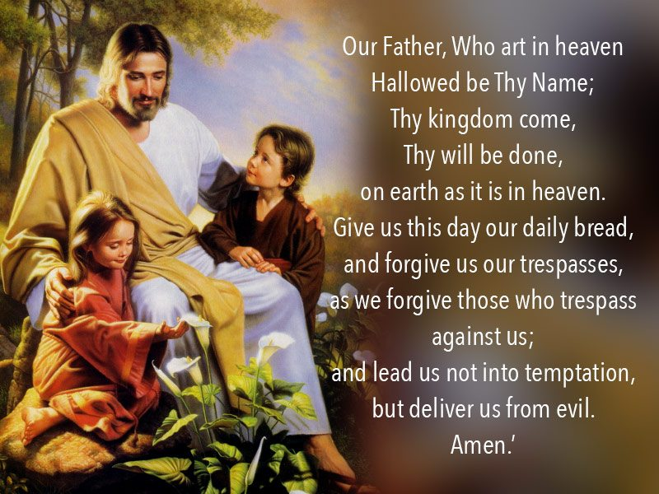

Slide 5

Spiritual Advisor’s Presentation
Father Eversole

Slide 6
In keeping with our Opening Prayer
Look into their hearts and not at what they look like
Joseph Hayne Rainey
Elijah J McCoy
Daniel Hale Williams
Mark Dean
A member of the US Congress who served five terms from South Carolina. Promoted civil rights through legislation.
Inventor and engineer, who was notable for his 57 U.S. patents, most to do with lubrication of steam engines. It is where we get the term, “Is that the real McCoy”. Most of our modern production line machines use one of his inventions to automatically lubricate machine parts.
A physician who performed the first known open-heart surgery in the United States and who founded a hospital with an interracial staff.
Co-Invented Color IBM PC Monitor and Gigahertz Chip, 1980 and 1999. The massive chip, built in 1999, would allow for higher processing rates at faster speeds within PCs.

Slide 7
Patricia Bath
Daniel James
Charles Drew
Quincy Jones
An Inventor, Doctor and Educator. A female doctor who received a medical patent. Invented the Laserphaco Probe for cataract treatment in 1986.
A fighter pilot in the U.S. Air Force, who in 1975 became a four-star general. Inducted into The National Aviation Hall of Fame. Noted for his fierce stance on individual responsibility.
A surgeon who pioneered methods of storing blood plasma for transfusion and organized the first large-scale blood bank in the U.S. Made some groundbreaking discoveries in the storage and processing of blood for transfusions. He also managed two of the largest blood banks during World War II.
An American record producer, conductor, arranger, composer, musician, television producer, film producer, instrumentalist, magazine founder, entertainment company executive, and humanitarian. His career spans six decades in the entertainment industry and a record 79 Grammy Award nominations, 27 Grammys, including a Grammy Legend Award in 1991.

Slide 8
Frederick McKinley Jones
James E. West
Took out more than 60 patents throughout his life, including a patent for the roof-mounted cooling system that’s used to refrigerate goods on trucks during extended transportation in the mid-1930s. He received a patent for his invention in 1940, and co-founded the U.S. Thermo Control Company, later known as Thermo King. The company was critical during World War II, helping to preserve blood, food and supplies during the war.
Co-invented the foil electret microphone, which was considerably less expensive to produce than the typically used condenser microphones. Two years after it was invented, the final model of the microphone was developed and in 1964 they patented the landmark invention. Only four years later, the new microphone was in wide production was used in hearing aids, tape recorders, most telephones and baby monitors.

Slide 9
Treasurer’s Report: Don Carlson
Current Balance
Bills Paid
Online Donations
Other financial issues as appropriate

Slide 10
President’s Report
Formation of the Saint Faustina Conference’s Education Committee.
  Committee Members
    Cathy Lee: Public School Teacher/Principal 42 years, Masters Degree in Educational Administration, Post Masters Certificate
    Dr. John Morris: PhD in Education, Director E-Learning American Military University
    Annie Mason: Manager of the Conference’s Highschool Scholarship Program, Masters Degree, Teacher 14 years, taught in Maine and wrote the district curriculum for art
    Laura Morris: Master of Education in Secondary Education, served on numerous universities as a full time and adjunct instructor, co-created curriculum for American Military University
    Don Carlson: American expert in advanced communications
    Dave Scharett: Region 16 STEM Council, Adjunct Professor Saint Leo University, guest lecturer Penn State University, Virginia State SkillsUSA Chairman of Engineering Evaluations, guest speaker in Spotsylvania and Stafford County Schools
  Basic Concept
    Collaborate with school Principal(s) and Counselor(s) to identify the neediest of the disadvantaged students who are falling behind their peers academically. Math, English, History (civics), Science, Reading, etc.
    Provide either one-on-one OR small group sessions to assist the children in comprehending the course of study (Virginia SOLs) and “catch up” with their fellow students
    Assistance may be virtual or in person within COVID 19 health guidelines
    Possibility of using one or more of the classrooms at the Marshall Center
  Put in writing Education Ministry’s Mission, Courses of Action, Vincentians Responsible for Actions
    The Who, What, When details
  Our District Council supports Saint Faustina Conference in this endeavor

Slide 11
May we humbly acknowledge the Lord’s Blessings in providing us the resources needed to help our Neighbor’s-In-Need
Not Least of Which Is the Support of our Priest and the Parish
2. District Council Webinar (via ZOOM) on Grants Tuesday, Feb 23rd at 7:00 pm
Moderated by Paul “Korky” Korkemaz
Saint Faustina represented by our successful Grant writing TEAM
  Cathy Lee, Annie Mason, Don Carlson, Dave Scharett
We stand to learn a lot from the other Conferences that have received other types of Grants

Slide 12
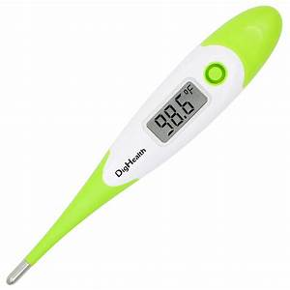

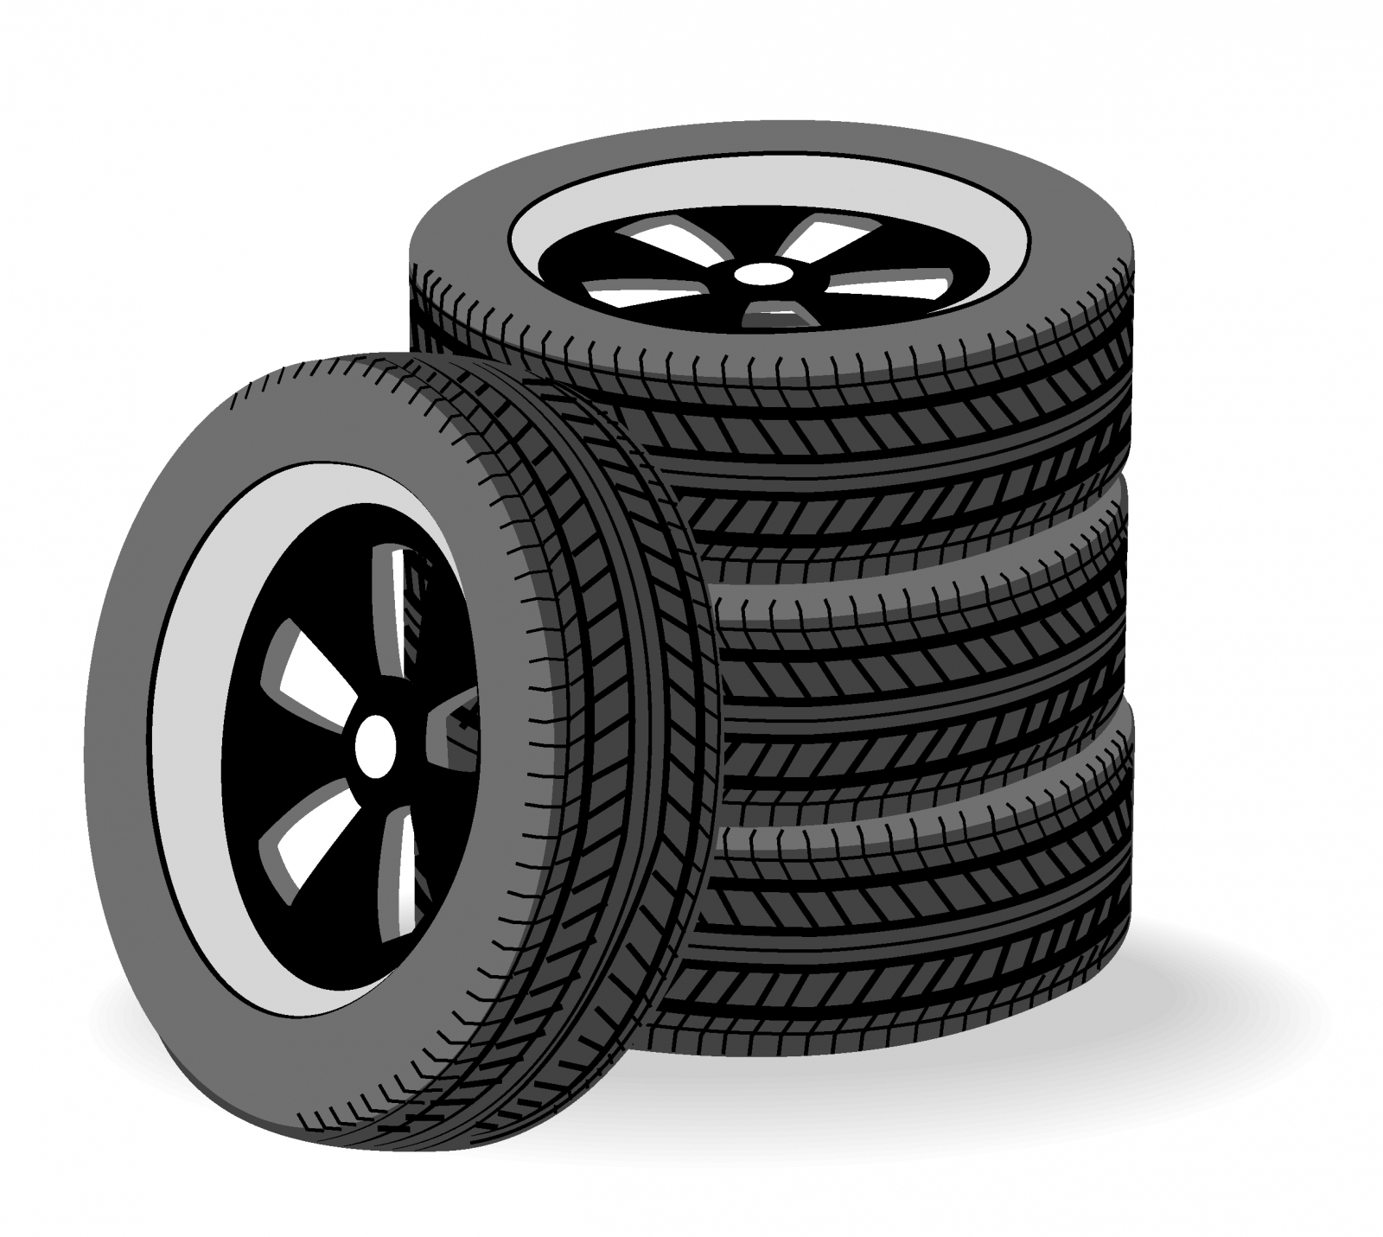
Home Visitations
Four cases of particular note:
  Assisted a Mother with a sick 2-year-old daughter: Thermometer, Pedialyte, Food, Home Essentials, Diapers
  Distributed 48 Donated Perishable Cakes to Neighbors-In-Need. Two went to young children that have never had a birthday cake. Birthdays were in February.
  Provided repairs to vehicle to ensure safe operation of the only family vehicle; two children in this Neighbor-In-Need Family.
  Provided Mortgage assistance to an elderly woman living alone. Fell behind because of surgery conducted out of state. Resides in Saint Patrick’s Parish

Slide 13
Public Affairs Report: Annie Mason
Public Affairs activities/issues to report

Slide 14
Secretary’s Report: Amy Whittaker
Open Old Business from prior meeting
Approval of Prior Meeting Minutes
The next Conference Spiritual Meeting will be Saturday, March 4th at 9:30 am via ZOOM

Slide 15
New Business: open to all members
1. New Business???

Slide 16
Reflect Upon God Creating ONE Human Race

Slide 17
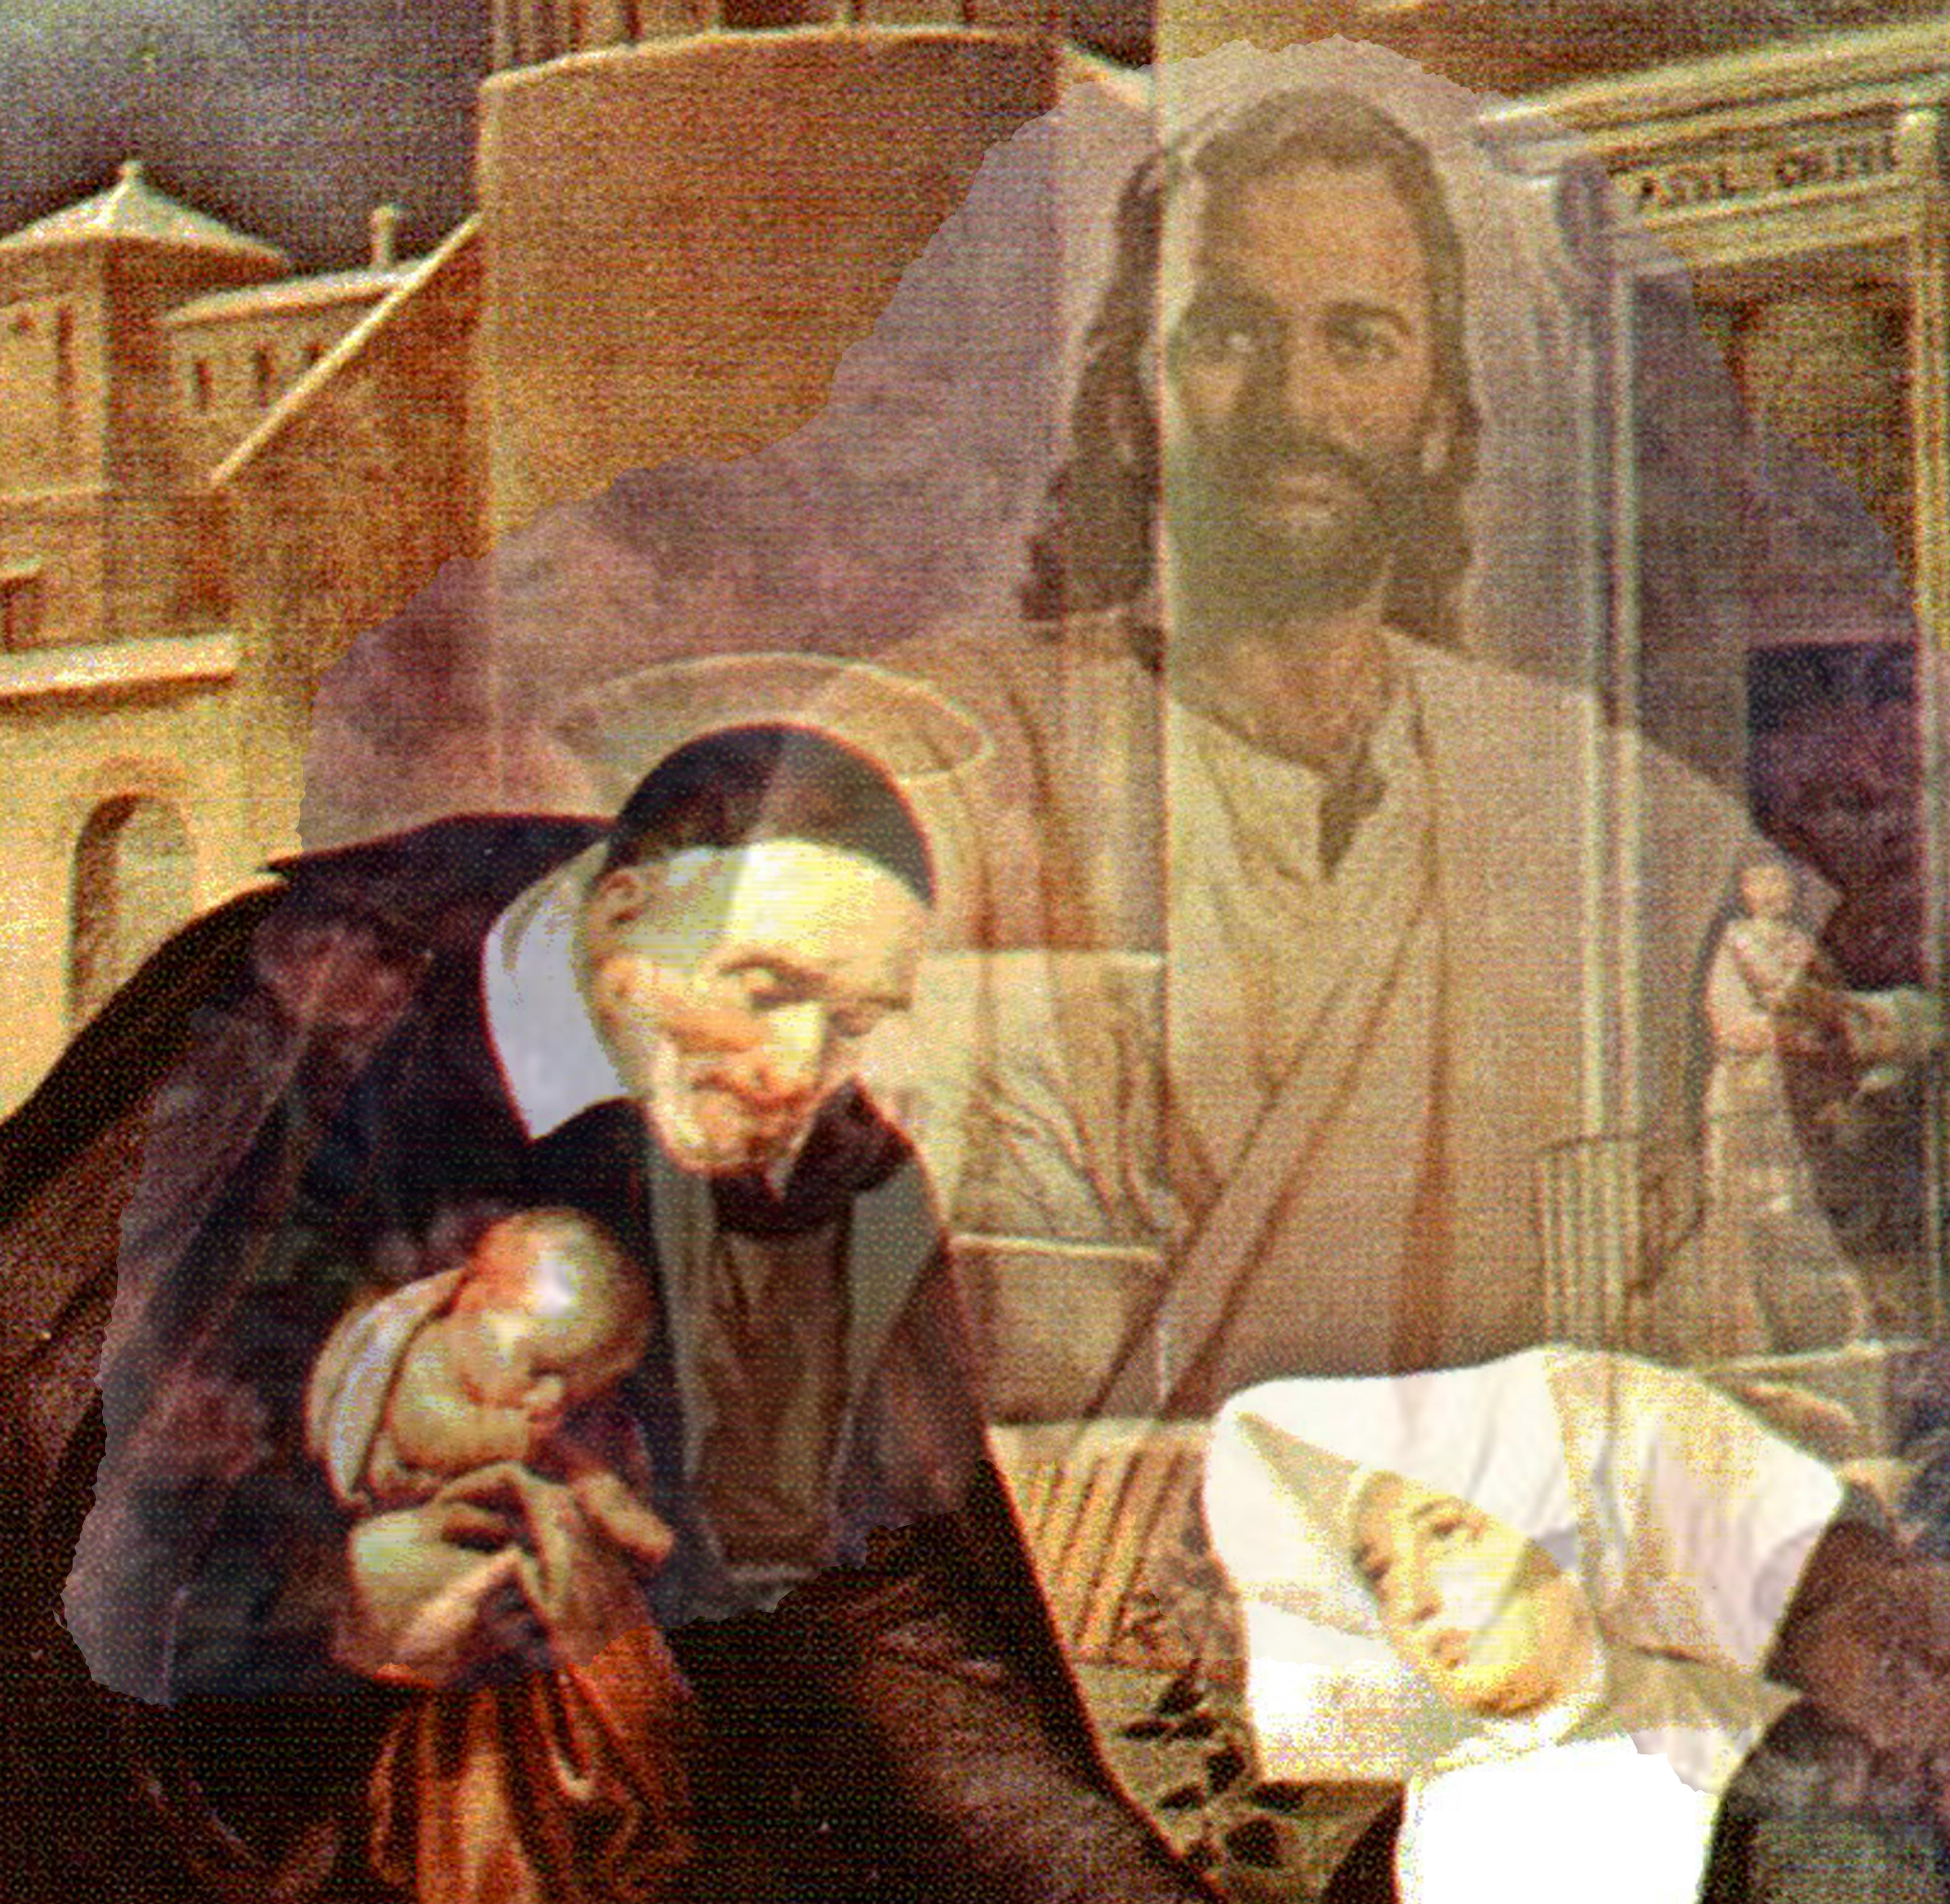
Closing Prayer & Spiritual Advice: Father Eversole

