Slide 1
St Faustina Conference Saint Vincent de Paul Society
Spiritual Meeting
26 June 2021

Slide 2
Agenda
TIME | EVENT | SPEAKER
9:30 AM | Meeting called to order by President | Dave Scharett
9:31 AM | Roll call by Secretary | Laura Morris
9:32 AM | Opening Prayer & The Lord’s Prayer | Dave
9:36 AM | Spiritual Advisor’s Presentation (Pray for Ann) | Father Eversole (Dave)
9:46 AM | Treasurer’s Report | Don Carlson
9:50 AM | Home Visitation Report | Dave
9:52 AM | President’s Report (defer to Friends of the Poor ® | Dave
10:00 AM | Friends of the Poor ® Walk Report | Annie Mason & Cathy Lee
10:05 AM | Public Affairs Report | Annie Mason
10:10 AM | Friendly Visitations Report | Ann Ellis
10:15 AM | Secretary’s Report | Amy (Dave)
10:20 AM | New Business | All Vincentians
10:25 AM | Closing Prayer | Father Eversole

Slide 5
Spiritual Advisor’s Presentation
Father Eversole

Slide 6
Let Us Pray for Our Friend Ann
Lord watch over and care for our friend – Ann
Heal Ann and provide her the means to help others; which has been and is her passion in life.
Lord hear our prayer.

Slide 7
Treasurer’s Report: Don Carlson
Current Balance
Bills Paid
Donations
Online donations
Other donations
Other financial issues as appropriate

Slide 8
Home Visitations
Conference Emergency Assistance Ministry
The Manager of the Conference Emergency Assistance Ministry is Michael March
The Current makeup of the Conference’s Ministry is:
Call Monitors of the Conference’s Assistance Line 540 834-5555 are Barbara Legaz and Deanna Kau.
Caseworkers of Conference ONLY financial assistance are Ann Ellis, Joe Darr, Lilian Fay, and Deborah Franks
Caseworkers of Catholic Charities funding OR combination of Catholic Charities & Conference financial assistance are John Tighe and Michael March
Actual visits to Assistance Line Callers homes are suspended for the foreseeable future.
In person meetings with callers will be conducted in a public place.
The Assistance Line Monitors will document the Assistance Line calls and provide an email of all the calls (regardless of ZIP Code and requests) to the Conference Manager (Michael March) and the Assistance Line Monitor Secretary (Melissa Miller) and info copy the Conference President (Dave Scharett)
The Assistance Line Monitors should continue to refer callers to other organizations as needed. Monitors and Caseworkers can access the Saint Faustina Conference website (www.svdpstfaustina.org) for the current listing of referrals. Enter the website, then click on “Programs”, then click on “Assistance” to get to the referrals such as our Conference Resources Document, all of the Jobs referrals, the Central Virginia Housing Authority, The Virginia Heating & Cooling Assistance Program, the Federally Assisted Senior Apartments listing, Section 8 and other federally assisted apartments, SNAP/WIC and Spotsylvania Social Services listings.
The Conference Manager will assign cases to individual Caseworkers.
The following are Conference Rules to be followed:
Caseworkers are authorized a maximum of $350 pledge on each case. Over $350 must be approved by the Conference Manager.
Once we help a Caller financially, they are not eligible again for financial assistance for 12 months. This also corresponds with Catholic Charities rules.
No motel rent except for exceptional situation determined by the Caseworker and the Conference Manager.
Caseworkers can provide other than financial assistance, such as food by referral to our Conference Resources Document and referral to:
The Community Ministry Center Hours of Operation
918 Bragg Road Tuesday 6-8PM
22407 Thursday 9-11AM
Saturday 9-11AM
Food is given out by family need and families may come every week for food.
Caseworkers can obtain Home Essentials for their cases through the Conference Manager.
For further assistance opportunities refer the callers to Findhelp.org
Case resolutions: As a general rule, case workers should be able to obtain the required signed form and documents needed to conclude each assigned case within 7 days or less from the Caseworkers initial contact with the caller. There are a few possible disqualifying factors such a Section 8 housing (Only applies to Catholic Charities assistance), no income, outdated or no lease, expired I.D. or non-current rental ledger.
Caseworkers have FLEXIBILITY in working a case. It is your interview and your assessment that will determine if the Conference will be able to help.
David E Scharett
David E. Scharett 18 June 2021
President
Saint Faustina Conference

Slide 9
SVdP Youth Conference
Recruitment may start next month
Parent must be the one to sign up their children
We have a form for that (see next slide)
We have a Service Activity Parental Permission Form (slide after that)
We have Conference Guidelines: NOTE Guideline #7
We have Conference Policy & Procedures Document for the Youth Conference
We have at least two mentors qualified to supervise the children
Stephen Gopas has signed up his sons: Shawn 16 and Daniel 14

Slide 11
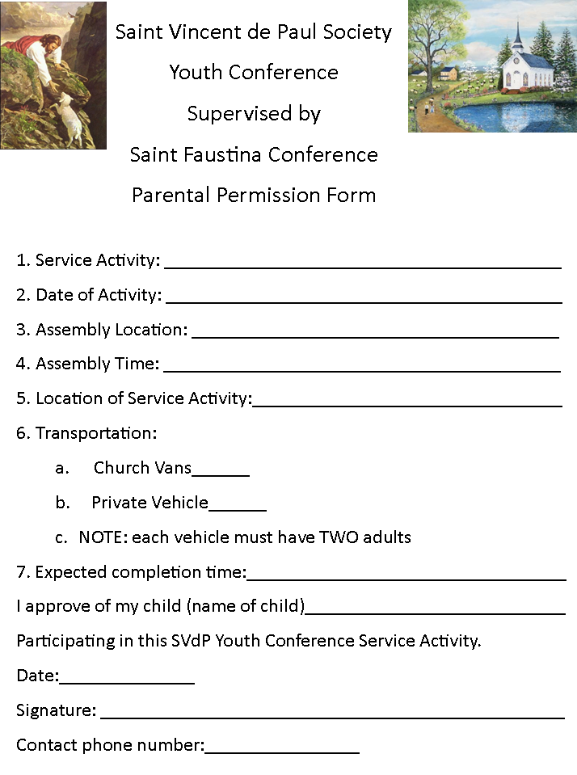

Slide 12
Bulletin Announcement for Saint Patrick Parish
The St Faustina Conference of The Society of St Vincent DePaul is forming a Youth Conference, for students in grades 8 through 12, to share God’s love with those most needy through participation in service projects that aid the poor of our area. Youth Conference members will be guided by adult Vincentians who have been approved by the Arch Dioceses Safe Environment Policy.
Interested families/students should email President of The St Faustina Conference, Dave Scharett.
2wcsctr9@gmail.com.

Slide 13
President’s Report Defer to Friends of the Poor ® Walk

Slide 17
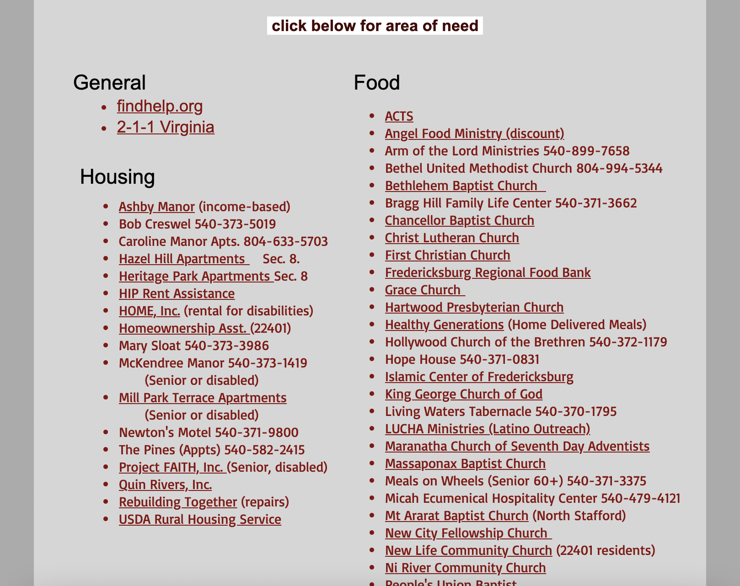

Slide 18
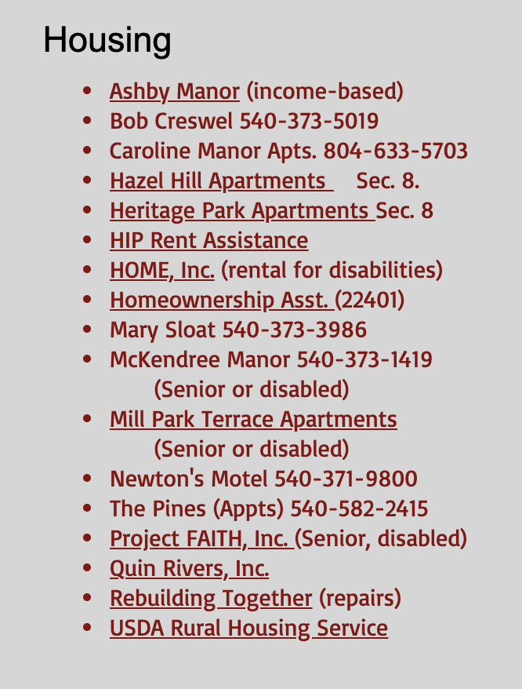

Slide 19
Public Affairs Report: Annie Mason
Public Affairs activities/issues to report
Updated conference website

Slide 20
Friendly Visitations
Updates on the Friendly Visitations Ministry: Amy Whittaker and Ann Ellis
Training

Slide 21
Secretary’s Report: Amy Whittaker (Laura)
Open Old Business from prior meeting
Student scholarship’s Certificate have been updated to reflect name change and honorees
Approval of Prior Meeting Minutes
The next Conference Spiritual Meeting will be Saturday, July 10th at 9:30 am In Person and via ZOOM

Slide 22
New Business: open to all members

Slide 24
Closing Prayer & Spiritual Advice: Father Eversole

