Slide 1
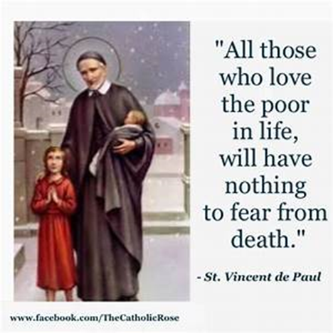
St Faustina Conference Saint Vincent de Paul Society
Spiritual Meeting
1 May 2021

Slide 2
Agenda
TIME | EVENT | SPEAKER
9:30 AM | Meeting called to order by President | Dave Scharett
9:31 AM | Welcoming our New Members: Andi and Bonnie | All Members
9:32 AM | Roll call by Secretary | Amy Whittaker
9:33 AM | Opening Prayer & The Lord’s Prayer | Cathy Lee
9:36 AM | Spiritual Advisor’s Presentation | Father Eversole
9:46 AM | Treasurer’s Report | Don Carlson
9:50 AM | Home Visitation Report | Dave
10:05 AM | Public Affairs Report | Annie Mason
10:15 AM | Friendly Visitations Report | Amy
10:20 AM | Secretary’s Report | Amy
10:25 AM | New Business | All Vincentians
10:30 AM | Closing Prayer | Father Eversole

Slide 3
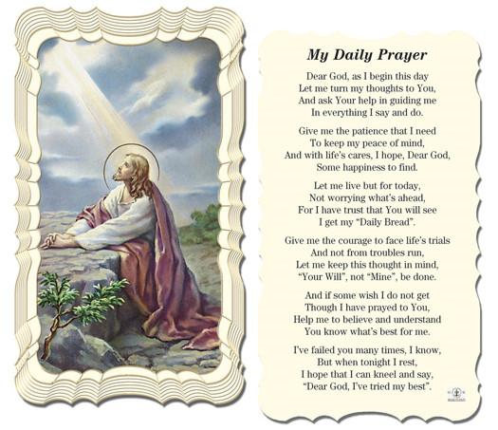
Dear Lord
This Is My Daily Prayer
Followed by
The Our Father
(next slide)

Slide 5
Spiritual Advisor’s Presentation
Father Eversole

Slide 6
Treasurer’s Report: Don Carlson
Current Balance
Balance minus $2000 for Scholarships and $700 obligated by Grants
Bills Paid
Donations
Online donations
Other donations
Other financial issues as appropriate

Slide 7
Home Visitations
Our homeless Neighbor-In-Need HAS obtained a SVdP District Alternative Loan Program loan.
He will finally have a permanent place to live.
Our Bishop Keating Council Knights cleared the right-of-way and area where the trailer will reside.
Over this past year our Saint Faustina Conference members have helped this disabled man in many ways.
We have prayed often, seeking the Lord’s guidance and thanking Him for providing us the means to help this Neighbor-In-Need
Joe Darr is joining the Home Visitation Ministry
E-signature capability: Training on 8 May
Food delivery capability established for special needs
Catholic Charities Emergency Assistance $2000 per caller ends at the end of this fiscal year (June 30th for CC). Assistance will revert to prior levels.

Slide 8
Grants
The Central Virginia Housing Coalition is increasing their assistance for delinquent rent. Michael March is the lead in coordinating this much needed support.
CANDID Learning:
Introduction to Foundation Directory Online webinar 27 April 2021
Foundation Directory Online (FDO) research capability
Funding Information Network by CANDID
FDO Essential Day Pass Guide: No cost!!!
You can find your local Funding Information Network at candid.org/find-us.

Slide 9
The American Recovery Plan Act - Grants
Nobody knows who, what, where, or how….. These tens of billions of dollars are going to be distributed to help those in need.
Federal departments have not formulated process nor procedures
Social Services did not know that they are the ones that will eventually distribute the funds to 501 c 3s
STANDBY……
Oregon Catholic Press (OCP) has opened the application process for its annual Parish Grants Program. “Our annual grants program demonstrates OCP’s commitment to assist Catholic faith communities across the nation to enhance their liturgy and worship.” "expanding educational and charitable outreach“ deadline, May 30, 2021, at www.ocp.org

Slide 10
Public Affairs Report: Annie Mason
Public Affairs activities/issues to report
Any further update on Walk-For-The-Poor
E-signature capability training

Slide 11
Friendly Visitations
Updates on the Friendly Visitations Ministry: Amy Whittaker and Ann Ellis

Slide 12
Secretary’s Report: Amy Whittaker
Open Old Business from prior meeting
GRANT WRITING!!!
Student scholarships status if not already discussed
Approval of Prior Meeting Minutes
The next Conference Spiritual Meeting will be Saturday, May 15th at 10:00 am via ZOOM

Slide 13
New Business: open to all members

Slide 14
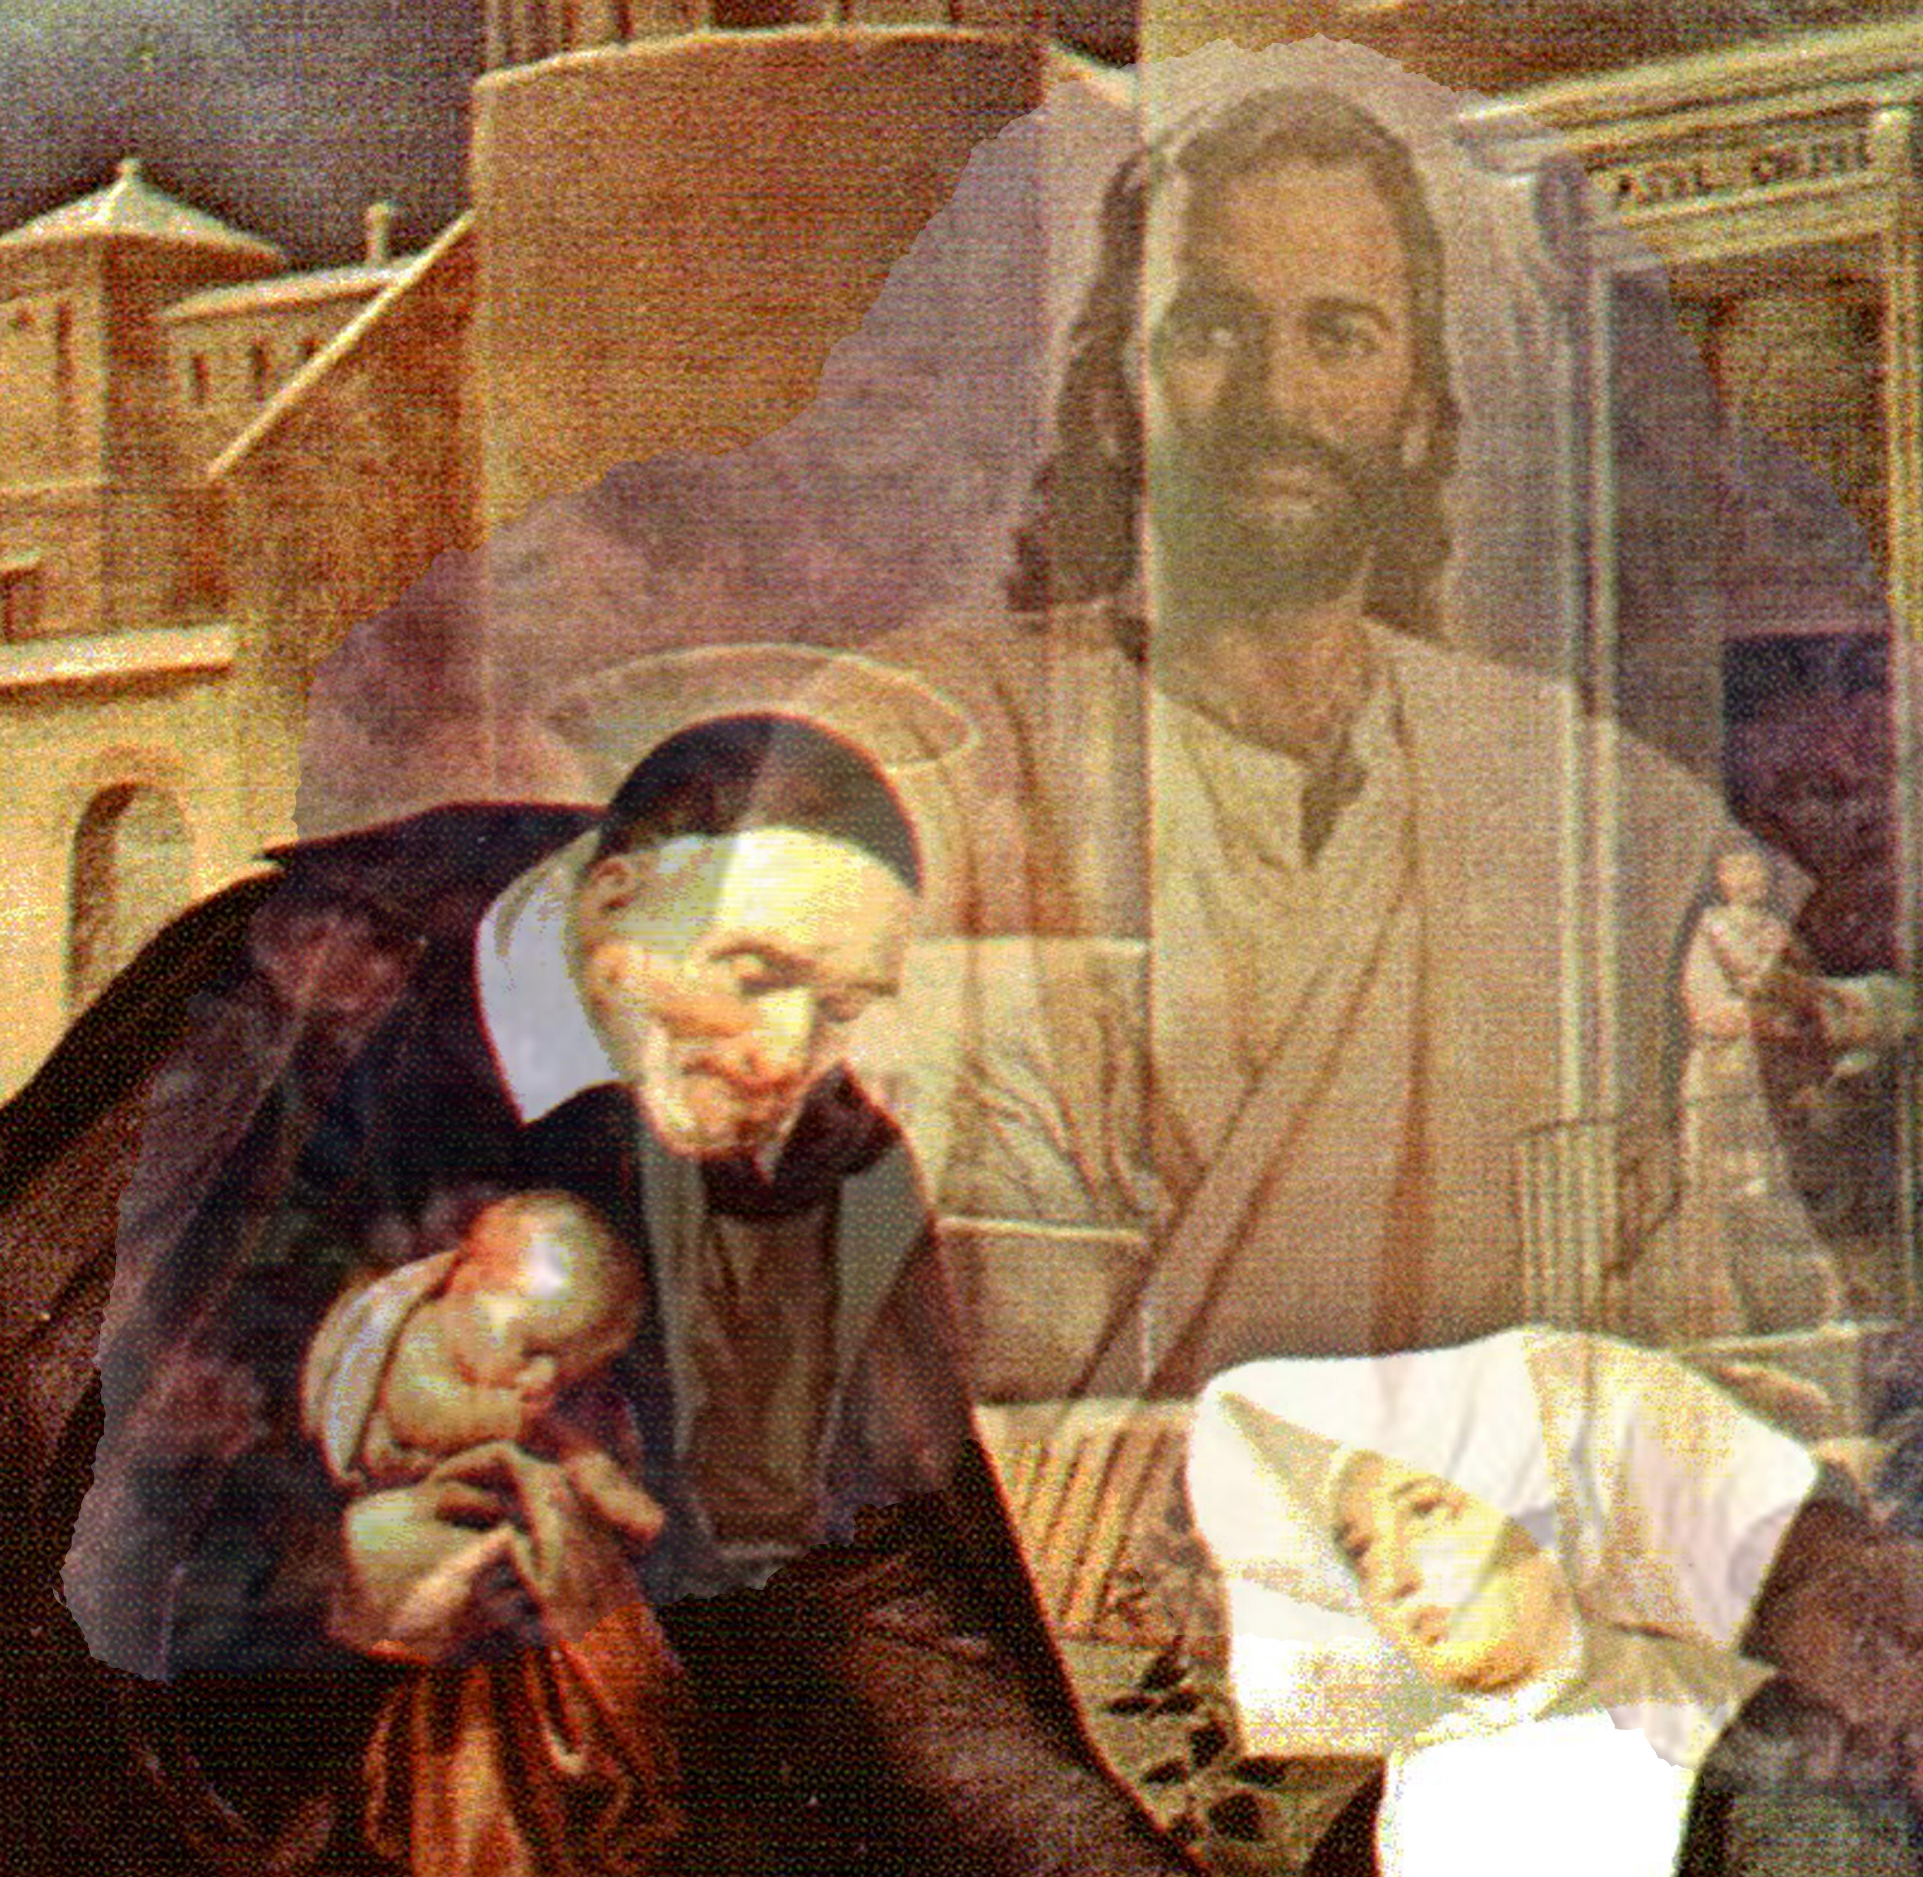
Closing Prayer & Spiritual Advice: Father Eversole

