Slide 1
St Faustina Conference
Saint Vincent de Paul Society
Conference Spiritual Meeting
7 November 2020

Slide 2
Agenda
Time | Event | Speaker
9:00 AM | Meeting call to order by the President | Dave Scharett
9:01 AM | Roll call by Secretary | Amy Whittaker
9:05 AM | The Lord’s Prayer | John Tighe
9:10 AM | The context of Saint Vincent de Paul’s passion for helping the poor | Father Eversole
9:20 AM | Reflections of The Rule, PART I: Purpose and Scope of Our Service; Rules 1.2 through 1.5 by the President | Dave Scharett
9:35 AM | Home Visitations in the Age of COVID 19 | Lillian Fay, Ann Ellis, John Tighe
9:40 AM | President’s Report | Dave Scharett
9:45 AM | Public Affairs Report | Annie Mason
9:50 AM | Treasurer’s Report | Don Carlson
9:52 AM | Secretary’s Report | Amy Whittaker
9:54 AM | New Business | Dave Scharett
9:58 AM | Reflections of a Vincentian | Laura Morris
9:59 AM | Closing Prayer | Father Eversole

Slide 3
The Rule, Part III, Statutes
The objective of these Statutes is to:
help nurture Vincentian Spirituality
Enhance the relationship among members
Enrich Vincentian service to those in need
Statute 1: The Essential Elements
The Essential Elements of the Society of St. Vincent de Paul are
Spirituality [faith]
Friendship
Service

Slide 4
The Rule, Part III, Statutes (continued)
Statute 2: Cultural Beliefs
Spiritual Growth
One Society
Servant Leaders
Today’s Society
Embrace Accountability
Inclusive Planning
Advocate for Justice
Your reflections on any either of these Statutes……….

Slide 5
Discussion of Home Visitations
Recent Cases or Cases that emphasize the impact of Home Visits on families:
Lillian Fay, Ann Ellis, John Tighe

Slide 6
President’s Report
Status of 2 new Conference Ministries
  SVdP Youth Conference update: Cathey Lee and Dave
  Cherished Souls Ministry Update: Amy Whittaker, Ann Ellis, Aliena Otal
@ $1600 in Conference Administrative Costs Shed
  State Farm Insurance Policy for Breezewood Pantry $456 canceled
  Electronic DropBox $1200 software terminated
Grant Writing being explored in detail: Society and CARES Grants
Conference Membership: 16 Vincentians, 15 Associate Vincentians and 2 Vincentians on a 1-year excused status

Slide 7
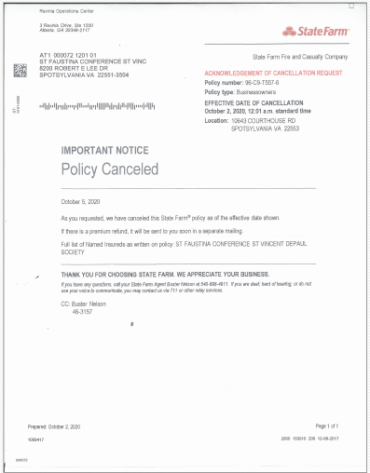

Slide 9
Public Affairs Officer’s Report: Annie Mason
Updates and Refurbishment of Conference website
  New and realigned Ministries
  New Format
  Members Only Section Replaces Drop Box
    Meeting Minutes
    Conference Bylaws
    Blank Forms Used by Conference
    Possibly Training Presentations
  New Online Donation Capability: Already received $500

Slide 10
Treasurer’s Report: Don Carlson
National Report status.
IRS Tax Return upcoming
Receipts, Receipts, Receipts: The key to tracking expenditures!!!
Donations, Donations, Donations: Of all kinds must be reported to the Treasurer
Bank Account status:
  Balance
  Month’s Expenditures to Date

Slide 11
Secretary’s Report: Amy Whittaker
Prior meeting minutes approved
Old Business from last meeting

Slide 12
New Business
Does any member have a new business to present?
The Next Spiritual Meeting will be on 7 November at 9:00 AM via ZOOM

Slide 13
Closing Reflections of a Vincentian

Slide 14
Society’s Closing Prayer
Father Eversole’s Closing Prayer
  Please pray for our Vincentians

