Slide 1
St Faustina Conference Saint Vincent de Paul Society
Spiritual Meeting
17 April 2021

Slide 2
Agenda
TIME | EVENT | SPEAKER
10:00 AM | Meeting called to order by President | Dave Scharett
10:01 AM | Welcoming our New Members: Andi and Bonnie | All Members
10:02 AM | Roll call by Secretary | Amy Whittaker
10:03 AM | Opening Prayer & The Lord’s Prayer | Cathy Lee
10:06 AM | Spiritual Advisor’s Presentation | Father Eversole
10:16 AM | Treasurer’s Report | Don Carlson
10:20 AM | Home Visitation Report | Dave
10:21 AM | The American Recovery Plan Act - Grants | Dave
10:31 AM | Public Affairs Report | Annie Mason
10:40 AM | Friendly Visitations Report | Amy
10:45 AM | Secretary’s Report | Amy
10:50 AM | New Business | All Vincentians
10:55 AM | Closing Prayers: A Student’s Prayer & Father’s Prayer | Dave & Father Eversole

Slide 3
Welcome Our New Members
Andria “Andi” Mullen
Bonnie Webber

Slide 4
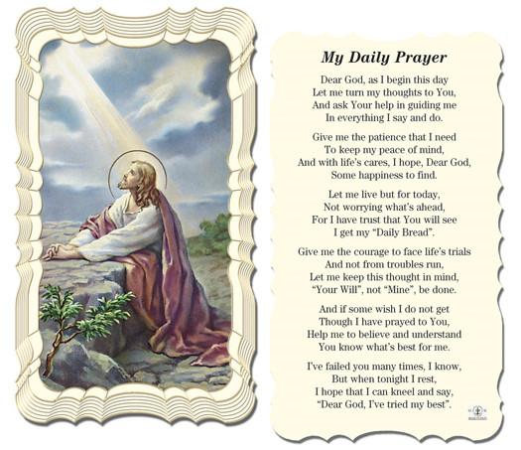
Dear Lord
This Is My Daily Prayer
Followed by
The Our Father
(next slide)

Slide 6
Spiritual Advisor’s Presentation
Father Eversole

Slide 7
Treasurer’s Report: Don Carlson
Current Balance
Bills Paid
Donations
Online donations
Other donations
Other financial issues as appropriate

Slide 8
Home Visitations
1. Paperwork has been filed for a SVdP District Alternative Loan Program loan for a Neighbor-In-Need. If this loan is approved by District, then this Neighbor-In-Need will finally have a permanent place to live.

Slide 9
The American Recovery Plan Act - Grants
1. The Central Virginia Housing Coalition is increasing their assistance for delinquent rent. Michael March is the lead in coordinating this much needed support.
Rental
The latest $1.9T Federal American Recovery Plan Act (FARPA) contains $21.6 billion in emergency rental assistance and more for utilities and food. Funds will be administered by the individual States through grants. Saint Faustina will be applying for one or more of these grants to directly support those in need/affected by COVID 19.
Members of the Conference attended a SVdP National Council Webinar AND a Virginia Rent Relief Program (RRP) Webinar on the American Recovery Plan Act re SVdP Webinar the Virginia Rent Relief Program Webinar.
Utilities
1. The FARPA also provides $4.5 billion for the Low-Income Home Energy Assistance Program (LIHEAP) to help households with utility assistance, as well as $500 million specifically for low-income households with excessive water and wastewater bills/arrearages. Water assistance will be administered through the income-based programs at local water departments.

Slide 10
The American Recovery Plan Act - Grants
Responses from 1st and 7th Congressional Districts
1st District: Below is the grant information that I think will fall into the categories you are looking for. The grants will be administered by the corresponding executive branch agency. Hope this is helpful.
Coronavirus (COVID-19) Grant Opportunities and Guidance | HHS.gov
CPD COVID-19 Homeless Emergency Solutions Grants (ESG) | HUD.gov / U.S. Department of Housing and Urban Development (HUD)
Coronavirus | HUD.gov / U.S. Department of Housing and Urban Development (HUD)
Loans and Grants | USDA
CRRSAA: Higher Education Emergency Relief Fund II (HEERF II)
b. 7th District: Similar but verbal: contact HUD, USDA and FEMA
A very interesting email comment sent to me from another Conference in our SVdP District.
“In brief, seeking grants from the state or FEMA are beyond our reach UNLESS
you are willing to hire people to administer and do accountability. We are 100
percent volunteer, like you, and we have no intention of being an organization
that does more than money in, money out. Our overhead is near zero.”
This Conference has extensive experience in grants.

Slide 11
The American Recovery Plan Act - Grants
Contacted our Spotsylvania County Social Services Office to see if they know how Virginia is going to disperse FRAPA funding. They were not aware that Social Services had any role in this. However, they stated that they would research this and call us back.
Oregon Catholic Press (OCP) has opened the application process for its annual Parish Grants Program. “Our annual grants program demonstrates OCP’s commitment to assist Catholic faith communities across the nation to enhance their liturgy and worship.” "expanding educational and charitable outreach“ deadline, May 30, 2021, at www.ocp.org

Slide 12
Public Affairs Report: Annie Mason
Public Affairs activities/issues to report
Any further update on Walk-For-The-Poor

Slide 13
Friendly Visitations
Updates on the Friendly Visitations Ministry: Amy Whittaker and Ann Ellis

Slide 14
Secretary’s Report: Amy Whittaker
Open Old Business from prior meeting
GRANT WRITING!!!!
Approval of Prior Meeting Minutes
The next Conference Spiritual Meeting will be Saturday, May 1st at 9:30 am via ZOOM

Slide 15
New Business: open to all members
Student scholarships if not already discussed
Any other new business
The Quarterly District Council meeting is tomorrow; Sunday April 18^{th.}
^{SVDP Council Spring Meeting}
Time: Apr 18, 2021 01:00 PM Eastern Time (US and Canada)
^{Join Zoom Meeting}
https://us02web.zoom.us/j/81670020477

Slide 16
Reflect Upon The
Difficulties of Our Children as They Attempt to Learn in this Age of COVID
Lord

Slide 17
Closing Prayer & Spiritual Advice: Father Eversole

