Slide 1
Saint Vincent DePaul Society Saint Faustina Conference
The Call For Help

Slide 2
Saint Faustina Conference
Thankful to have new members
Families in St Matthew & St Patrick Parishes are in need of our assistance
How do we learn about their needs?
Assistance Line
How do we respond to their needs?
Home Visitations

Slide 3
The Call for Help
Conference
Interview
Form
Catholic Charities
Interview
Form
Copy of
Delinquent Bill
● Utility
● Rent
●Mortgage
Cutoff Notice
Eviction Notice
Lease Agreement
Loan Agreement
● Section 8 Housing?
Photo ID
Proof of Income
IRS Form W-9
Referral
Home
Visitation
Team Decision
Email
Case Closed
Assistance
Not Provided
Provide
Assistance
Conference Utility Company
Pledge
Contact Landlord or Mortgage Company
Conditional
Pledge
Case Closed
Emergency
Assistance
Schedule Home Visit
Email
Email
Catholic
Charities
Submit Pledge Form to Conference Assistant Treasurer
Email
Email
Submit Catholic Charities Interview Forms as required
Dominion Power
Home
Visitation
Case Closed
REC
Spotsylvania County

Slide 4
The Call for Help
Conference
Interview
Form
Catholic Charities
Interview
Form
Copy of
Delinquent Bill
● Utility
● Rent
●Mortgage
Cutoff Notice
Eviction Notice
Lease Agreement
Loan Agreement
● Section 8 Housing?
Photo ID
Proof of Income
IRS Form W-9
Submit Catholic Charities Interview Forms as required
Referral
Home
Visitation
Call Catholic Charities OR Utility Co For Pledge Status
Team Decision
HV Team Assigned OR
CC Interview scheduled
Email
Case Closed
Assistance
Not Provided
Provide
Assistance
Conference Utility Company
Pledge
Contact Landlord or Mortgage Company
Conditional
Pledge
Case Closed
Home Visit
Scheduled
Emergency
Assistance
Schedule Home Visit
Email
Email
Catholic
Charities
Submit Pledge Form to Conference Assistant Treasurer
Email
Email
Submit Catholic Charities Interview Forms as required
Dominion Power
Home
Visitation
Case Closed
REC
Spotsylvania County

Slide 5
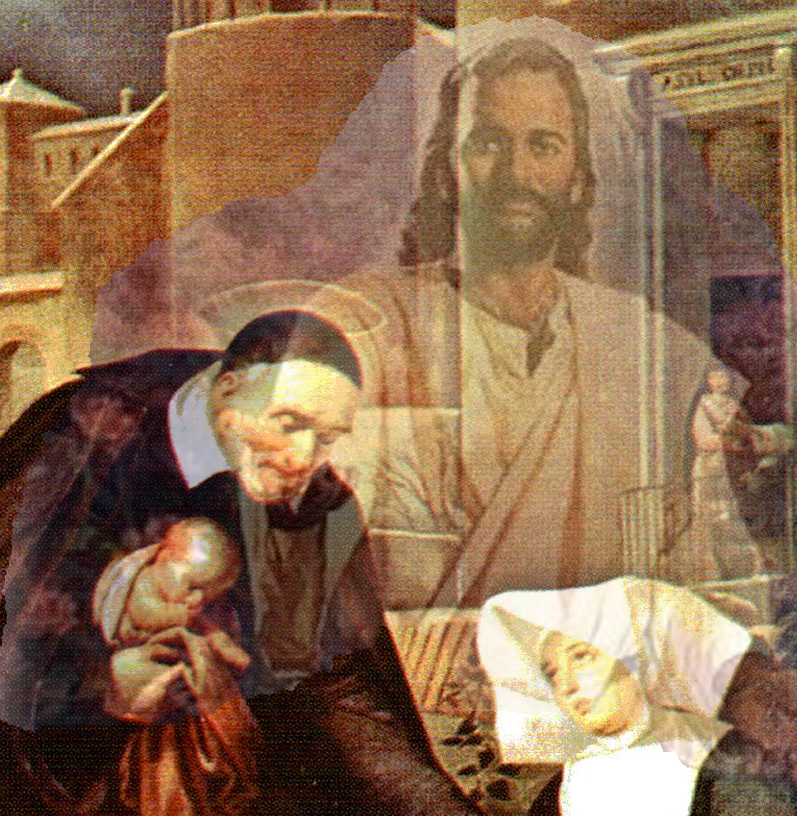
Welcome To The World of Vincentians
Dedication to Christ

