Slide 1
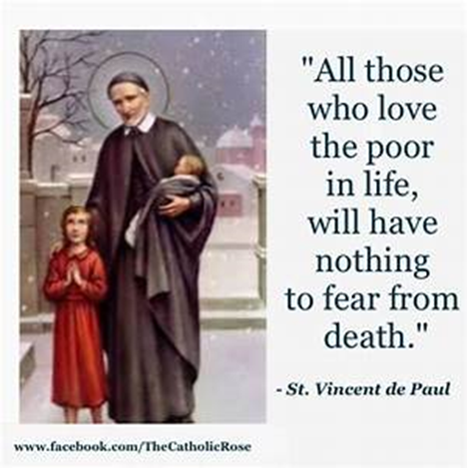
St Faustina Conference
Saint Vincent de Paul Society
Spiritual Meeting
6 March 2021

Slide 2
Agenda
TIME | EVENT | SPEAKER
9:30 AM | Meeting called to order by President | Dave Scharett
9:31 AM | Roll call by Secretary | Amy Whittaker
9:05 AM | Opening Prayer & The Lord’s Prayer | Cathy Lee
9:10 AM | Spiritual Advisor’s Presentation | Father Eversole
9:20 AM | Treasurer’s Report | Don Carlson
9:25 AM | Home Visitation Report | Dave
9:30 AM | President’s Report | Dave
9:40 AM | Public Affairs Report | Annie Mason
9:45 AM | Secretary’s Report | Amy
9:50 AM | New Business | All Vincentians
9:57 AM | Closing Prayers | Laura Morris & Father Eversole

Slide 3

Dear Lord
This Is My Prayer
Followed by
The Our Father
(next slide)

Slide 4
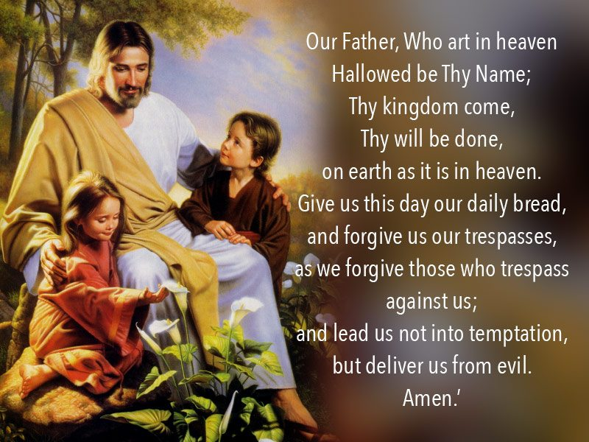

Slide 5

Spiritual Advisor’s Presentation
Father Eversole

Slide 6
Treasurer’s Report: Don Carlson
Current Balance
Bills Paid
Online Donations
Note that in our February Monthly Report we had $9,200 in our account and that we had basically $9,000 in Grants and Donations. Had we not received those Grants and Donations in February we would have had $200 in our banking account.
Other financial issues as appropriate

Slide 7
Home Visitations
1. The Assistance Line handled 52 calls; 14 calls were repeats; and 20 calls were passed on to be processed.
2. The Home Visitation Team worked 36 cases in February. 16 were open cases from prior months.
3. Assistance was provided to 9 families;
a. 5 families received utility bill assistance;
b. 4 families received assistance with medicine, transportation, vehicle repairs, food, and vehicle fuel;
4. 23 cases were closed; 13 cases are work in-progress. SFC SVdP paid a total of $5,105.99 in support for Neighbors-In-Need in February 2021.
5. The Catholic Charities Emergency Assistance Office paid $1500 and have pledges of $650 during February 2021.
We are encountering 3 categories of Neighbors-In-Need (Keep this in mind for our closing prayer)
  Elderly living alone on a fixed income
  Families with a large number of children where at least one parent has lost their job
  Families where both parents have lost their jobs due to COVID
We are trying to identify job fairs, job websites and any other source of potential jobs to better serve our Neighbors-In-Need
Receiving more Conference website calls for assistance
The other severe issue is heating with electricity!!! The MOST expensive way to heat.
  a. $400 to $500+ monthly electrical bills

Slide 8
President’s Report
Formation of the Saint Faustina Conference’s Education Ministry.
“Education is a pathway out of poverty”
Our District Council and The National Council support this Saint Faustina Conference endeavor
  Committee Members
    Cathy Lee: Public School Teacher/Principal 42 years, Masters Degree in Educational Administration, Post Masters Certificate
    Dr. John Morris: PhD in Education, Director E-Learning American Military University
    Annie Mason: Manager of the Conference’s Highschool Scholarship Program, Masters Degree, Teacher 14 years, taught in Maine and wrote the district curriculum for art
    Laura Morris: Master of Education in Secondary Education, served on numerous universities as a full time and adjunct instructor, co-created curriculum for American Military University
    Don Carlson: American expert in advanced communications
    Dave Scharett: Region 16 STEM Council, Adjunct Professor Saint Leo University, guest lecturer Penn State University, Virginia State SkillsUSA Chairman of Engineering Evaluations, guest speaker in Spotsylvania and Stafford County Schools
  The Education Committee has developed an initial DRAFT Mission Statement, developed specific Action Items, and assigned specific Vincentians that are responsible for completing the actions
  Basic Concept
    The Assistance Line callers currently provide family demographics as a part of the Home Visitation Interview.
    A Home Visitation qualified Vincentian will review completed interview forms for children of Elementary School age and filter information for the Education Ministry.
    The identified families will be contacted by the Education Ministry. Is their child falling behind their peers academically? Grade level and subject will be identified: Math, English, History (civics), Science, Reading, etc.
    If the parents express a desire to have us assist their child with additional mentoring, then the Education Ministry assigns an appropriate mentor from their list of mentors.
    Appropriate Virginia SOLs are downloaded, learning materials such as workbooks are ordered, and the education mentor makes contact with the family to arrange for the mentoring.
    Provide either one-on-one OR small group sessions (IAW COVID Protocols) to assist the children in comprehending the course of study (Virginia SOLs) and “catch up” with their fellow students
    Assistance may be virtual or in person within COVID 19 health guidelines
    Possibility of using one or more of the classrooms at the Marshall Center

Slide 9
May we humbly acknowledge the Lord’s Blessings in providing us the resources needed to help our Neighbor’s-In-Need
Not Least of Which Is the Support of our Priest and the Parish
2. District Council Webinar (via ZOOM) on Grants WAS Tuesday, Feb 23rd at 7:00 pm
Moderated by Paul “Korky” Korkemaz
Saint Faustina represented by our successful Grant writing TEAM
  Cathy Lee, Annie Mason, Don Carlson, Dave Scharett
We DID learn a lot from the other Conferences that have received other types of Grants.
As a result, a “Case Statement for The Saint Faustina Conference” has been developed for use in future Grant applications. (Cathy)
We learned of specific websites and Grant databases that we should go to in finding Grants appropriate for the needs of our Conference.

Slide 10
Public Affairs Report: Annie Mason
Public Affairs activities/issues to report

Slide 11
Secretary’s Report: Amy Whittaker
Open Old Business from prior meeting
  Easter “Basket” Prep March 26th, 1-3pm at the Conference Room.
  Drive-up Distribution March 27th, 10am – Noon in front of the Parish Center
Approval of Prior Meeting Minutes
The next Conference Spiritual Meeting will be Saturday, March 20th at 10:00 am via ZOOM

Slide 12
New Business: open to all members
1. Saint Matthew Women’s Guild now supporting SFC Santa’s Sack Ministry
2. Other New Business???

Slide 13
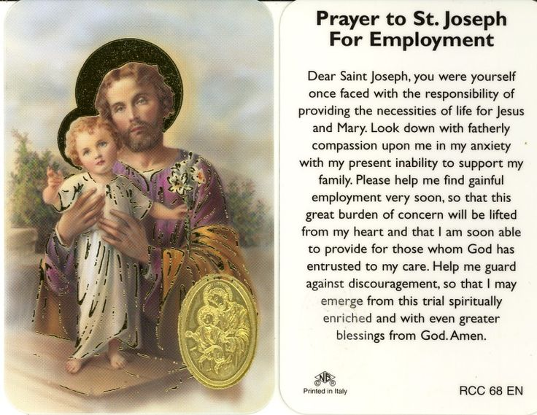
Reflect Upon Our Neighbors-In-Need
Who Desperately Need Jobs

Slide 14
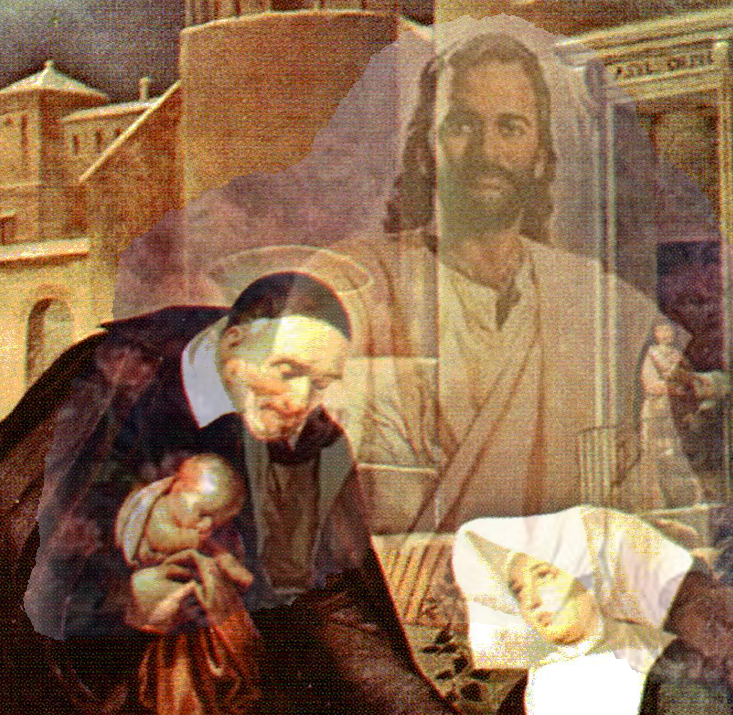
Closing Prayer & Spiritual Advice: Father Eversole

