Slide 1
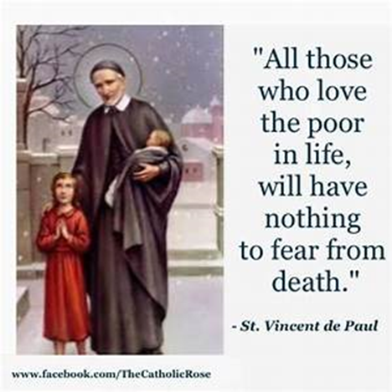
St Faustina Conference Saint Vincent de Paul Society
Spiritual Meeting
14 August 2021

Slide 2
Agenda
TIME | EVENT | SPEAKER
9:30 AM | Meeting called to order by President | Dave Scharett
9:31 AM | Roll call by Secretary | Amy Whittaker
9:32 AM | Opening Prayer & The Lord’s Prayer | Dave
9:36 AM | Spiritual Advisor’s Presentation | Father Eversole
9:46 AM | Treasurer’s Report | Don Carlson
9:50 AM | Public Affairs Report | Annie Mason & Cathy Lee
9:55 AM | President’s Report | Dave
10:10 AM | Friendly Visitations Report | Dave
10:15 AM | SVdP Youth Conference | Cathy
10:20 AM | Secretary’s Report | Amy
10:25 AM | New Business | All Vincentians
10:30 AM | Closing Prayer | Father Eversole

Slide 3
PRAYER TO ST. JOSEPH FOR ONE’S FAMILY
Joseph, strengthen in our family every bond of love which unites us --
the marriage bond, the love of parent and child, the bonds of mutual love between all.
Joseph, protect our family from every danger from without and from every threat to peace, unity, and harmony within.
Joseph, teach us to be kind and loving towards one another, careful for one another, tolerant of one another, forgiving towards one another.
Joseph, may contentment with our lot and joy in each other abound in our house, as we seek faithfully to serve and greatly to love God.
Joseph, be you yourself a father towards the family of ours,
and pray Mary be a mother to us.

Slide 5
Spiritual Advisor’s Presentation
Father Eversole

Slide 6
Treasurer’s Report: Don Carlson
Current Balance
Bills Paid
Donations
Online donations
Other donations
Other financial issues as appropriate

Slide 7
Public Affairs Report: Annie Mason
Public Affairs activities/issues to report
Friends of the Poor ® Walk
We need volunteers for:
Registration table
Walking Course set up
SVdP Membership Recruiting
T-shirt distribution to walkers
Signage
Other???
svdpstfaustina.org

Slide 8
President’s Report
7 MAJOR EVENTS
Friends of the Poor ® Walk September 18th
Annual Conference Audit Sept/Oct
Coffee & Donuts Sunday October 3rd
Coats-to-Go October 16th
Thanksgiving Dinners November 19th
Coffee & Donuts Sunday December 5th
Santa’s Sack December 16-18th

Slide 9
President’s Report
Annual Conference Audit:
Financial Audit: Parish Office,
Operational Audit: Cathy Lee and Dave
Coffee & Donut Sundays
Starting on October 3rd
Order donuts on Thursday, September 30th
Melissa Miller is checking on the best deal we can get
Sign out Parish Center key: Friday. Dave
Pick up donuts (they may be delivered), juice boxes, two quarts of coffee creamer Sunday Morning at 7:00am
Need to set up tables: Saturday.
Ensure that icemaker is turned on: Saturday. Dave
Put out SFC placemats: Sunday morning early. Need volunteers, Lilian, Danya, …..
Make coffee: Sunday morning very early. Dave responsible
Get ice from icemaker and ice down bottled water: Saturday morning early. Need volunteers
Set up the slide videos and TEST!!!! Saturday: Jared, Dave, and John Morris
SFC Slides for TVs: Dave responsible

Slide 10
President’s Report
Coats-To-Go (SFC; Bishop Keating, Battlefield and Holy Trinity Councils; MANARC)
NOTIFY Neighbors-In-Need families and Spotsylvania Elementary School Counselor in Sept.
Saturday 16 Oct
8:00am set up tables and signs in parking lot: Volunteers & Mini-Vinnies
Greeter Table and Exit Table
8:30am move coats, hats, scarfs, home essentials from storage at Jim Walsh's basement: John Morris and Knights
Set out coats by size: Volunteers & Mini-Vinnies
9:30am to 11:30am OPEN
11:30 to noon clean up
Signs to be printed in September

Slide 11
President’s Report
Thanksgiving Dinners [pending](same time schedule as prior years) (SFC, Bishop Keating Council, Spotsylvania Elementary, Germanna Community College, St Matthew Pantry)
Friday 19 Nov
40 Dinners: Pick up coolers at Knights’ shed, bagged food at Saint Matthew Pantry, and frozen turkeys at Publix
10 Robert E Lee Elementary: DELIVER 9:30AM (has to be on a school day)
10 Gladys P Todd Academy: DELIVER 10:00AM (has to be on a school day)
10 Great Expectations: DELIVER 10:00AM (has to be on a school day)
10 Emergency Assistance: DELIVER 11:00AM - 1:00PM

Slide 12
President’s Report
Santa's Sack (SFC, Bishop Keating Council, MANARC, St Matthew Women’s Guild)
Notify SFC Neighbors-In-Need Families from SFC List: November: Joanie and Dave
Thursday 16 December - Saturday 18 December
Thursday 16 December move gifts from storage to Parish Center 9:00am -10:00am
Thursday 16 December sort gifts and set up for filling sacks 10:00 am - 12:00pm
Friday 17 December fill Santa's Sack, label sacks, sort sacks by family surname 9:00am - 3:00pm
Saturday 18 December hand out Santa's Sacks (in parking lot) as families arrive 10:00am - 12:00pm

Slide 13
President’s Report
Messages from the Pulpit
Short Pulpit message and bulletin message 1st Sunday of the month
Follow up with a Flyer insert in bulletin 3rd Sunday of the month
September, November, January, March, May, July
September: Winter Coats-To-Go and Thanksgiving Dinners
November: Santa’s Sack
January: “Your Conference - Recruiting
March: Easter and Easter Baskets
May: High School Scholarships
July: Education
As we stand up the new Conference Ministries, we will incorporate their messages: SVdP Youth Conference, Friendly Visitors

Slide 14
Friendly Visitations
Updates on the Friendly Visitations Ministry: Ann Ellis/Dave
Our first Neighbor-In-Need of a Friendly Visitor
Training schedule?
Please include Connie Monastra, Bonnie Webber, Ann Ellis, Alice Foley, Alina Otal, Herman Fletcher, Dave Scharett and Amy Whittaker

Slide 15
SVdP Youth Conference: Cathy Lee
Recruitment will start in September
Stephen Bolas wants his sons to join: Shawn 16 and Daniel 14
Cathy should have the honor of signing up the very first members
Signup flyers need to be printed (30)
Parental Permission Slips for Service Projects need to be printed (100)

Slide 16
Secretary’s Report: Amy Whittaker (Laura)
Open Old Business from prior meeting
Student scholarships certificates be awarded?
Approval of Prior Meeting Minutes
The next Conference Spiritual Meeting will be Saturday, August 28th at 9:30 am In Person and via ZOOM

Slide 17
New Business: open to all members

Slide 18
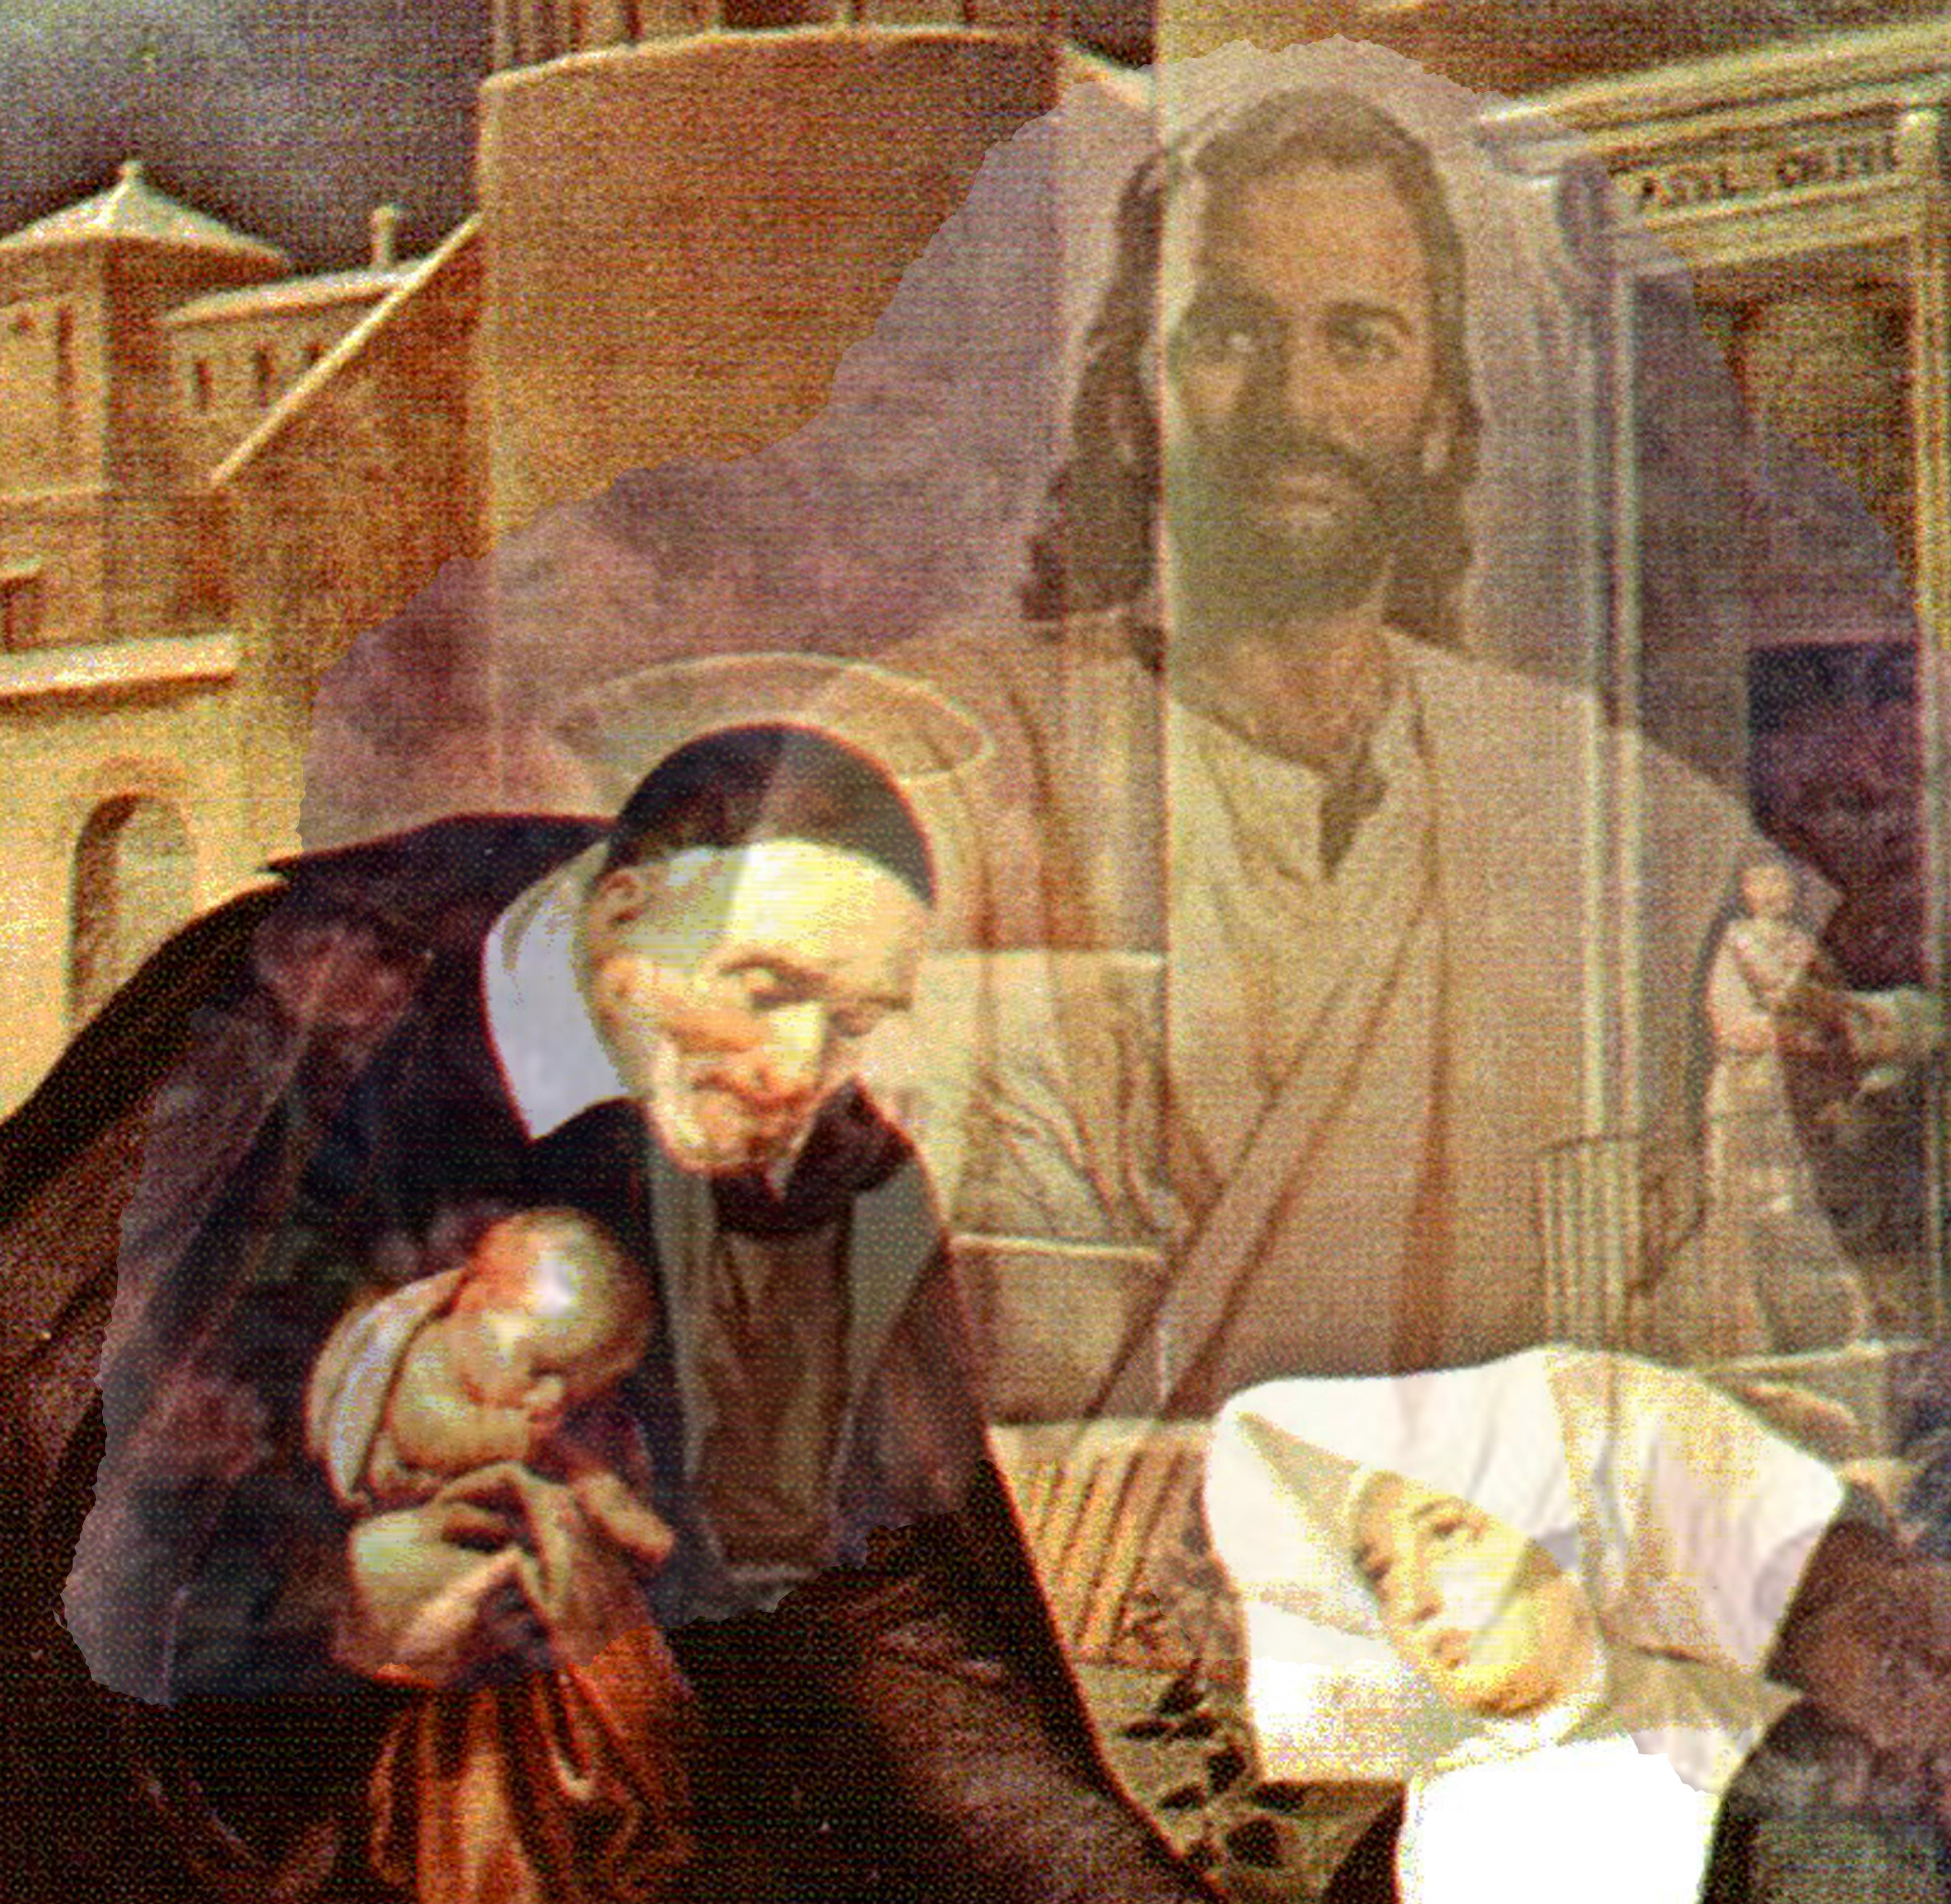
Closing Prayer & Spiritual Advice: Father Eversole

Slide 20
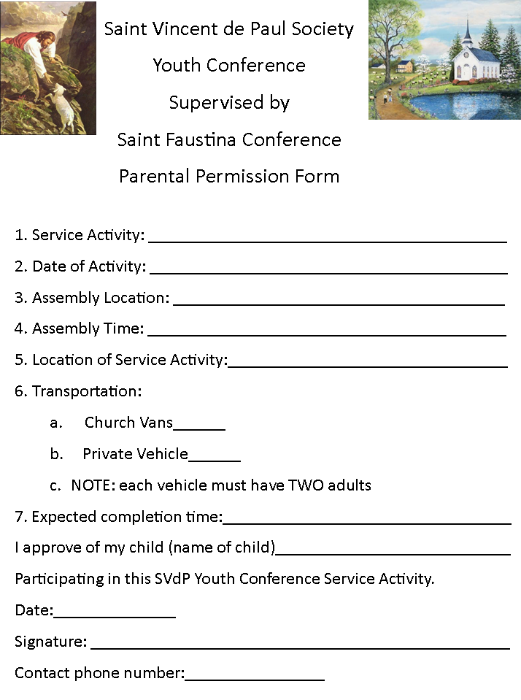

Slide 21
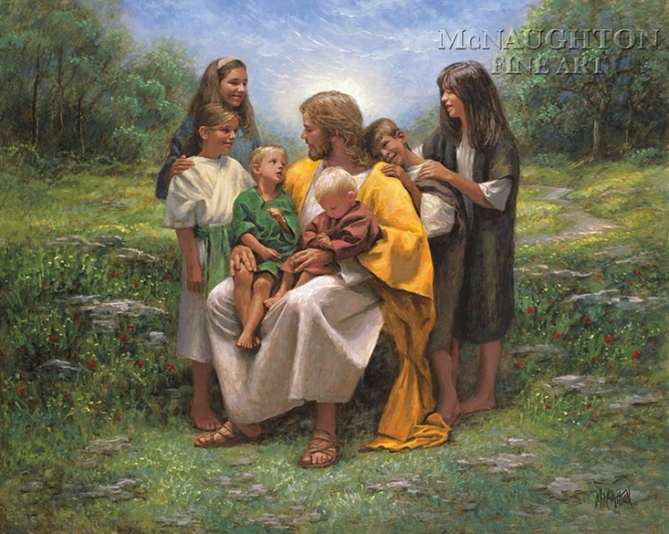
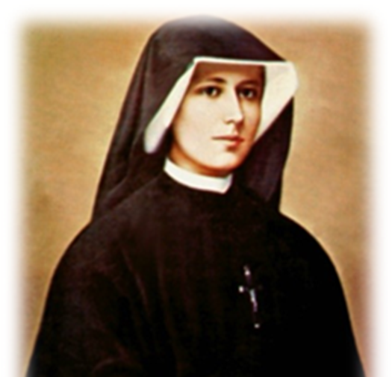
To Find the Lord’s Way
On this day
Let us pray
To find the Lord’s way.
For we have many
Who are in need of plenty.
Lead them to the land of milk and honey.
We gather here to praise You.
Though we seem to be few
We know that through You there is nothing we can’t do.
Lord hear our pray today.
We seek Your love each day.
Help us Lord to find Your way.
In the name of our Lord and Savior, Jesus Christ.
Amen

