Slide 1

Conference Assessments as a Tool for Conference and Council Revitalization
Sunnie Johnson-Lain
St. Vincent de Paul—Cincinnati

Slide 2
Conference Assessments: Nine Criteria to Evaluate Conference Life, Based on the SVDP Rule
  Spiritual enrichment of the conference and its members; ongoing formation
  Meetings
  Stewardship of Conference Funds
  Basic Structure, Organization and Officers
  Making Home Visits
  Accountability and Annual Reports
  Special Works and Twinning (Solidarity)
  Membership and Recruitment
  Parish Relationship

Slide 3
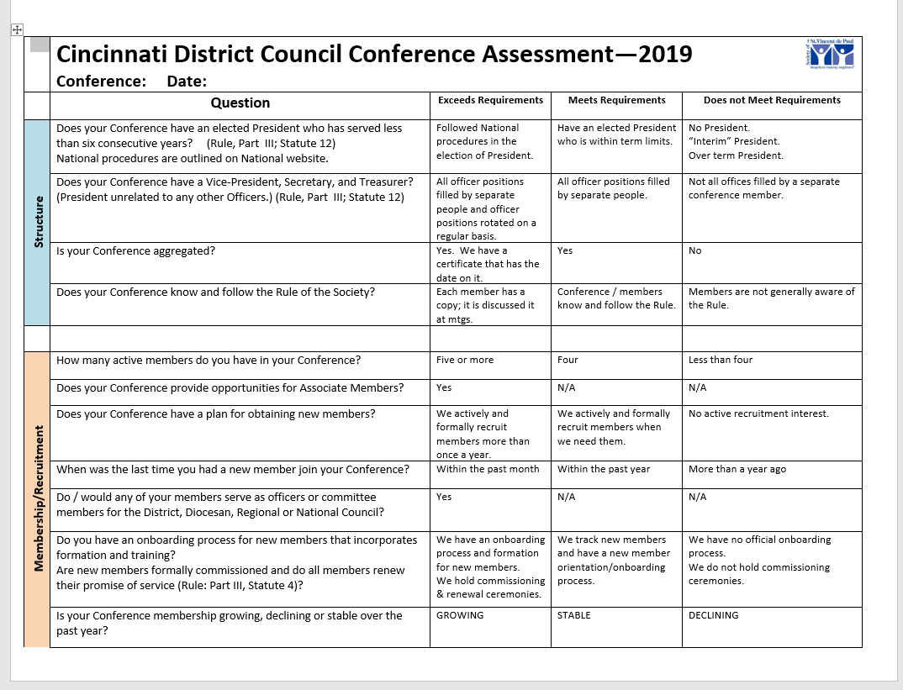

Slide 4
Assessment Process:
  Schedule meeting with Conference President, Director of Conferences and member of Conference Life Committee; go on regularly scheduled Conference meeting day
  Go through assessment with President and CLC member
  Send graded assessment along with a letter to the Conference President with a request for him/her to share it at upcoming meeting in order to start a conversation in the Conference about plans
  Follow up with a visit to the Conference in roughly three months to see how things are going—do they need support to achieve the needed changes?

Slide 6
Conference Level Action Plans for Identified Focus Areas:
  Assessment is a conversation; a tool for the Conference to assess:
    Where it is now
    What is needed
    What unique gifts the Conference has
    What the Conference’s goals/plans are for the future
  Conference uses the completed assessment to begin to vision for the future; some complete a SWOT analysis
  Follow up with a visit with Council representative(s) in three months

Slide 7
Council Level Action Plans for Identified Focus Areas:
Focus Area One: Meetings –Action Plan:
  Discuss possibility of Alternate Second Meeting
  Develop President’s Workshop related to meetings (2015)
  Introduce Bylaws
Focus Area Two: Structure—Action Plan:
  Identify over-term Presidents
  Develop Annual Presidents Workshop
  Develop Workshops for Treasurer and Secretary
  Develop Annual Spiritual Advisor Retreat/Training
Focus Area Three: Home Visits—Action Plan:
  Develop Home Visit Workshop
  Create opportunities for “sharing” home visitors
  Award Conferences making frequent Home Visits
  Develop a culture where Home Visits are expected and valued
Focus Area Four: Twinning/Solidarity—Action Plan:
  Create a mechanism for streamlined Council-wide twinning
  Recognize Conferences who twin regularly
  Create opportunities for Vincentian engagement at Special Works
  Have conversations about hoarding
  Hold Council-wide events

Slide 8
Council Level Action Plan Specific to Revitalization:
Create high quality, easy to use recruiting materials and pathway to recruitment
Annual Recruiting Workshop
Monthly Recruitment and Fundraising Toolkit
Creating a welcoming culture in Conferences (this is the most critical)

