Slide 1
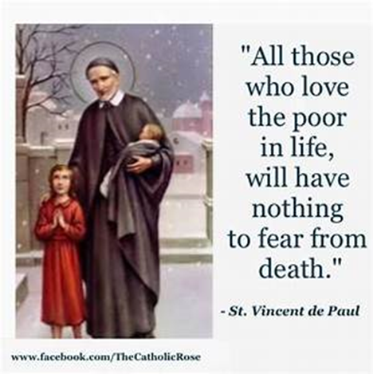
St Faustina Conference Saint Vincent de Paul Society
Spiritual Meeting
6 February 2021

Slide 2
Agenda
TIME | EVENT | SPEAKER
9:00 AM | Meeting called to order by President | Dave Scharett
9:01 AM | Roll call by Secretary | Amy Whittaker
9:05 AM | Opening Prayer & The Lord’s Prayer | Dave Scharett
9:10 AM | Spiritual Advisor’s Presentation | Father Eversole
9:20 AM | President’s Report | Dave
9:30 AM | Public Affairs Report | Annie Mason
9:40 AM | Treasurer’s Report | Don Carlson
9:45 AM | Secretary’s Report | Amy
9:50 AM | New Business | Dave
9:57 AM | Closing Prayers | Laura Morris & Father Eversole

Slide 3
A Prayer
That Strengthens
Our Distressed
Neighbors-In-Need
Followed by
The Our Father
(next slide)

Slide 5
Spiritual Advisor’s Presentation
Father Eversole

Slide 6
Presidents Report
The Saint Faustina Conference has been recognized publicly by the
District Council for its activities to help our Neighbors-In-Need.
Winter Coats
Partnership with KoC Councils, a template for other Conferences to follow
Santa’s Sack
Partnership with MANARC provided added resources to serve needy children
Home Essentials
Template for other Conferences to follow
Easter Baskets with message of the true meaning of Easter
Template for other Conferences to follow
On time submission of National Report
One of three conferences to do so
Initiative to stand up a Youth SVdP Conference (and praised by the National Council)
Template for other Conferences to follow
Ozanam Orientation Training January 13th
National Council’s Friends of the Poor Grant
One of twelve grants Nationwide: There are 4500 Conferences Nationwide
Cathy Lee led the Conference’s effort: THANK YOU!!!!!!!

Slide 7
May we humbly acknowledge the Lord’s Blessings in providing us the resources needed to help our Neighbor’s-In-Need Not Least of Which Is the Support of our Priest and the Parish
2. Friends of the Poor $5,000 Grant: Cathy Lee’s comments
3. Community Foundation of the Rappahannock River Region $1,000 Grant: Annie Mason’s comments
4. Online Donations: Annie Mason’s comments
5. Easter Baskets for our Neighbors-In-Need Children: Laura Morris’ comments
6. Ozanam Orientation Training: 38 attendees, 19 were SFC
SFC now has 20 of their 30 members as fully qualified Vincentians
7. SFC Neighbors-In-Need Database
Thanks to Joanie Goins’ tremendous effort we now have our own list of families in need with their contact information and family demographics
8. The Santa’s Sack Ministry has a wonderful start on next Christmas
Spent @ $1,200 for @ $7,200 worth of gifts that are now in storage (see next slide)

Slide 8
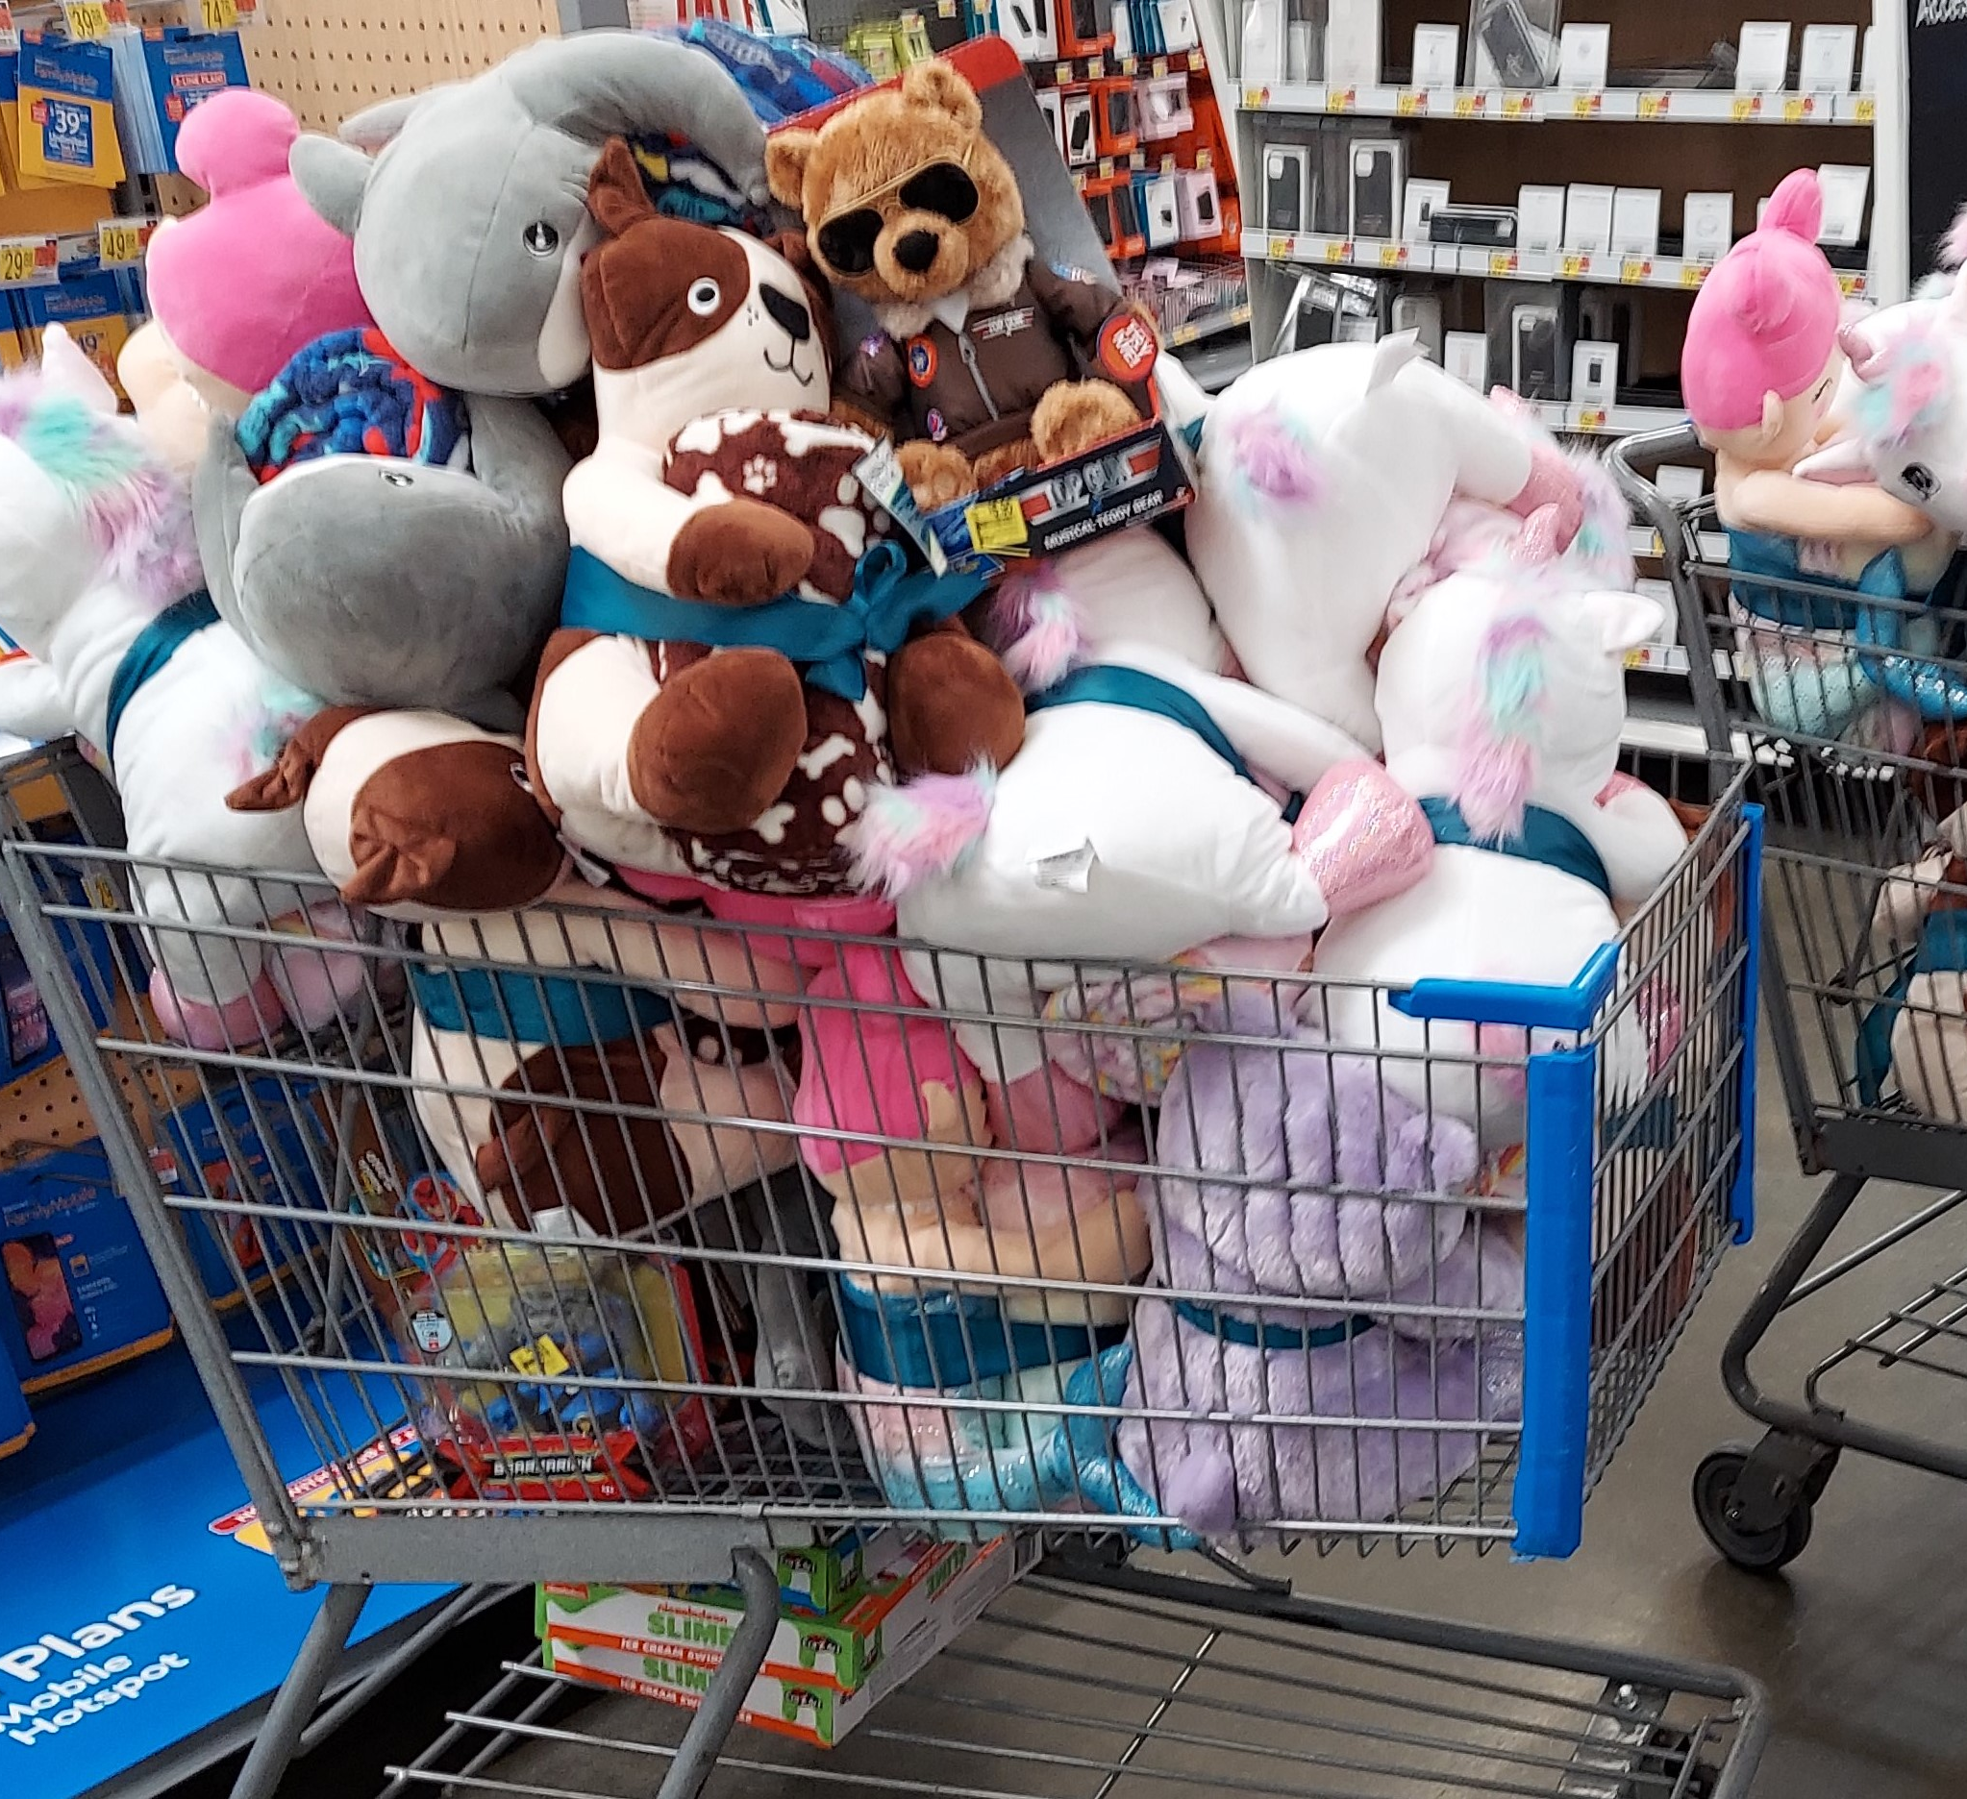
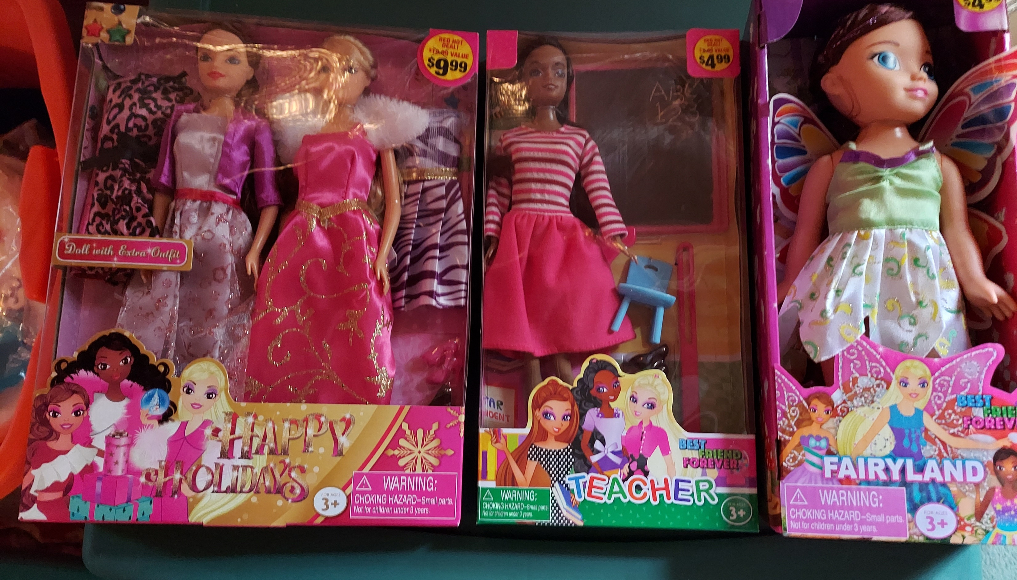

Slide 9
Home Visitations
1. Our Home Visitation Teams worked 26 cases in January
Conference PAID: $2574.78 PLEDGED: $2453.56
Catholic Charities PAID: $1350.00 PLEDGED: $2350.00
2. Four cases of particular note:
A young couple with 5 children under 8 years old: Utility Bill, Car Repair, Food, Phone, Home Essentials, Diapers, Winter Clothes
A single Mom with 6 children: Utility Bills, Food, Home Essentials
A single Mom survived a terrible auto accident: Utility Bills
A Pakistani Catholic Family that fled severe religious persecution and sought asylum in America
3 SVdP Conferences assisting this family

Slide 10
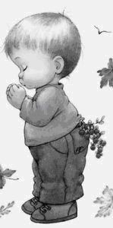
One Neighbor-In-Need Testimonial Three sentences from the heart
“Thank you, thank you, thank you!”
“Thank you for your hard work and your diligence and blessing my family as an advocate for myself.”
“God bless you and those that have been in assistance to My family and I.”

Slide 11
Public Affairs Report
E-signature capability that should be able to support Home Visitations in the age of COVID virus.
Website update
Other activities/issues

Slide 12
Treasurer Report
Current Balance
Bills Paid
Other Information

Slide 13
Secretary Report
Open Old Business from prior meeting
Mail slot at Parish Office --- Father Eversole
Callers have NO computer
Some do not have smart phones
Some do not know how to use their smart phones to send us documents
Approval of Prior Meeting Minutes
The next Conference Spiritual Meeting will be Saturday, Feb 20th at 10:00 am via ZOOM

Slide 14
New Business: open to all members: John Morris
Four new Sandwich Board Signs Purchased
1 paid for by the Parish
1 paid for by the KoC Bishop Keating Council
2 paid for by the Saint Faustina Conference
All are stored in the KoC Shed
White polymer, weatherproof, internal sand weighting, locks in open position
Hold two standard 24” wide by 36” high fiberboard signs

Slide 15
New Business: open to all members
2. Redistribution of child Christmas gifts that families did NOT pick up.
three bags of gifts that we may be able to align with our extremely impoverished Home Visitation families’ children.
3. Draft SVdP Youth Conference SOP
Very basic and IAW National and Church directives and guidance.
National provided a SVdP Youth Conference Handbook.
See Parental Permission Form on next slide
4. Other New Business???

Slide 16
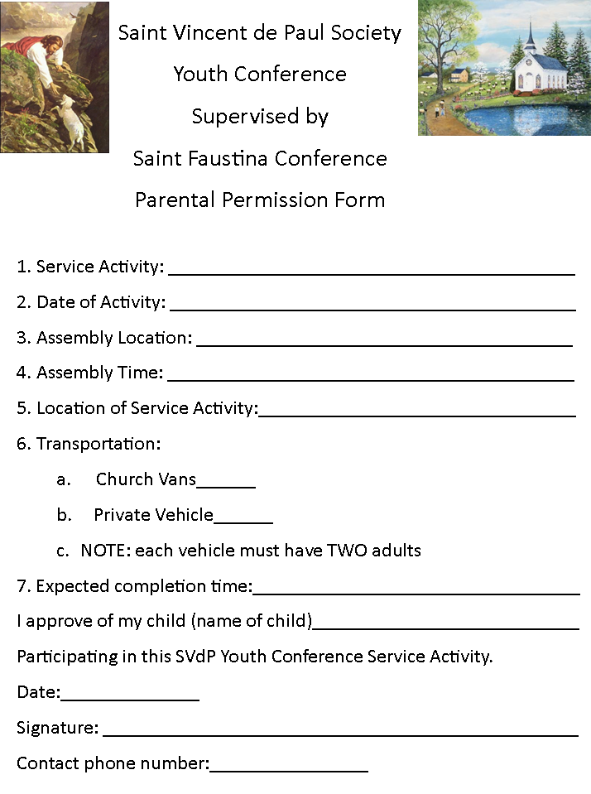

Slide 17
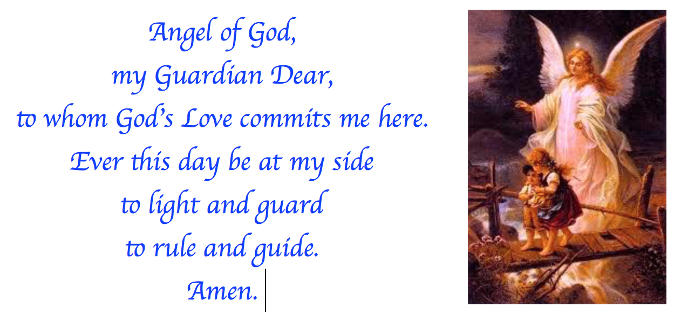
Reflect that our Guardian Angel is with us throughout our life: Laura Morris

Slide 18
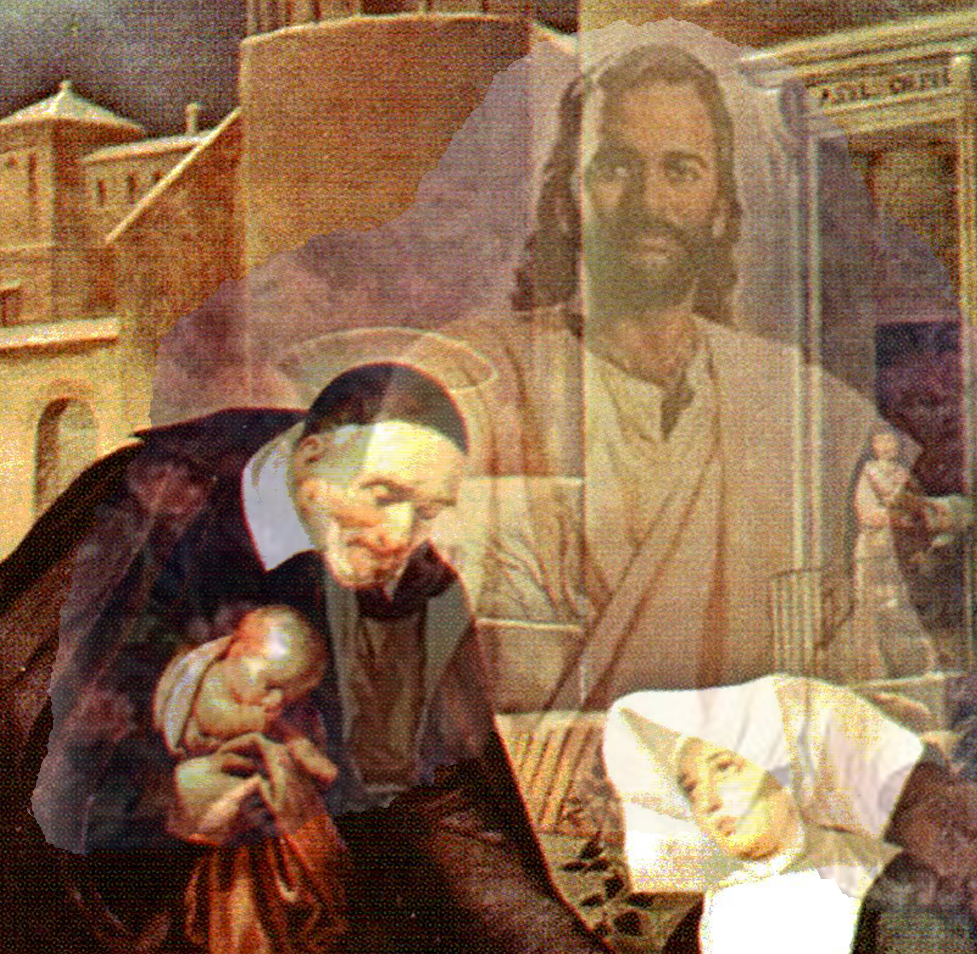
Closing Prayer & Spiritual Advice: Father Eversole

