Slide 1
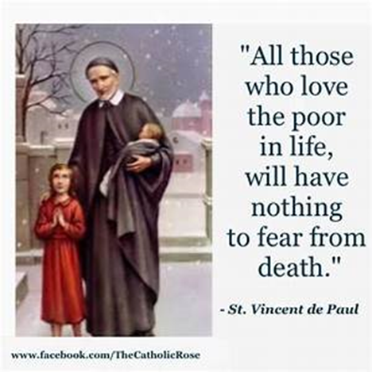
St Faustina Conference Saint Vincent de Paul Society
Spiritual Meeting
10 April 2021

Slide 2
Agenda
TIME | EVENT | SPEAKER
9:30 AM | Meeting called to order by President | Dave Scharett
9:31 AM | Roll call by Secretary | Amy Whittaker
9:05 AM | Opening Prayer & The Lord’s Prayer | Laura Morris
9:10 AM | Spiritual Advisor’s Presentation | Father Eversole
9:20 AM | Treasurer’s Report | Don Carlson
9:25 AM | Home Visitation Report | Dave
9:30 AM | President’s Report | Dave
9:40 AM | Public Affairs Report | Annie Mason
9:45 AM | Secretary’s Report | Amy
9:50 AM | New Business | All Vincentians
9:57 AM | Closing Prayers | Annie & Father Eversole

Slide 3
Dear Lord
This Is My Prayer
Followed by
The Our Father
(next slide)

Slide 5
Spiritual Advisor’s Presentation
Father Eversole

Slide 6
Treasurer’s Report: Don Carlson
Current Balance
Bills Paid
Online Donations
Online donations $600
NEW Partner/Donor $500
Cash donations $200
Other financial issues as appropriate

Slide 7
Home Visitations
1. Worked 31 cases.
Closed 21 cases
Helped 10 families
2 cases no longer needed help this month
1 case referred to MICAH and to the Brisbane Shelter
2. Catholic Charities provided $1,950 in utilities support.
3. Catholic Charities Emergency Assistance Office has increased the amount that they will pay for either rent or utilities to $2,000. This is a big deal!!!
4. Saint Faustina Conference paid $3,315.51 in utility bills. This time of year, sees large increases in electric bills for those who heat with electricity (the MOST expensive way to heat). The Conference paid $836.68 in rent and $110 for other items.

Slide 8
Home Visitations
5. The Central Virginia Housing Coalition is increasing their assistance for delinquent rent. Michael March is the lead in coordinating this much needed support.
6. The latest $1.9T Federal American Rescue Plan Act (FARPA) contains $21.6 billion in emergency rental assistance and more for utilities and food. Funds will be administered by the individual States through grants. Saint Faustina will be applying for one or more of these grants to directly support those in need/affected by COVID 19. Members of the Conference attended a SVdP National Council Webinar on how the SVdP Conferences may access these funds.
Assistance will be available to households meeting certain income requirements, at risk of homelessness, or with at least one member on unemployment, and could be for up to 12 months of rent (including future payments as well as arrears).
The bill also includes:
• $5 billion for Emergency Housing Vouchers for people experiencing homelessness or at risk of
becoming homeless.
• $5 billion in flexible funding for the HOME Investment Partnerships Programs
• $750 million for Native Americans and Native Hawaiians
• $100 million for rural housing
Utilities
The bill provides $4.5 billion for the Low-Income Home Energy Assistance Program (LIHEAP) to
help households with utility assistance, as well as $500 million specifically for low-income households
with excessive water and wastewater bills/arrearages. Water assistance will be administered through
the income-based programs at local water departments.
7. Saint Faustina Conference Grant writing Team:
Annie Mason
Cathy Lee
Don Carlson
Dave Scharett
Any other volunteers??

Slide 9
President’s Report
On March 27th The Saint Faustina Conference provided Easter Baskets to 92 Neighbors-In-Need Children.
The Conference has distributed an additional 60+ Easter Baskets.
It is worth noting that Saint Faustina in conjunction with its partners, MANARC and the KoC Bishop Keating Council used the Easter Baskets to convey the true meaning of Easter to these children. The baskets contained "He Is Risen" candy bags, "I am a Child of Jesus" magnets, "Jesus Loves Me" bracelets, appropriate prayer cards and bookmarks, a small religious coloring book and of course many kinds of Easter candy to include jellybeans.
The Mothers were all exceedingly happy as were the children.
Much of what was given to the children was donated to The Saint Faustina Conference.
SFC received several complements from District Council; shared with WGK

Slide 10
President’s Report
7. Nomination of NEW Saint Faustina Conference Members
Andria “Andy” Mullen: sponsor Ann Ellis
Wants to support the Education Ministry
A teacher and counselor for many years
Has taught at Saint Matthew’s summer school for several years
Active in Birthright
Bonnie Webber: sponsor Dave Scharett
Wants to support the Friendly Visitations Ministry and the Easter Basket Ministry
Previously active in the Saint Faustina Conference Baby Closet particularly at Easter
Caregiver for an elderly gentleman for years
IAW SVdP rules admission to Saint Faustina Conference is by unanimous consent

Slide 11
Public Affairs Report: Annie Mason
Public Affairs activities/issues to report
Status update on Walk-For-The-Poor
Father Eversole’s support for the event at Saint Matthew’s
National Council guidance and support
Richmond Conference support
September timeframe
Guest speaker
Annie Mason and Cathy Lee will need other Conference Members help as we get closer to the date.

Slide 12
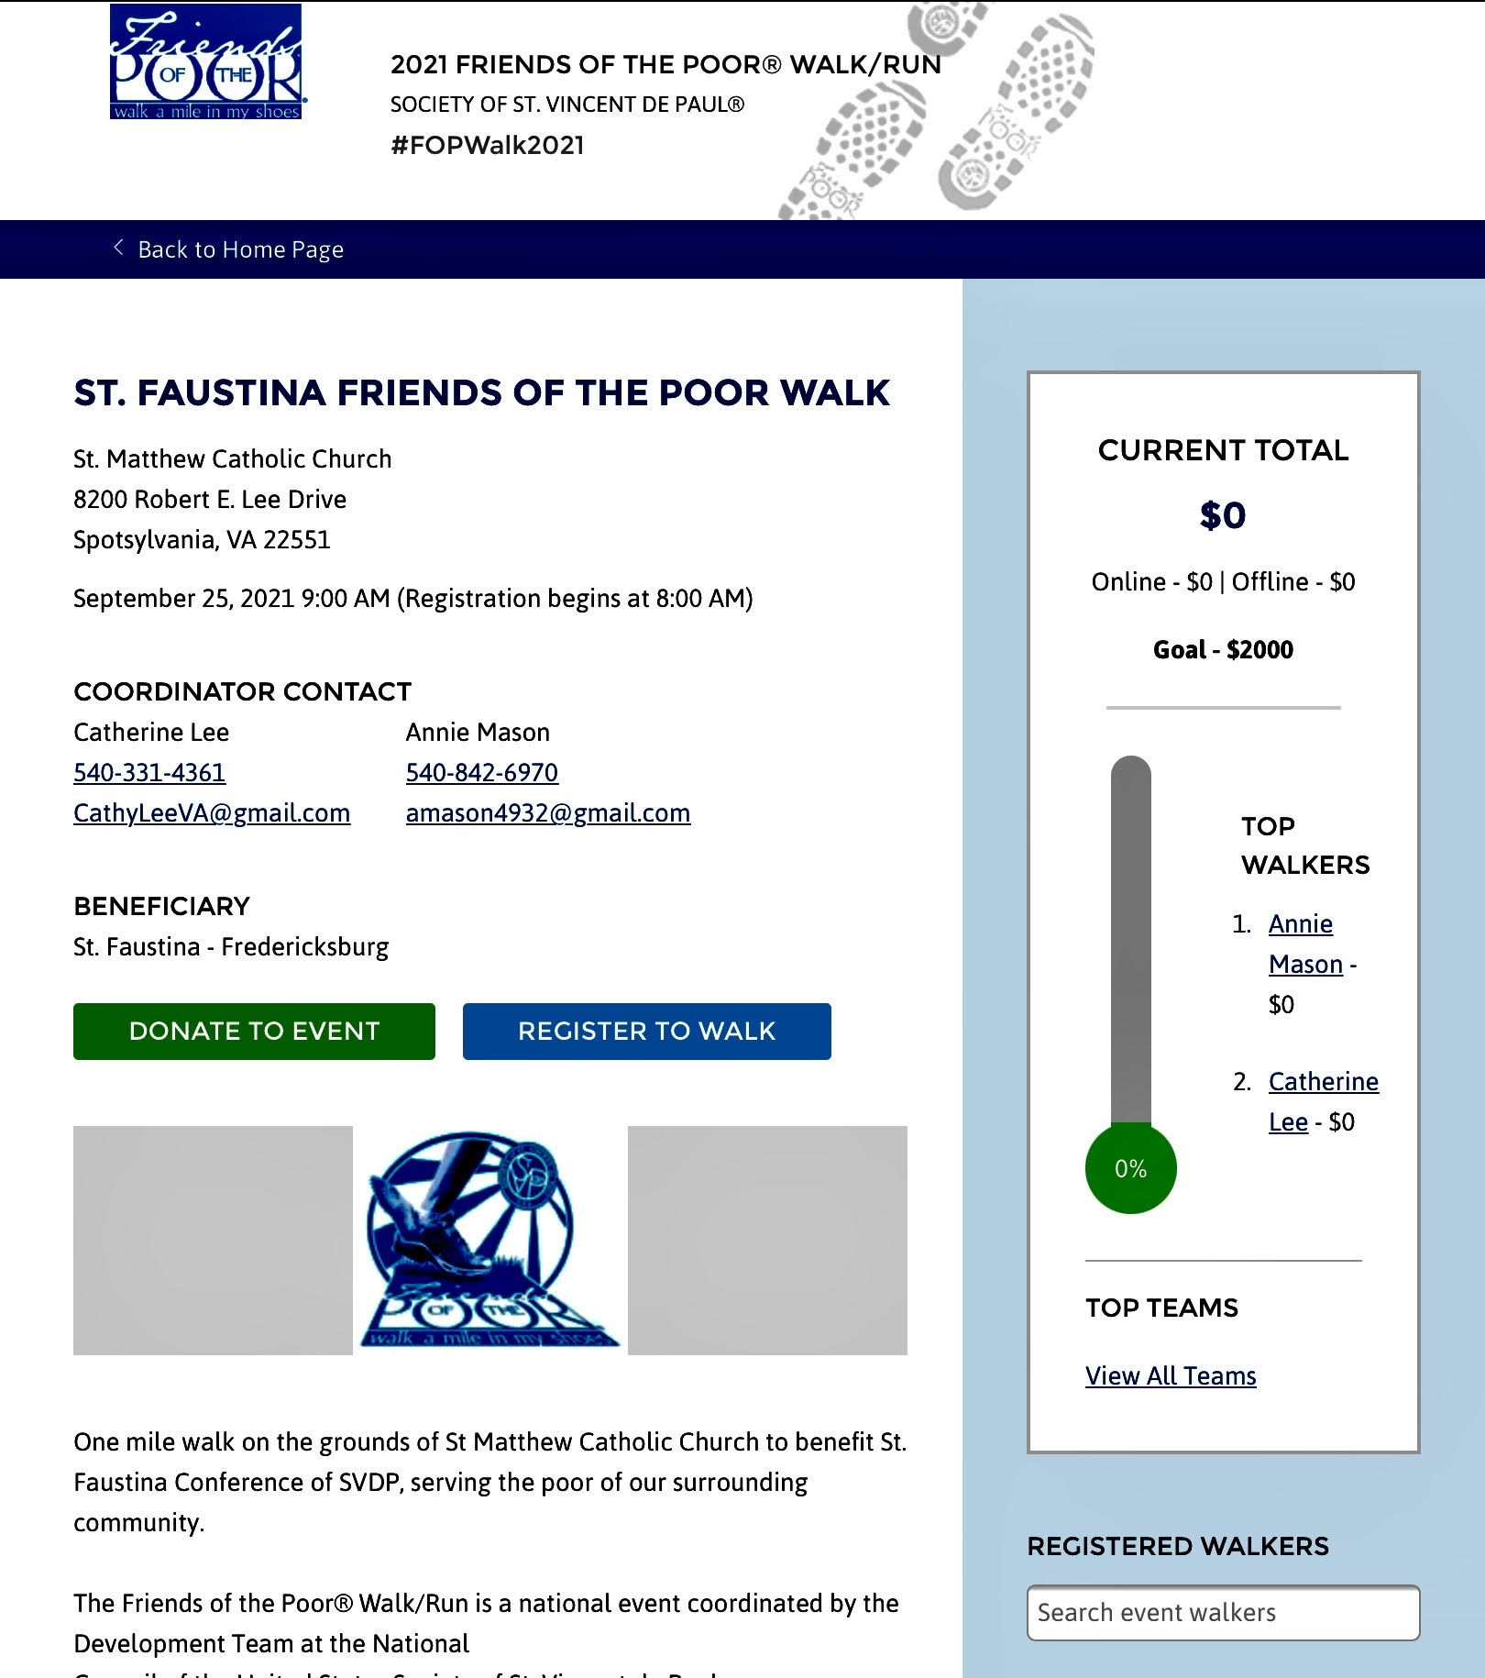

Slide 13
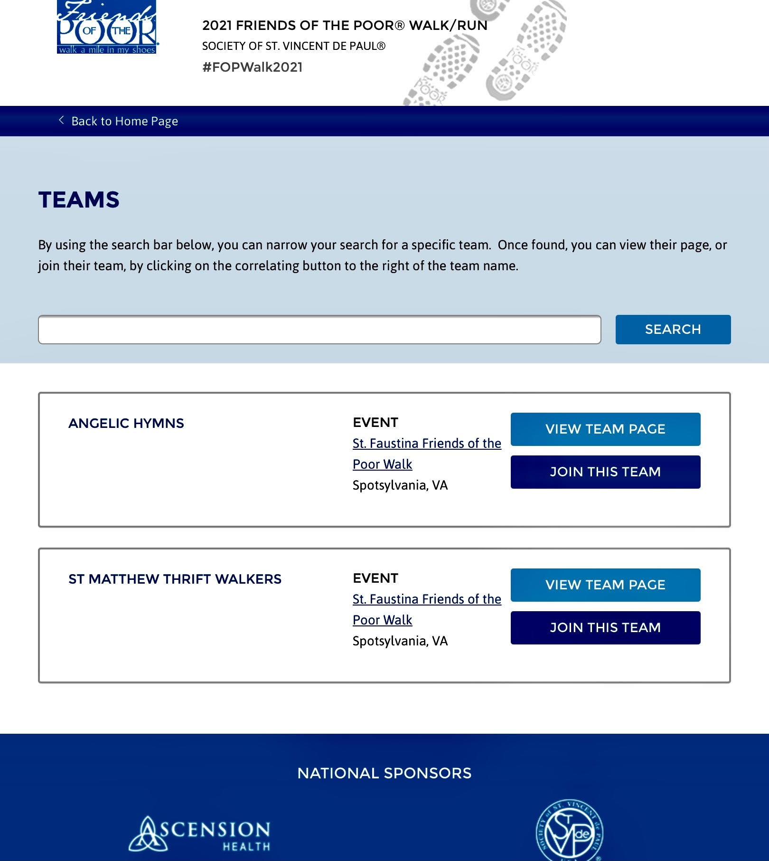

Slide 14
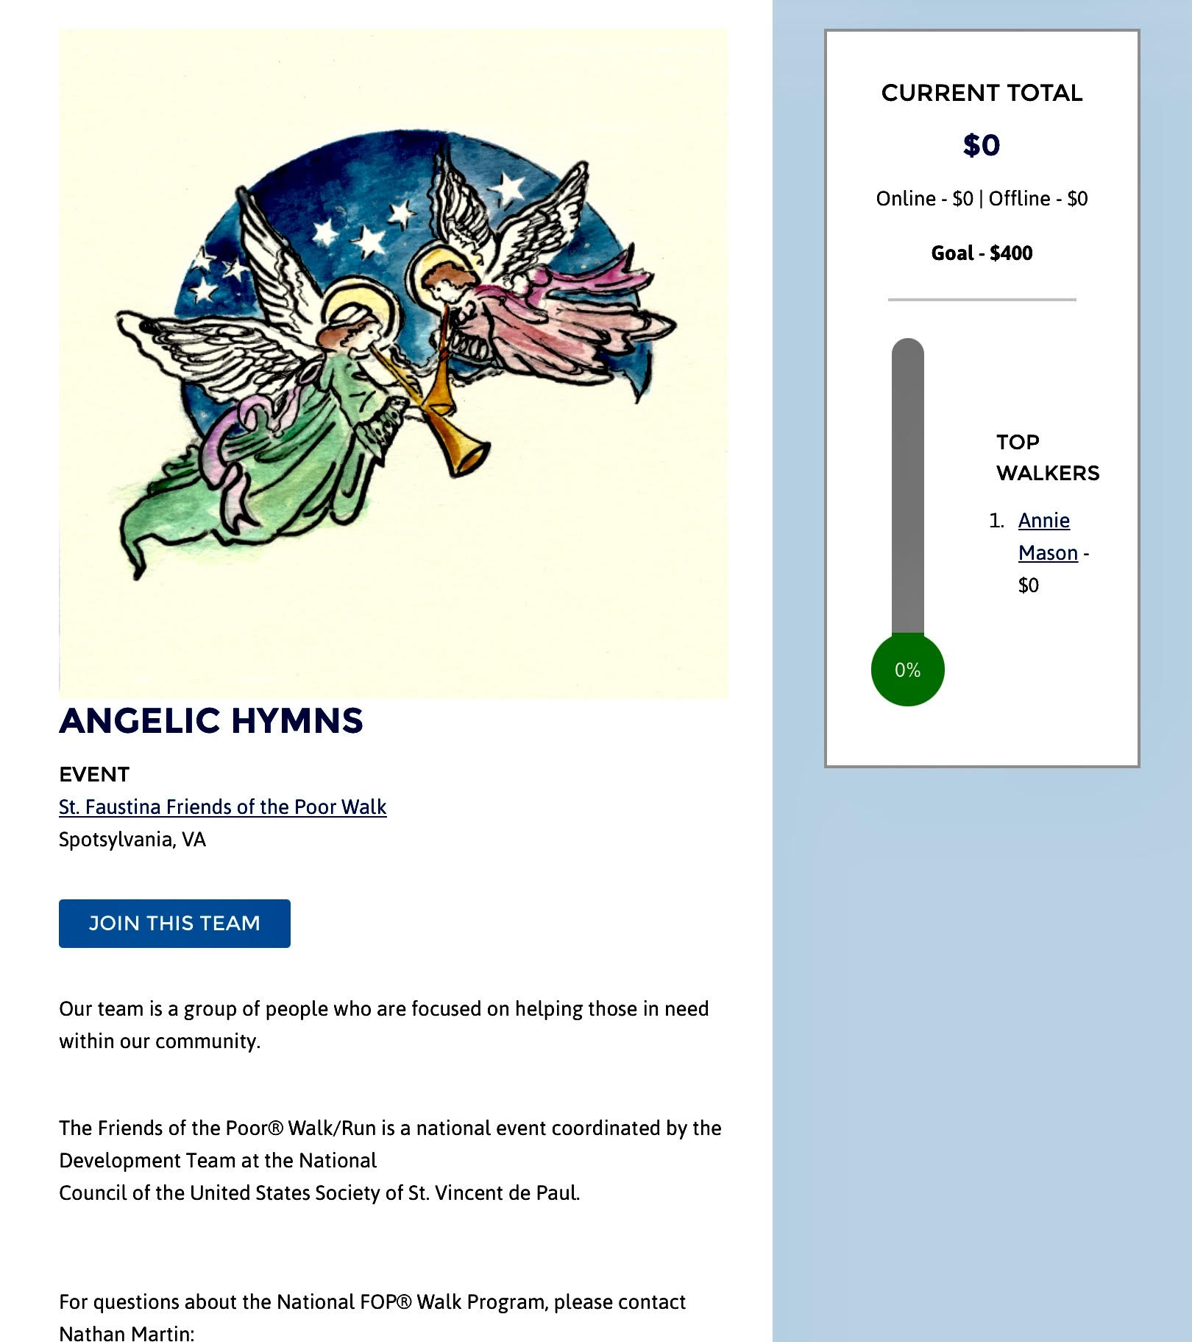

Slide 15
Friendly Visitations
Training opportunities for members of this Ministry: Ann Ellis

Slide 16
Secretary’s Report: Amy Whittaker
Open Old Business from prior meeting
GRANT WRITING!!!!
Approval of Prior Meeting Minutes
The next Conference Spiritual Meeting will be Saturday, April 17th at 10:00 am via ZOOM

Slide 17
New Business: open to all members
PORTLAND—At a time when Catholic parishes and campus ministry programs are experiencing particular financial hardship due to the COVID-19 pandemic, Oregon Catholic Press (OCP) has opened the application process for its annual Parish Grants Program. Created by OCP’s Board of Directors, the Parish Grants Program provides vital assistance to parishes and campus ministry parish programs seeking to enhance the worship experience of their communities, develop and reinforce liturgical and music ministries, create and strengthen multicultural ministries, and expand educational and charitable outreach. “Our annual grants program demonstrates OCP’s commitment to assist Catholic faith communities across the nation to enhance their liturgy and worship,” said OCP Publisher Wade Wisler. “The pandemic has brought immense challenges to parishes and campus ministry programs over this past year and we are more committed than ever to doing our part to support the essential ministries they provide — and which so many depend upon — in the spirit of the Gospel of Jesus Christ.” Since its inception in 2001, the OCP Parish Grants Program has awarded more than $3.3 million to parishes throughout the United States. Parish Grants are commonly used for: Purchasing music, hymnals and other worship materials; Improving multicultural ministries with additional training and purchasing of bilingual worship materials; Providing online, digital or electronic resources to support liturgy preparation; Upkeep, repair and replacement of musical instruments, equipment and facilities; and Attending or hosting musical or liturgical conferences or workshops. Parishes and campus ministries programs may apply for the OCP Parish Grants Program until the deadline, May 30, 2021, at www.ocp.org . Scroll to the bottom of the page and click Parish Grants under Quick Links. OCP, a not-for-profit publisher of liturgical music and worship resources based in Portland, Oregon, has been in operation for nearly 100 years. Worship programs produced by OCP are used in over two thirds of Catholic churches in the United States and are distributed worldwide.
it also states "expanding educational and charitable outreach“

Slide 18
New Business: open to all members
3. We have been made aware of financial funeral assistance for families who had members die from COVID. Families can be reimbursed up to $9,000 for funeral expenses, retroactive to January 20, 2020. Those who apply will need to submit identifying documentation of the person who died, as well as a death certificate.
https://www.fema.gov/disasters/coronavirus/economic/funeral-assistance?fbclid=IwAR23ewqXEeg8eszdF8NO0OUAjF-oCEqjNjqenxqhx0UFvc4ByzazWDZ3uHM#eligible
4. Here is something else that might help others, too: Unemployment: "IRS.GOV New Exclusion of up to $10200 of Unemployment ...
https://www.irs.gov › forms-pubs › new-exclusion-of-u...
5 days ago — Amounts over $10,200 for each individual are still taxable. ... If you have already filed your 2020 Form 1040 or 1040-SR, you should not file an amended return. The IRS will automatically refund money to people who already filed "
In Virginia unemployment is exempt from state taxes.
5. Other New Business???

Slide 19
New Business: open to all members
6. Websites for Job Searches
www.Diversityjobs.com
www.Indeed.com
www.Glassdoor.com/Job/jobs.htm
www.Helponebillion.com
www.Indeed.com
www.Jobing.com
www.Linkedin.com
www.Linkup.com
www.Monster.com
www.Neuvoo.com
www.Startwire.com
www.Ziprecruiter.com/jobs-hiring-now

Slide 20
Reflect Upon Our Neighbors-In-Need
Who Desperately Need Jobs

Slide 21
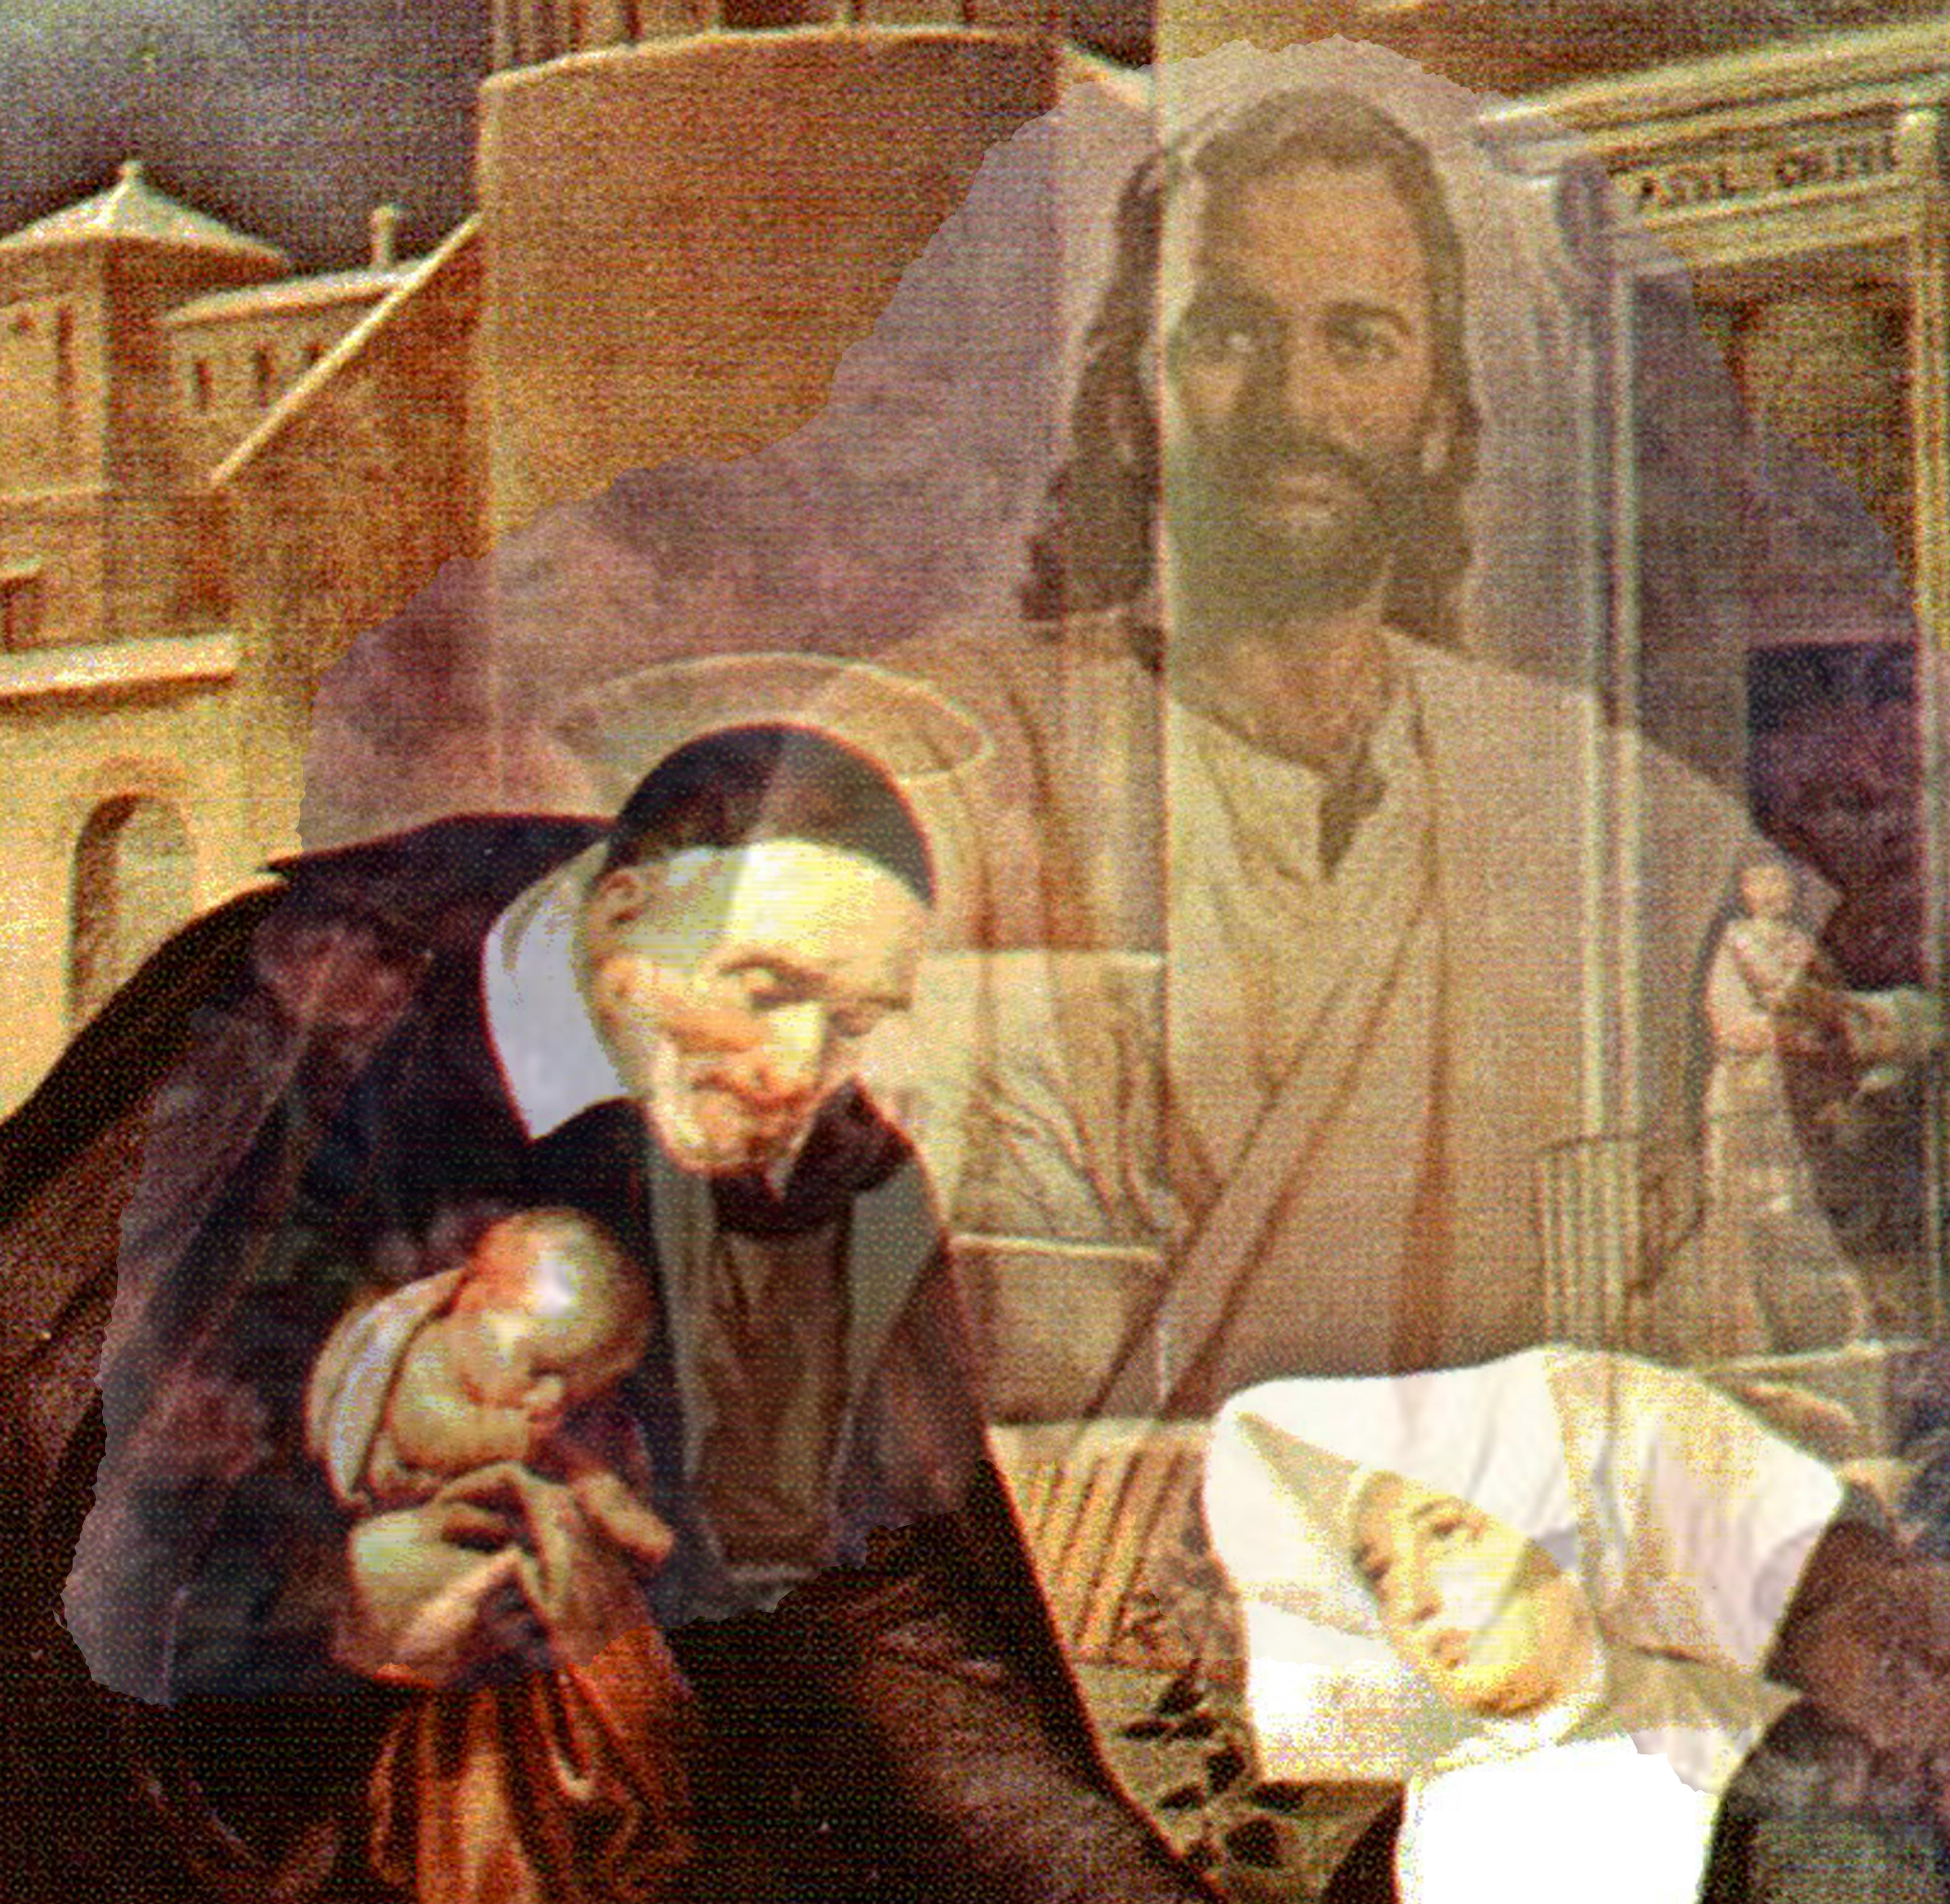
Closing Prayer & Spiritual Advice: Father Eversole

Slide 22
Home Visitations
8. Home Visitation Team
Barbara Legaz
Deanna Kau
Lilian Fay
Ann Ellis
Deborah Franks
Annie Mason
Michael March
John Tighe
Laura Morris
Dave Scharett (Copied)
Ashley Juszczak (rejoin)
Matt Juszczak (rejoin)
May we humbly acknowledge the Lord’s Blessings in providing us the resources needed to help our Neighbor’s-In-Need Not Least of Which Is the Support of our Priest and the Parish

