Slide 1
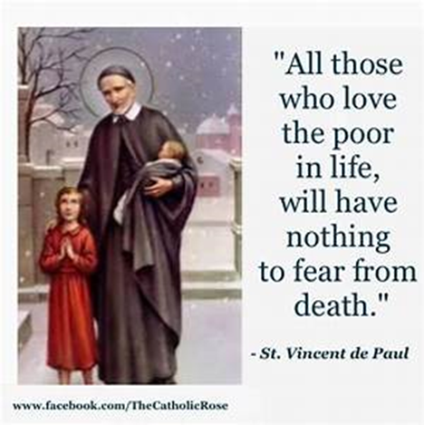
St Faustina Conference Saint Vincent de Paul Society
Spiritual Meeting
11 December 2021

Slide 2
Agenda
TIME | EVENT | SPEAKER
9:30 AM | Meeting called to order by President Welcome our guest; Lisa Ullrich | Dave Scharett
9:31 AM | Roll call by Secretary | Amy Whittaker
9:32AM | Opening Prayer & The Lord’s Prayer | Dave
9:36 AM | Spiritual Advisor | Father Eversole
9:46 AM | Treasurer’s Report | Don Carlson
 | Public Affairs Report | Annie Mason (Trip to NYC)
9:55 AM | Emergency Assistance Report | Dave
10:00 AM | President’s Report | Dave
10:15AM | Youth Conference | Cathy Lee
10:19 AM | REMINDER | Dave
10:20 AM | Secretary’s Report | Amy
10:25 AM | New Business | All Vincentians
10:30 AM | Closing Prayer | Father Eversole

Slide 3
Saint Nicholas of Myra Patron Saint of Children

Slide 4
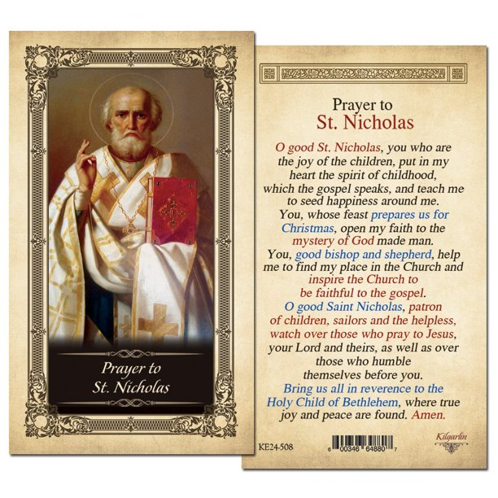

Slide 5
Pray for Our Vincentians
Susan Sablon’s in-laws, Bud and Marie. Bud has cardiovascular issues and Marie is suffering from dementia.
Ann Ellis has cared for so many people in her live. Now she needs our prayers for her breathing issue.
Jim Walsh needs our prayers for his health.
Joanie Goins and son Scott
Please pray to our Lord and Savior to heal our Vincentian Sisters, Brothers, and family members!!!

Slide 7
Spiritual Advisor’s Presentation
Father Eversole

Slide 8
Treasurer’s Report: Don Carlson
Current Balance
Bills Paid
Donations
Online donations
Other donations
Other financial issues as appropriate

Slide 9
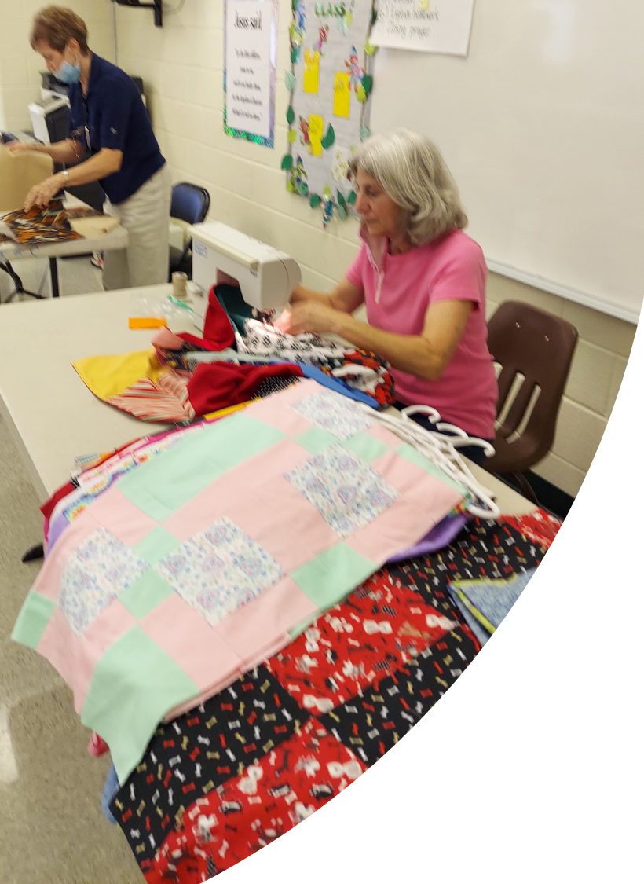
Public Affairs Report: Annie Mason
svdpstfaustina.org

Slide 10
Emergency Assistance
Nearly all the Neighbors-In-Need that we helped were affected in some way by the COVID virus
New supply of Home Essentials
Catholic Charities provides substantial financial support to SFC

Slide 11
President’s Report

Slide 12
Santa’s Sack
We signed up 25 new families for Santa’s Sack
79 children
45 Girls and 34 Boys
Thursday 9 December picked up 85 Home Essential Bags
MANARC helping in a BIG way!!!! Incredible Partner
Friday 10 December received $1,000 in wrapped presents from Veterans Cycle Warriors at MANARC

Slide 13
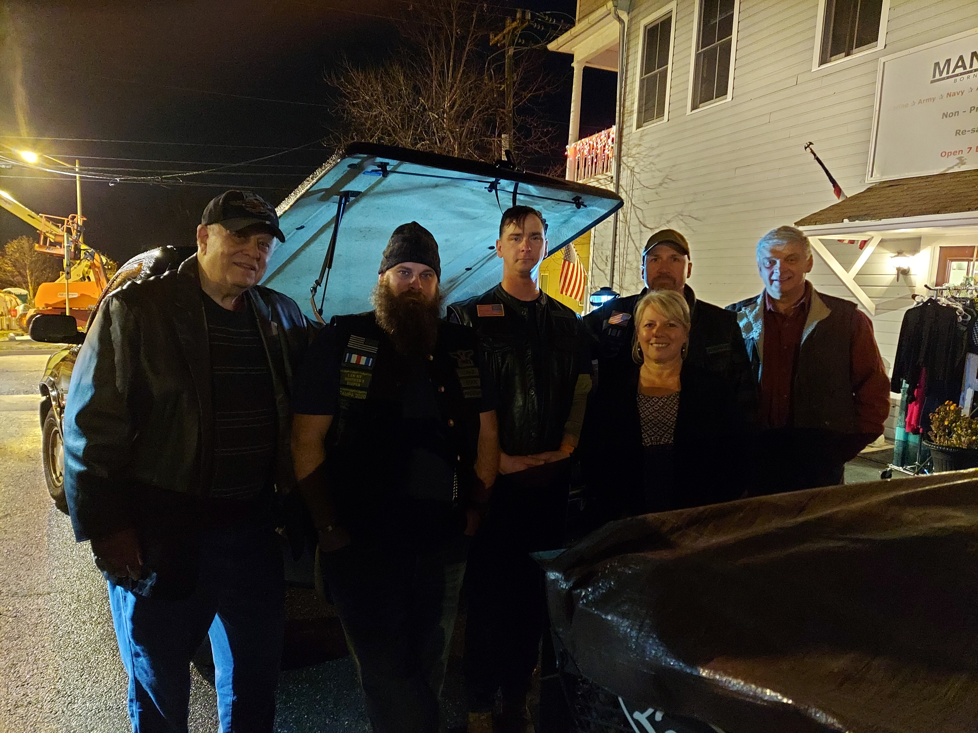
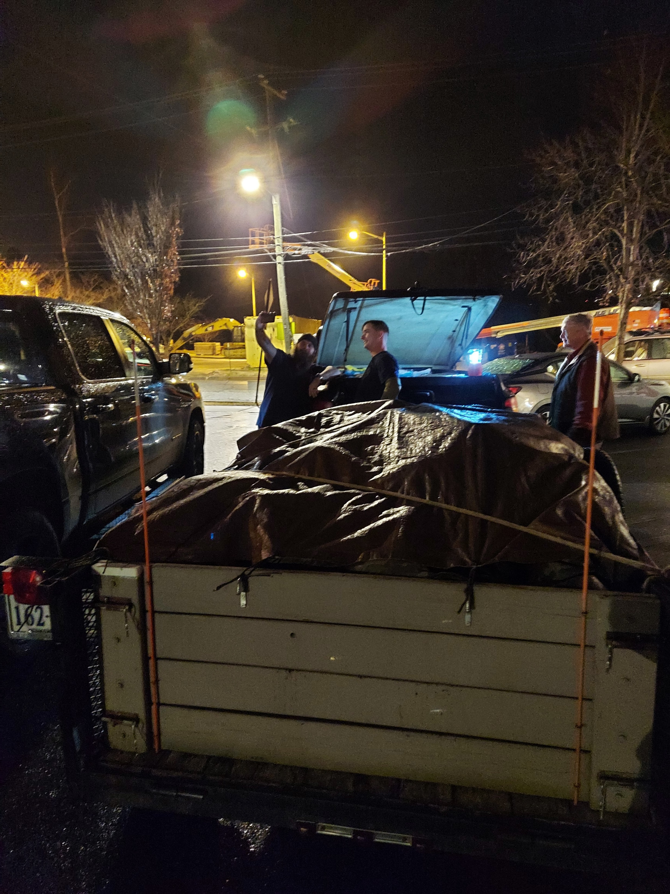

Slide 14
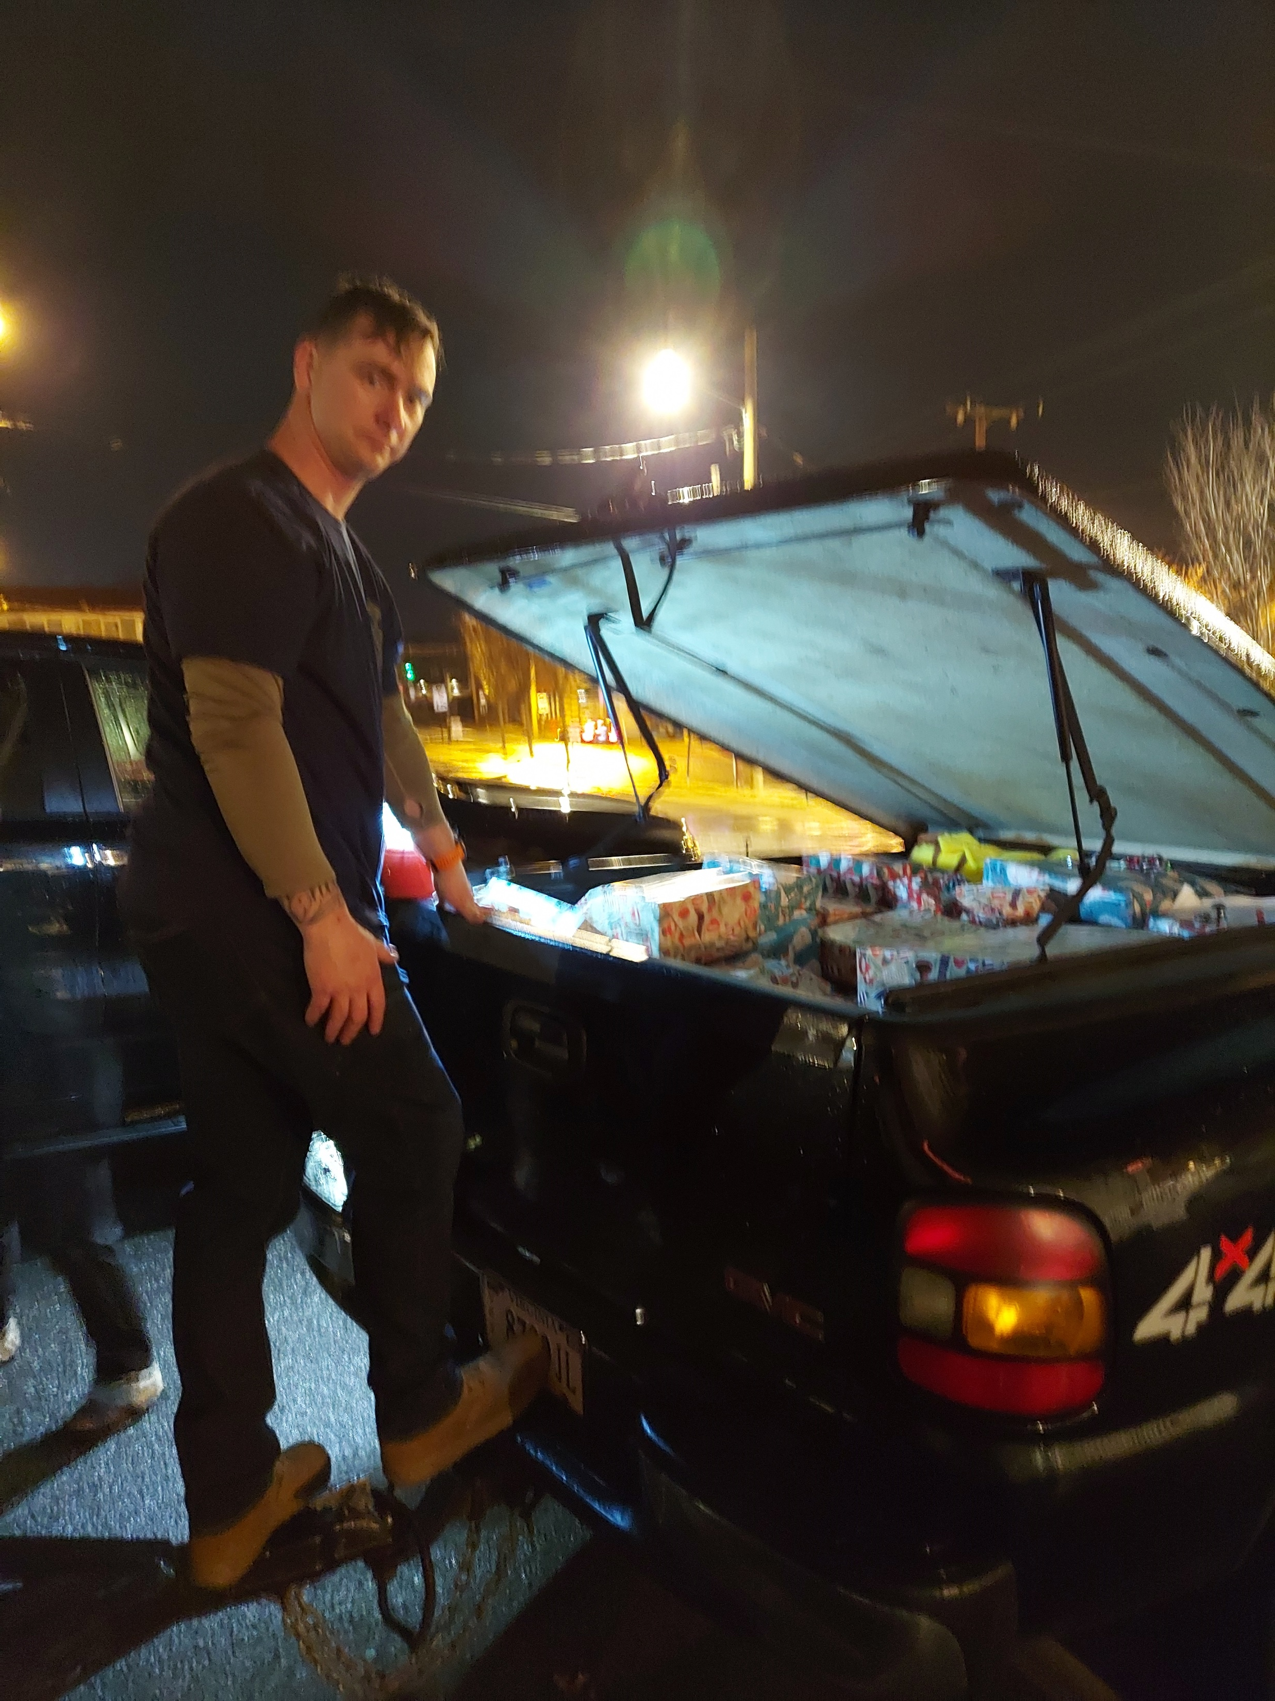
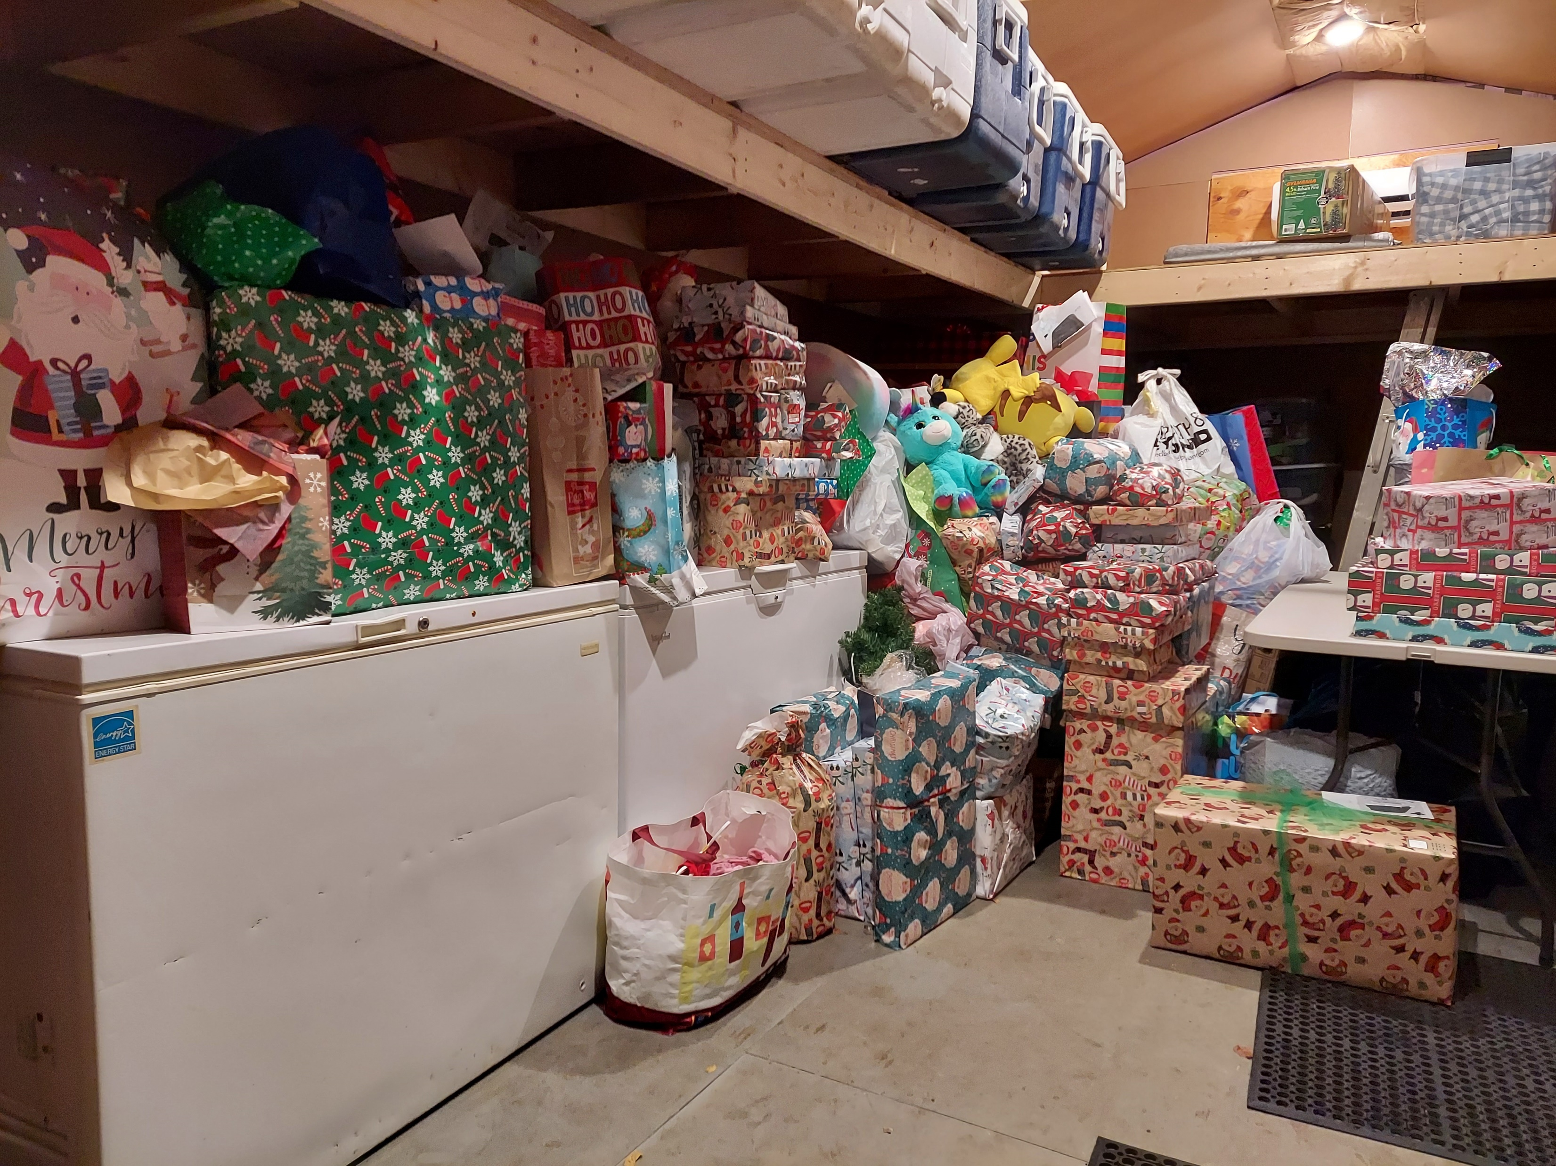
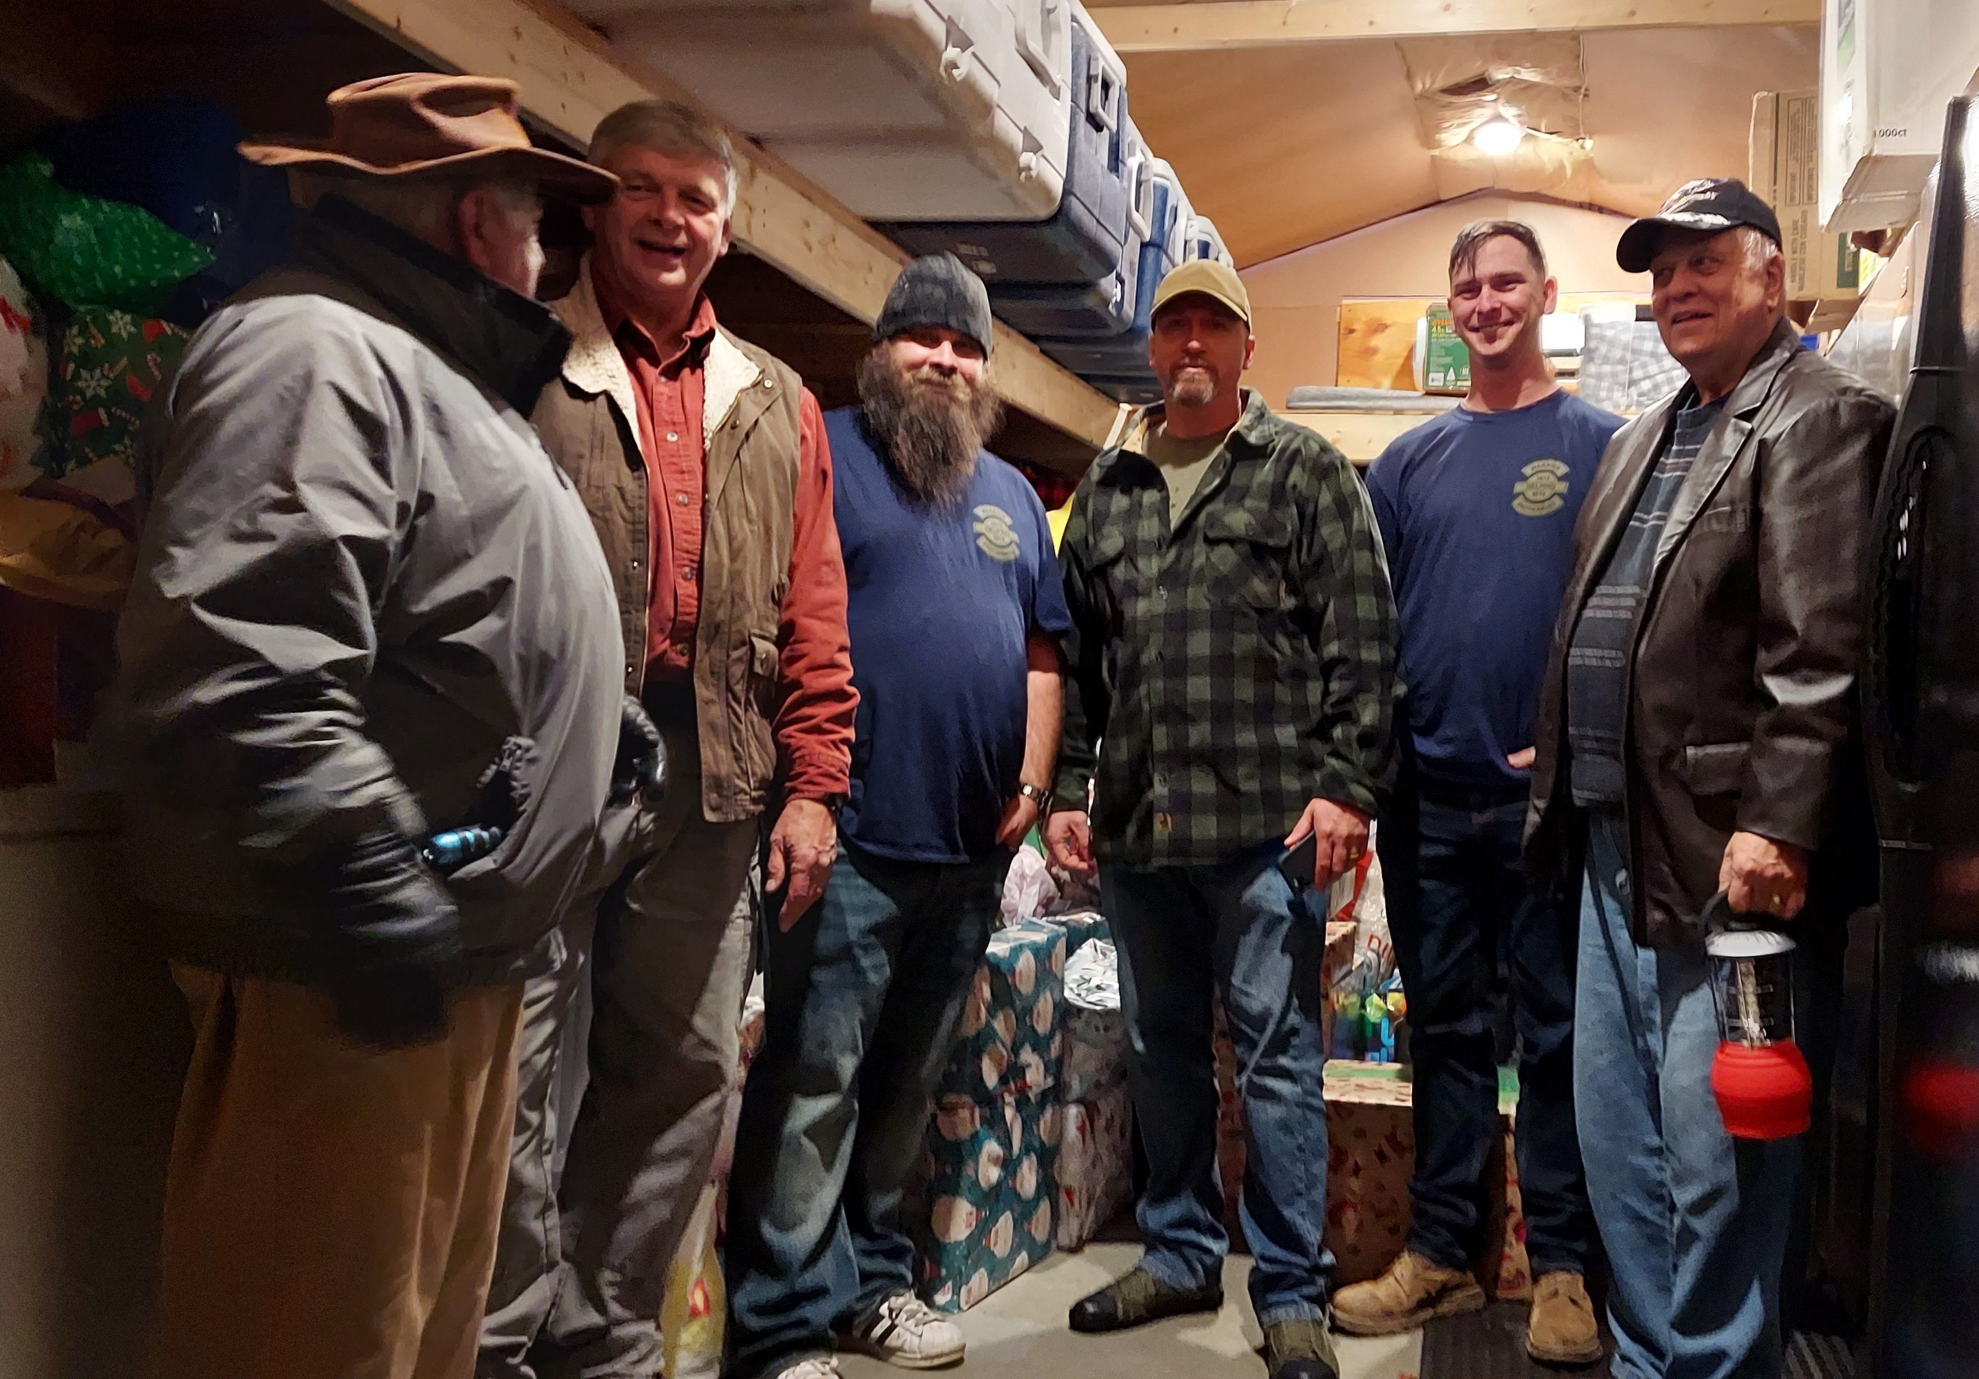

Slide 15
Santa’s Sack
Thursday 16 December move gifts from storage to Parish Center 9:00am -10:00am
Thursday 16 December sort gifts and set up for filling sacks 10:00 am - 12:00pm
Friday 17 December 9AM to 4PM fill Santa Sacks: Child and Adult
Saturday 18 December 8:30AM pick up Roaster Chickens from BJ’s
Saturday 18 December Virtus Compliant Adults in place 9AM
Saturday 18 December 9AM Santa Sack Volunteers arrive and organize for distribution
Saturday 18 December 10AM to Noon give out Santa Sacks as notified families arrive. Santa Sacks will be taken from the Parish Center to the family vehicle.

Slide 17
Saint Faustina Youth Conference
Introductory Meeting was 11/13/21
Update from Cathy Lee

Slide 18
REMINDER
7 MAJOR EVENTS
Friends of the Poor ® Walk September 18th SUCCESSFUL
Coffee & Donuts Sunday October 3rd SUCCESSFUL
Coats-to-Go October 16th SUCCESSFUL
Annual Conference Audit after January 16th
FIRST YOUTH CONFERENCE MEETING Nov 13th SUCCESSFUL
Thanksgiving Dinners November 18th SUCCESSFUL
Coffee & Donuts Sunday December 5th SUCCESSFUL
Santa’s Sack December 16-18th

Slide 19
Secretary’s Report: Amy Whittaker
Open Old Business from prior meeting
New way to donate update: 1Give
Approval of Prior Meeting Minutes
The next Conference Spiritual Meeting will be Saturday, January 8th at 9:30 am In Person and via ZOOM

Slide 20
New Business: open to all members
New Saint Faustina Members:
John Needham
Lisa Ullrich

Slide 21
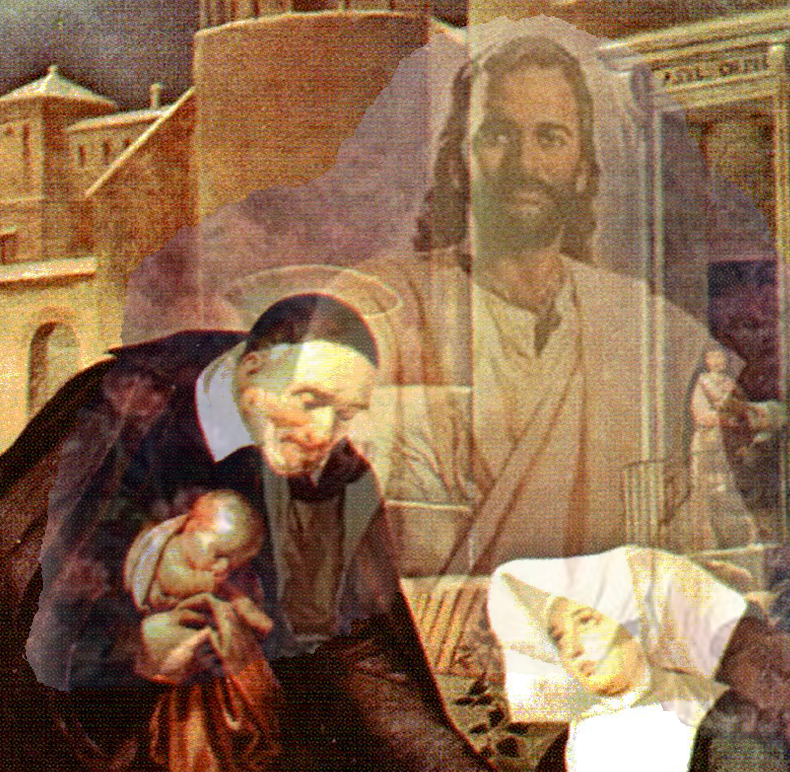
Closing Prayer & Spiritual Advice: Father Eversole

Slide 22
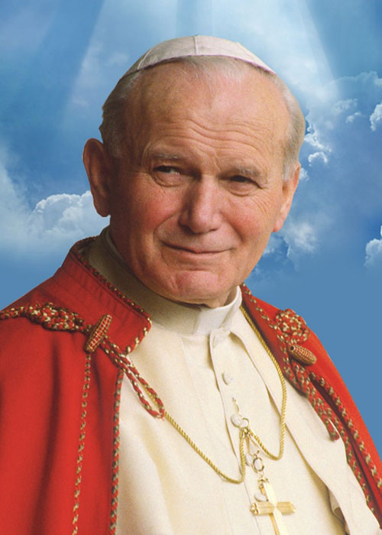
Prayer to St. John Paul II
Oh, St. John Paul, from the window of heaven, grant us your blessing!
Bless the Church that you loved and served and guided, courageously leading her along the paths of the world in order to bring Jesus to everyone and everyone to Jesus.
Bless the young, who were your great passion. Help them dream again, help them look up to the heavens again, to find the light that illuminates the paths of life here on earth.
May you bless each and every family! You warned of Satan’s assault against this precious and indispensable divine spark that God lit on earth. St. John Paul, with your prayer, may you protect the family and every life that blossoms from the family.
Pray for the whole world, which is still marked by tensions, wars and injustice. You opposed war by invoking dialogue and planting the seeds of love: pray for us so that we may be tireless sowers of peace.
Oh St. John Paul, from heaven’s window, where we see you beside Mary, send God’s blessing down upon us all.
Amen.

